Slide 1
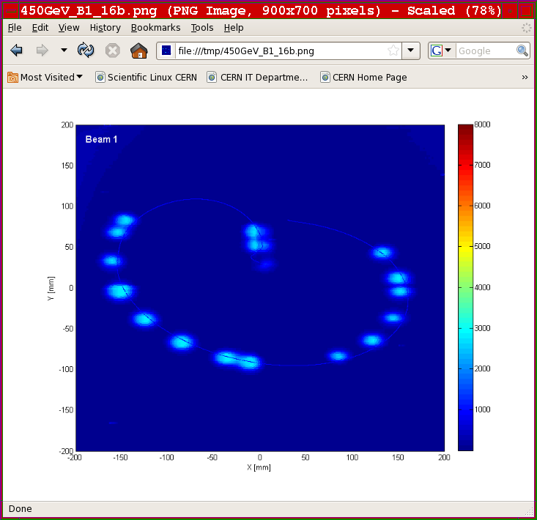
State-of-the-art and Future Challenges for Machine Protection Systems
IPAC14, Dresden, 20th June 2014
Jörg Wenninger
CERN Beams Department
Operation group – LHC
Acknowledgements: R. Schmidt, M. Zerlauth, D. Wollman, S. Redaelli, G. Valentino,
B. Dehning, C. Bracco, J. Uythoven, V. Kain (CERN), M. Werner, T. Lensch (DESY),
G. Stancari (FNAL)

Slide 2
Introduction
Material robustness
Instrumentation
Collimation and halo
Availability, safety and operation
Conclusion

Slide 3
MPS is…
An accelerator consist of an ensemble of equipment. The components must be protected when powered – without beam.
Superconducting magnets/cavities can quench with / without beam !
⇒ Equipment protection
The beam adds an extra damage potential for a subset of the accelerator components – those exposed to beam.
⇒ Machine protection
Machine protection is the collection of measures that protect an accelerator from beam induced damage
Not a universal definition !
In this presentation I will discuss Machine Protection in relation with beam

Slide 4
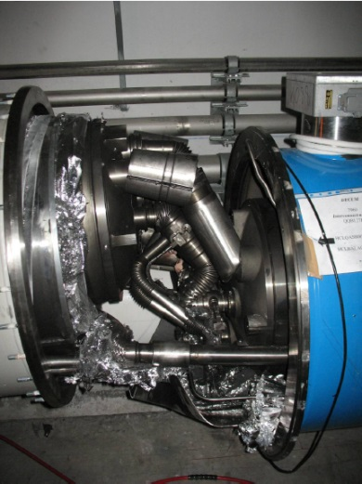
Risks and protection
Protection is required when there is some risk.
Risk = probability of an incident
x consequences (money, downtime, radiation doses).
Probability of an uncontrolled beam loss:
What are the failures that lead to beam loss into equipment?
What is the probability for the failure modes?
Consequences:
Damage to equipment.
Downtime of the accelerator for repair.
Activation of material, dose to personnel.
MP designers mitigate probability and consequences
Define matrix of occurrence frequency and cost
⇒ protection requirements
⇔ SIL concept for safety
*Safety Integrity Level

Slide 5
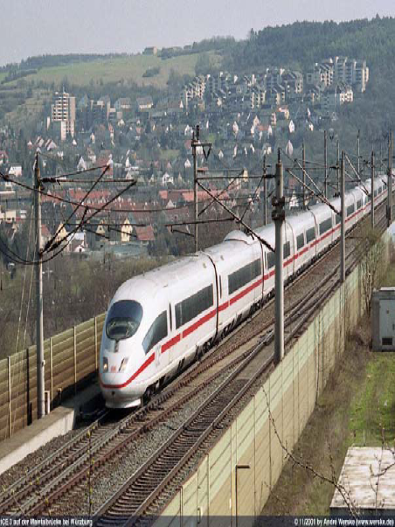
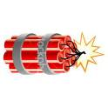
Damage potential of beams
Beam momentum
Particle type
Protons – ions – electrons – photons.
Energy stored in the beam
1 MJ can heat and melt 1.5 kg of copper.
1 MJ = energy stored in 0.25 kg of TNT.
Beam power
Beam size
Time structure of beam
One LHC beam = 360 MJ =
The kinetic energy of a 200 m long train at 155 km/hour
90 kg of TNT
Different accelerators (colliders, linacs, hadron - lepton) cannot always be compared directly!
MPS challenges can be quite different !

Slide 6
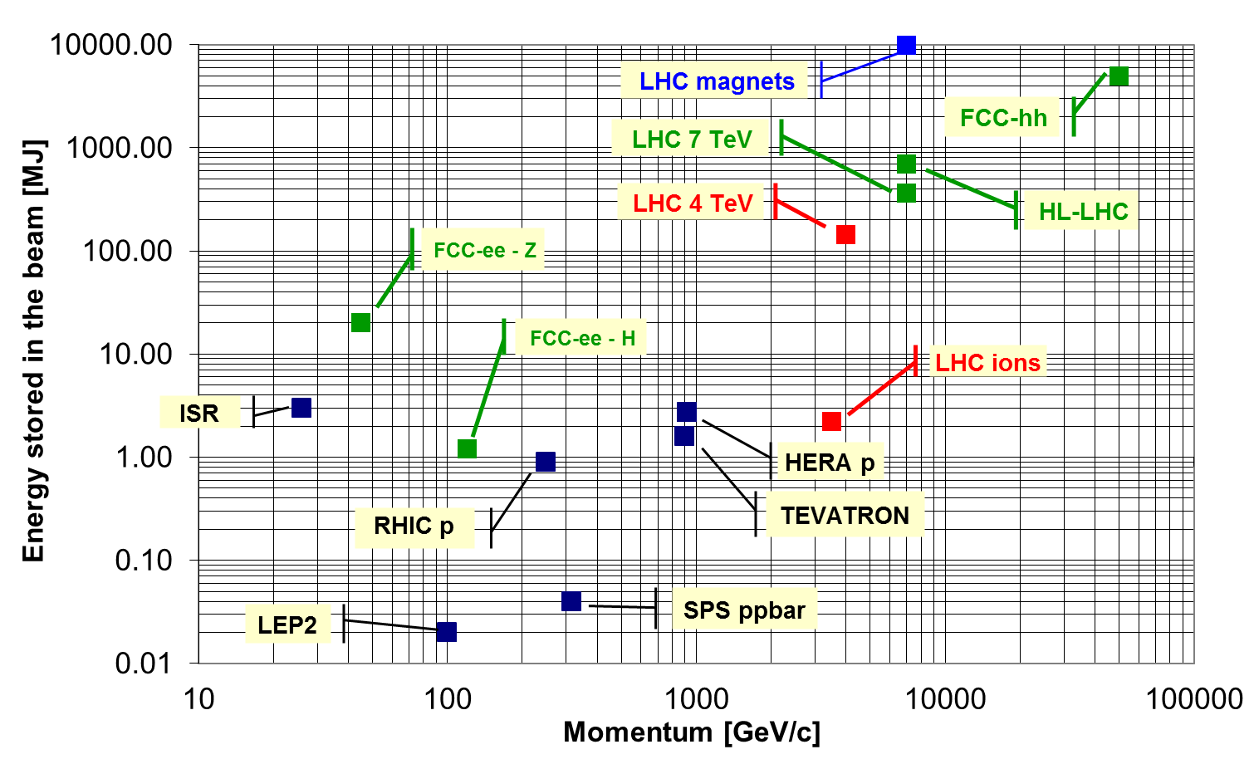
Stored energy – colliders
World record @ LHC: 140 MJ @ 4 TeV
MOXAA01
TUPRO016

Slide 7
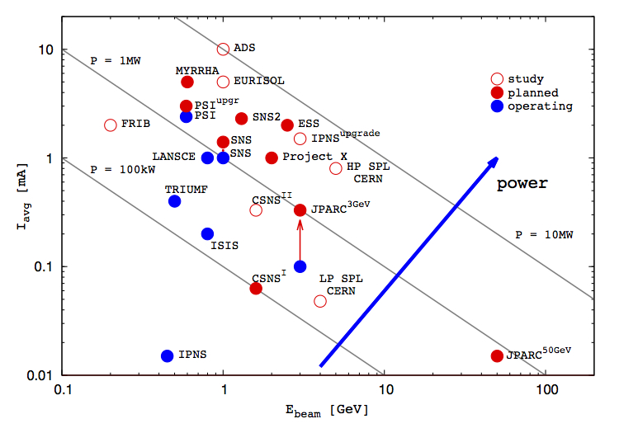
High power hadrons sources
Planned projects: 1-10 MW range
J. Wei -MOYBA01
IFMIF
LIPAc
10 MW
0.1 MW
1 MW
Courtesy M. Lindroos
ILC ~ 20 MW

Slide 8
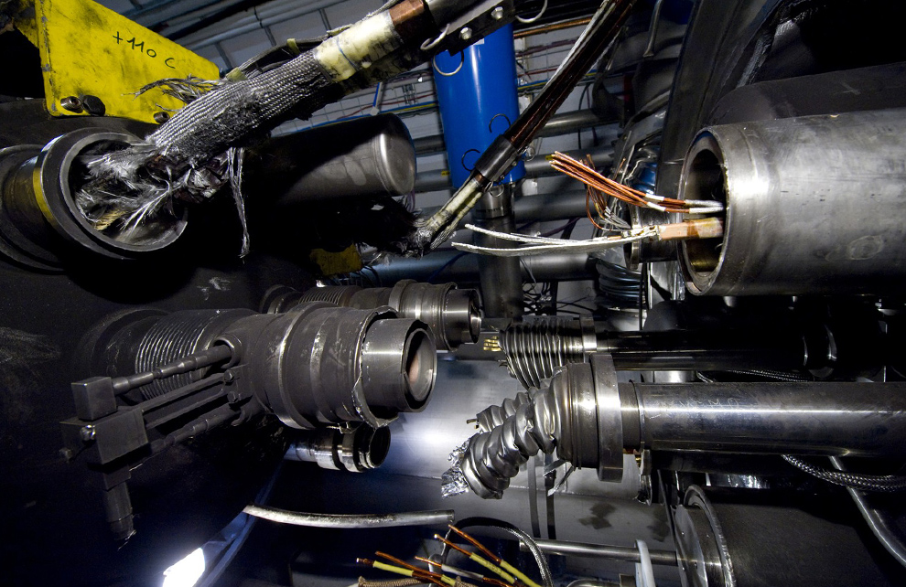
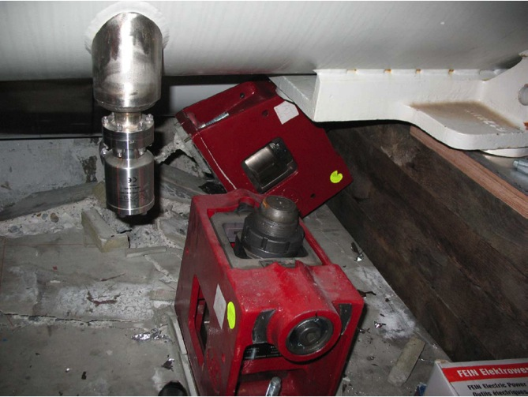
Release of 600 MJ at LHC
The 2008 LHC accident happened during test runs without beam.
A magnet interconnect was defect and the circuit opened. An electrical arc provoked a He pressure wave damaging ~600 m of LHC, polluting the beam vacuum over more than 2 km.
Collateral damage from the helium pressure wave dominates !
Arcing in the interconnection
Magnet displacement
53 magnets to repair, 14 months downtime
J. Wenninger for LHC, PAC09
Over-pressure

Slide 9
Example from the other end of the scale…
SNS short errant beams (~10 μs) : beam outside the normal operation envelope. Issues with beam intensity loss well below ‘classical damage’ level:
Errant beam loss in SC Linac leads to accumulating damage,
Degradation of SC Linac cavity performance over time.
⇒ Detailed investigations to improve the situation. Majority of trips located in room temperature linac.
Damage to undulator magnets at FELs / light sources.
Degradation with low loss /radiation levels.
W. Blokland & C. Peters, IBIC13
L. Froehlich, FEL2012
Petra III - WEPRE035

Slide 10
Modern Machine Protection System : P³
Protect the machine
Highest priority is to avoid damage of the accelerator.
Protect the beam
Complex protection systems may reduce the accelerator availability, an aspect that must be taken into account at the design phase.
Trade-off between protection and operation.
Availability (targets): ~99% light sources, ~95% spallation sources like SNS, ESS, LHC so far modest 35%.
Provide the evidence
Clear (post-mortem) diagnostics must be provided when:
the protection systems stop operation,
something goes wrong (failure, damage, but also ‘near miss’).
Machine protection is not limited to designing a fast interlock !
Machine protection must be closely integrated into the machine design !

Slide 11
Circular - linear
Circulating beams: with the notable exception of kicker magnet failures (injection / dump) the impact of a failure on the beam usually develops progressively – many turns
Provides room for reaction by the MPS.
Linacs, beam transfer: once the beam is produced or the transfer is initiated the beam cannot be stopped anymore.
Avoid incorrect element settings before launch.
Mitigation by active and passive protection, probe beams / bunches,
intermediate dumps.

Slide 12
LHC beam: stored - transfer
Despite storing up to 140 MJ at 4 TeV, not a single superconducting magnet was quenched with circulating beam – threshold ~ few 10’s of mJ.
Many magnets were however quenched at injection, mainly due to (expected) injection kicker failures.
The beam (~2 MJ) is safely absorbed in injection dump blocks, but the shower leakage quenches magnets over ~1 km.
MOPRO019-20
FCC-hh injected intensity @ 3 TeV limited by MPS concerns !
Collimation
Injection point
BLM signal
BLM dump
threshold
BLM saturation !
3.3 km

Slide 13
Introduction
Material robustness
Instrumentation
Collimation and halo
Availability, safety and operation
Conclusion

Slide 14
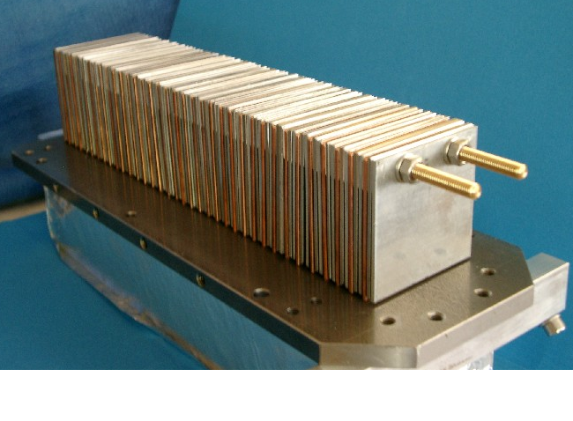
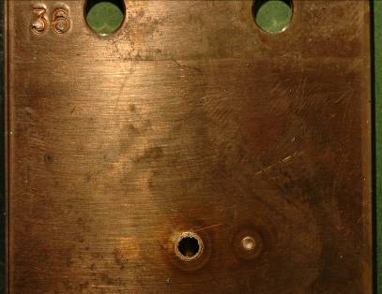
Material limits – passive protection
An important aspect for collimators, absorbers, dumps and targets is the survival due to nominal or abnormal impacts.
LHC dump block must withstand up to 700 MJ → strong dilution !
For high intensity & energy proton beams, current material limits are around 3-4 MJ – low density and high resistance to shocks.
In the past decade a lot of effort was invested to better understand the interaction of high energy / high density beams with matter.
Ad-hoc test for LHC @ 450 GeV
MOPRI086
Shot | Intensity / p+
A | 1.2×10¹²
B | 2.4×10¹²
C | 4.8×10¹²
D | 7.2×10¹²
A B D C
V. Kain et al, PAC05
6 cm

Slide 15
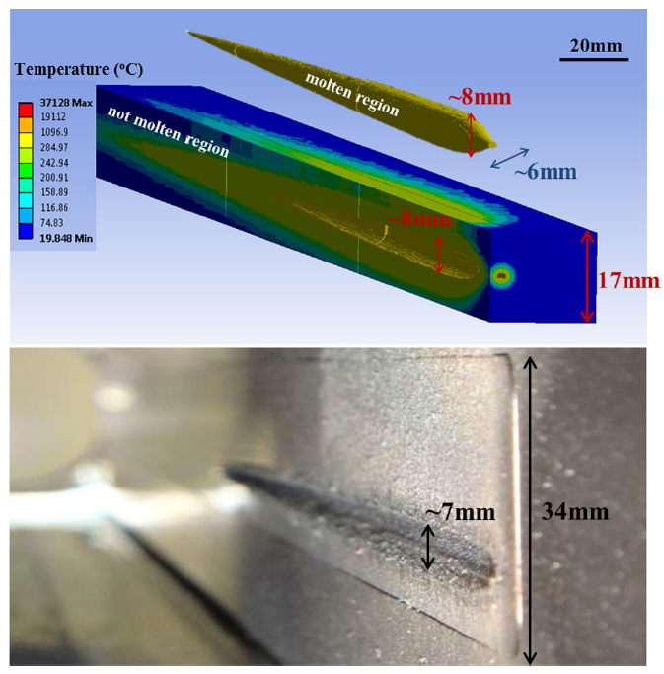
Materials test facility
New beam line at the SPS @ CERN coupled to a high radiation to materials test facility - HiRadMat.
2-3 MJ beam, 7-8 μs (fast extraction).
Tunable beam intensity and density.
PRSTAB 17, 021004 (2014)
Test of new materials, bench marking of simulation codes.
Robust materials:
CFC, graphite, boron nitrite.
Impedance ⇒ coating.
Tungsten collimator test
THPRI096
MOPRO038

Slide 16
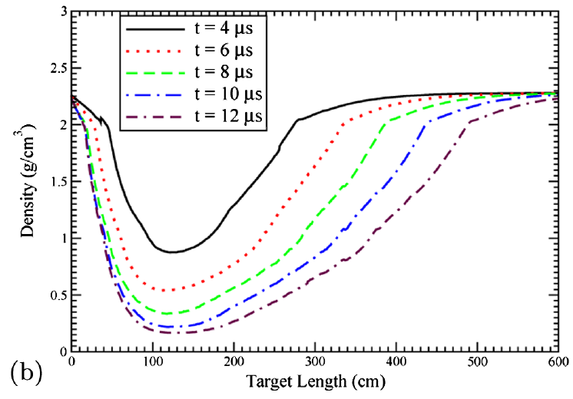
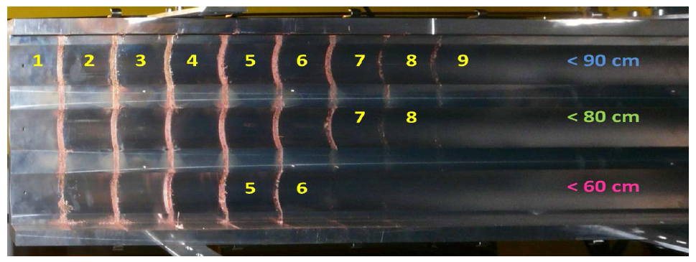
Hydrodynamic tunneling
For high intensity beams made of long bunch trains hydrodynamic tunneling significantly increases the damage range in a material.
Leading bunches melt the material and create a plasma, the following bunches see less material and penetrate deeper etc.
MOPME047
Experimental verification with SPS beam on Cu target @ HiRadMat
LHC beam in carbon target
25 cm/μs
Penetration of ~20 m
For the 50 TeV FCC-hh proton beam the penetration depth is > 100 m
PRSTAB 15, 051003 (2012)

Slide 17
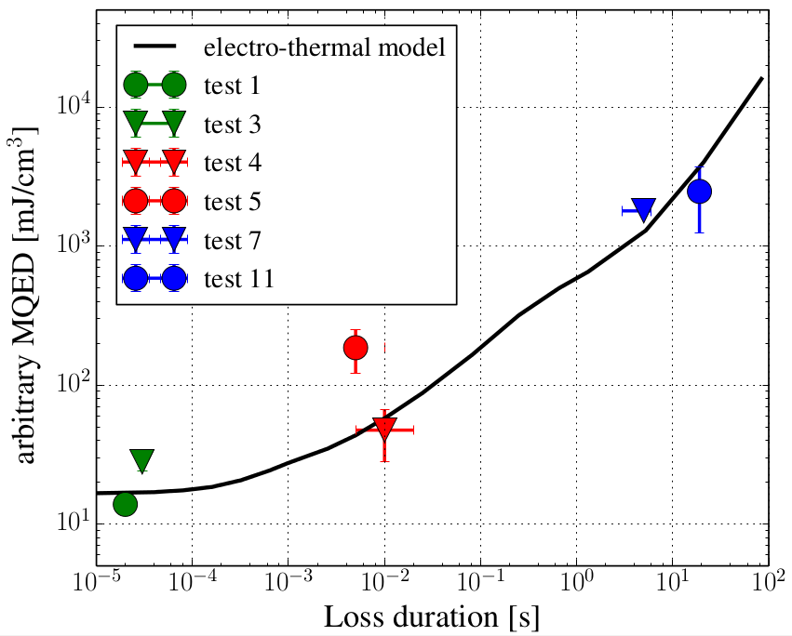
Quenches
Understanding quench levels of magnets are essential to set correct thresholds for beam loss monitors.
Impact on availability – dump versus quench recovery.
Beam induced quenches involve complex simulations on the beam (tracking + FLUKA, GEANT, MARS…) and on the magnet side. And experimental tests are required.
Influence of the loss time scale.
Series of beam tests at the LHC
to prepare for higher energies.
LHC magnets
Workshop on beam induced quenches in preparation,
CERN 15th-16th September 2014
WEPRI092
MOOCB01

Slide 18
Introduction
Material robustness
Instrumentation and failure detection
Collimation and halo
Availability, safety and operation
Conclusion

Slide 19
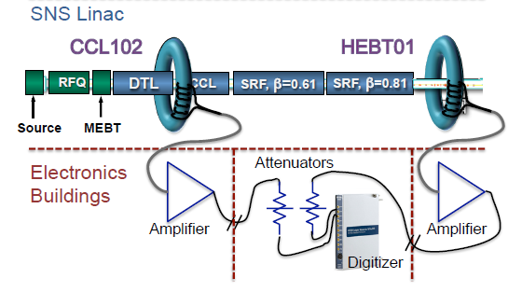
Instrumentation
Nowadays almost all beam instrument types are used in interlocks:
BCTs (masking, linac losses, fast ring losses,…)
Beam loss monitors (not at very low energy!),
Beam position monitors,
Synchrotron light monitors.
A general challenge for beam instrumentation is to cope with an increasing dynamic range between safe commissioning beams and nominal beams – minimize systematic effects.
Applies to ALL instruments – not just for MPS devices.
At LHC: 4 orders of magnitude !
Beam position measurements should be independent of bunch intensity and filling pattern.
Dynamic range of BLMs (→ see s. 12).
W. Blokland, C. Peters, IBIC13
J-PARC - THPME130

Slide 20
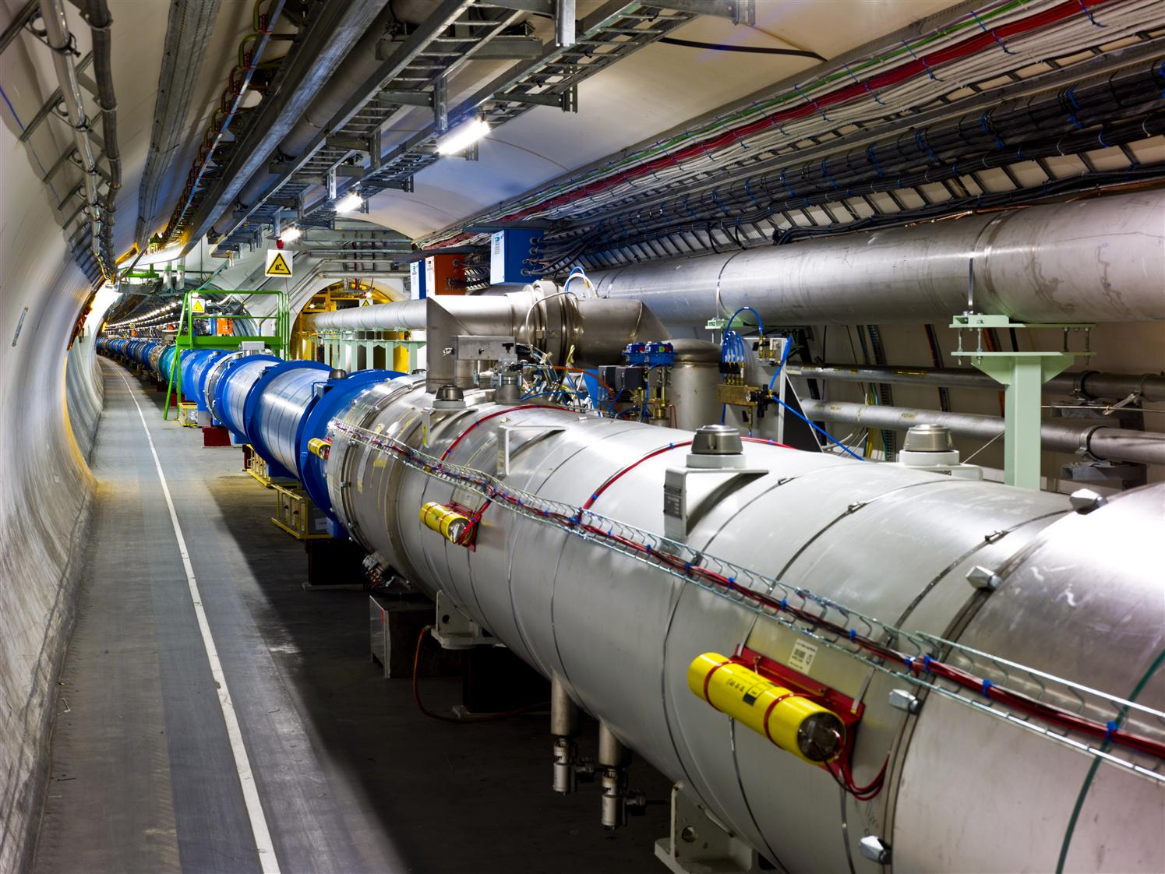
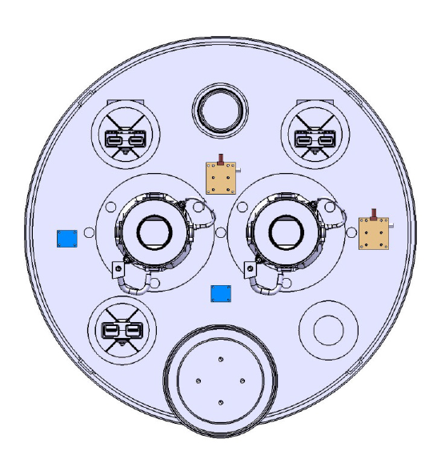
‘Cryogenic’ BLMs
To improve the sensitivity of BLMs: from the outside to the inside of the cryostats – avoid shielding from iron yokes.
BLMs in cryogenic environment (LHe, silicon, diamonds).
First tests in the LHC in 2015.
Similar ideas at FRIB and IFMIF for high sensitivity halo monitors.

Slide 21
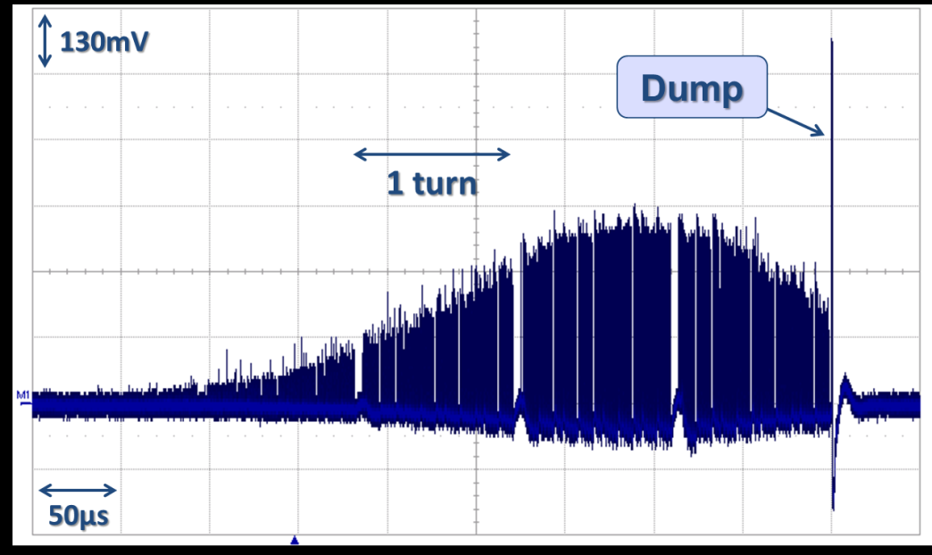
Beyond just protection
The sensitivity and speed of certain BLMs (diamonds, scintillators) provide powerful diagnostics beyond the pure protection.
LHC: CVD diamonds for bunch-by-bunch diagnostic – machine & experiments.
IFMIF : CVD diamonds μ−loss halo diagnostics and tuning, integrated into cryo-module as close as possible to the beam.
XFEL : Scintillator+PMT for bunch-by-bunch diagnostics.
Dust particle – ‘UFO’ – falling into the LHC beam.
Bunch by bunch losses @ LHC from diamond detectors close to primary collimators
T. Bär

Slide 22
Beam as witness
Direct ‘injection’ of an intense beam into a synchrotron or a linac may be problematic or require large / extensive monitoring efforts.
⇒ concept of ‘witness’ beam / bunch
The LHC with nominal injection of 3 MJ (>> damage threshold) uses the beam presence concept.
Only a probe beam (typically 10¹⁰ protons, max 10¹¹) may be injected into an EMPTY ring.
Logic is implemented with a highly reliable and redundant ‘presence’ measurement – diode detection system.
Even a probe bunch was able to quench 4 magnets at injection !
CLIC and ILC foresee to use witness bunches (ahead of main train) or low intensity witness trains.

Slide 23
Introduction
Material robustness
Instrumentation
Collimation and halo
Availability, safety and operation
Conclusion

Slide 24
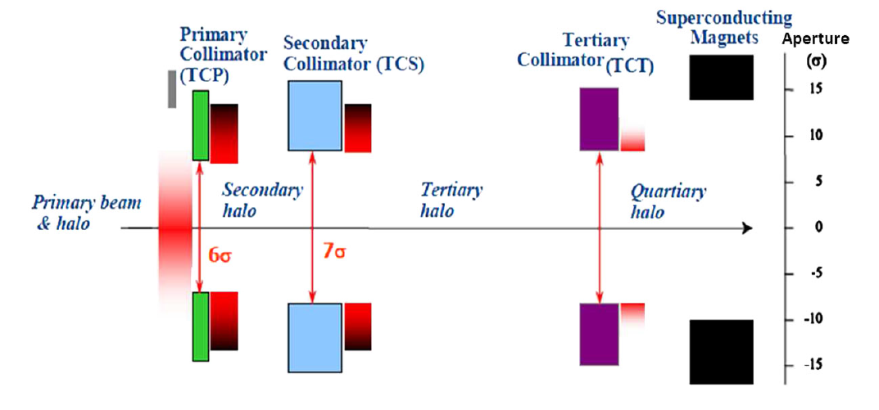
Collimating the halo
At the LHC it was demonstrated that a multi-stage collimation system with >100 collimators can be operated efficiently and that it provides excellent and reproducible cleaning and protection – no quench with circulating beam.
Cleaning efficiencies of ≈99.99% - verified regularly with defined procedure.
- Also for protection against asynchronous beam dumps – Carbon jaws.
One alignment per year ⇔ reproducible orbit, optics and collimator position.
Alignment speed improvement by automation (from 20 mins to ~3 mins / collimator)
Beam loss map
1/10000
MOPRO043
Courtesy S. Redaelli

Slide 25
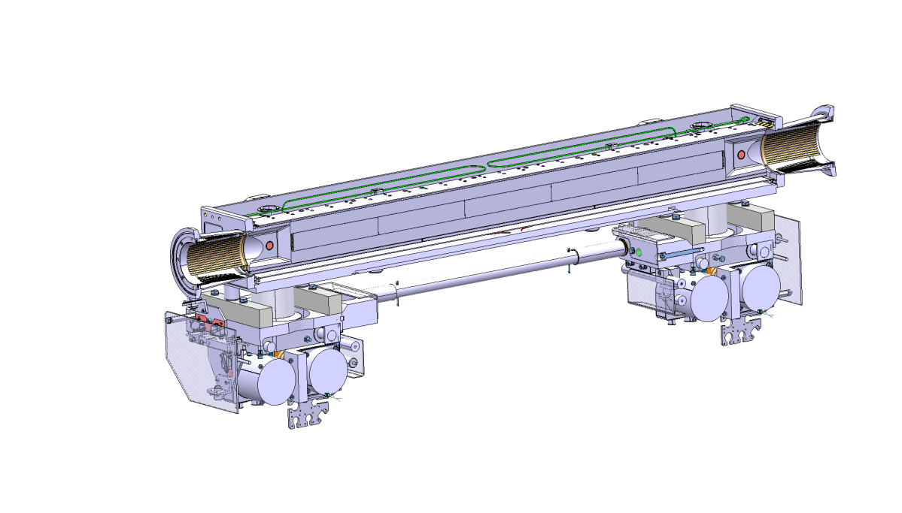
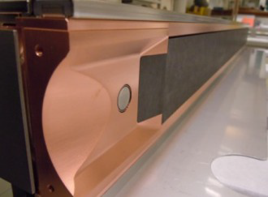
Merging instrumentation and collimation
Setting up many collimators with loss signals is very time consuming.
Integration of BPMs into the jaws for next generation collimators (LHC):
Direct monitoring of the beam position wrt jaw center.
Very fast setup (< 1 min/collimator), interlocking of beam wrt jaws.
High resolution on position with small gaps.
The first collimators with integrated BPMs will be used in operation at the LHC in 2015.
Jaw
BPM button
BPM button
G. Valentino et al., PRSTAB 17, 021005

Slide 26
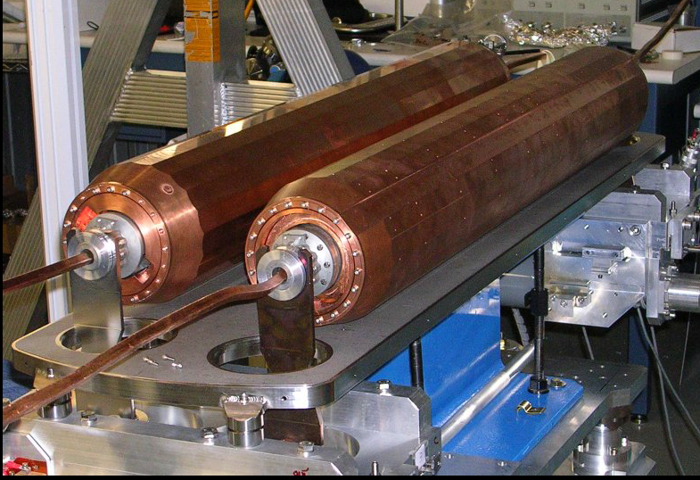
Other trends in collimation
Rotatable (‘disposable’) collimators: less robust, but better impedance. Multiple surfaces to cope with limited number of ‘incidents’.
→ lower the impedance.
Development in progress for LHC
prototype with 20 faces.
MOPRO044
J. C. Smith et al, IPAC10
‘Cryogenic’ collimators: catch losses in cold regions.
Ion(Cryo)-catchers for SIS100.
Cryo-collimators for HL-LHC.
MOPRI105
MOPRO042
Crystal assisted collimation: improved collimation efficiency with bend crystal extraction of the halo under a secondary collimator.
RHIC, Tevatron, test installation on one LHC beam for 2015.
MOPRI110

Slide 27
Beam halo
Halo control and monitoring becomes an issue in many facilities.
The HL-LHC beam halo (~4-5σ) will store ~10’s MJ (scaling from 4 TeV).
A fast halo loss (by Crab Cavity failures) may lead to collimator damage !
Similar worries for IFMIF, LCLS etc.
Halo cleaning by electron lenses for synchrotrons (pioneered at the Tevatron) and monitoring techniques (very sensitive and fast BLMs, synchrotron light monitors) are under development.
Potential issue for MP without halo due to faster onset of critical loss rates! Reduced margin for reaction – rings.
TUPRO003
J. Marroncle et al, IBIC 2012
MOPRO117
Smooth onset of losses
Sharp onset of losses
Keep some bunches with tails !

Slide 28
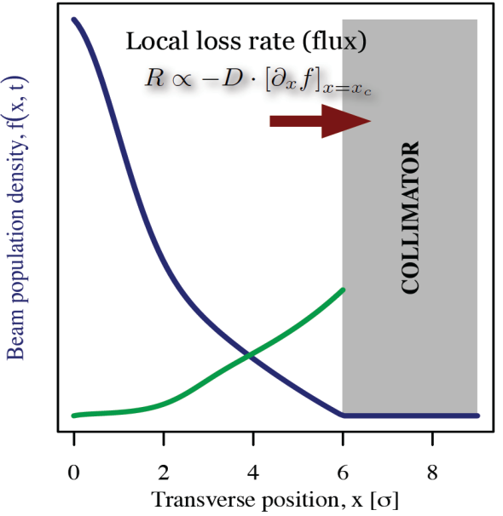
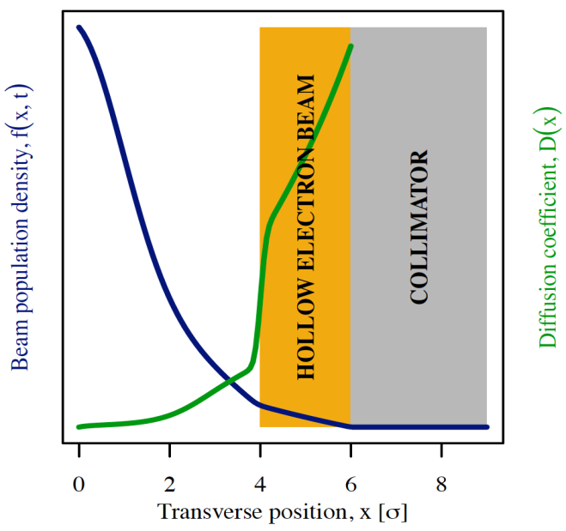
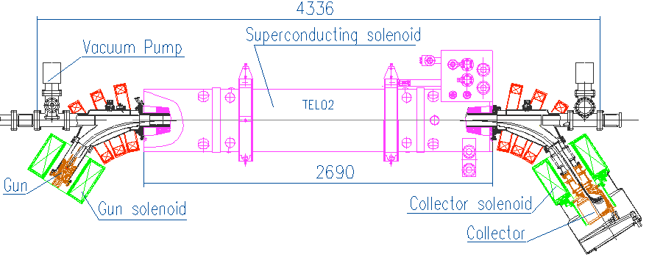
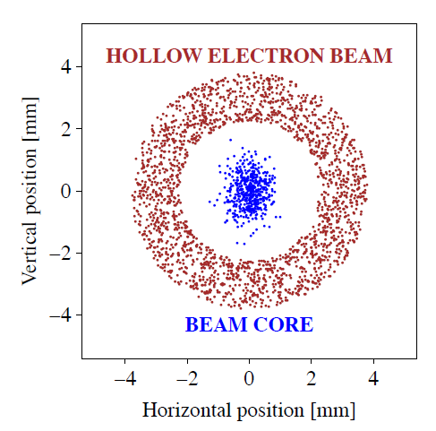
Hollow lens
Halo cleaning by electron lens demonstrated at Tevatron.
Soft scrapper,
No material damage,
Tunable strength –
diffusion speed
Beam population
Diffusion speed
p
p
Such a lens is considered as an option for HL-LHC (CERN-LARP collaboration).
G. Stancari -TUOBA01
Stancari et al., Phys. Rev. Let. 107, 084802

Slide 29
Introduction
Material robustness
Instrumentation
Collimation and halo
Availability, safety and operation
Conclusion

Slide 30
Availability and safety
Peak performance is not everything, a high availability and safety are a key factor for modern machines.
In many projects availability considerations are included from the design phase.
100’s to 1000’s of inputs into the MPS.
Right level between too safe and too relaxed.
Different approaches can be used:
Failure mode, effects and criticality analysis (FMECA) to asses safety and availability of the main systems,
Defines needs for redundancy, testing etc
Failure analysis based on IEC 61508 standard.
Reviews by colleagues in the field of MPS.
Input and review by external consultants in the field of safety (car industry, air traffic…). Fruitful exchange !
Approach to safety system analysis and design.
ESS - MOPME047
SIS100 - THPME058
LINAC4 - THPRI020

Slide 31
Failure analysis
For LHC the detailed failure analysis (FMECA) provided reasonable estimates for safety and false triggers (within factor 2 or better).
But it requires significant efforts and a systematic approach !
A key benefit of a failure analysis:
In depth analysis of the system,
Dangerous common mode failures may be revealed !
Wikipedia
Whether such an analysis is worth the effort depends evidently on the consequences !

Slide 32
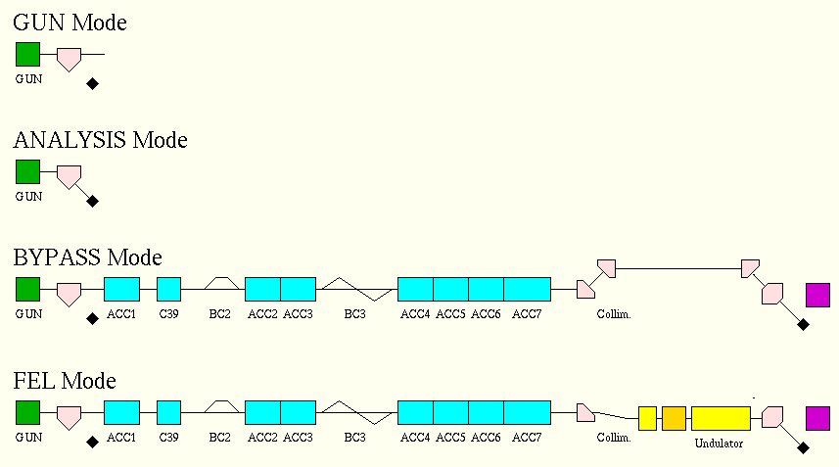
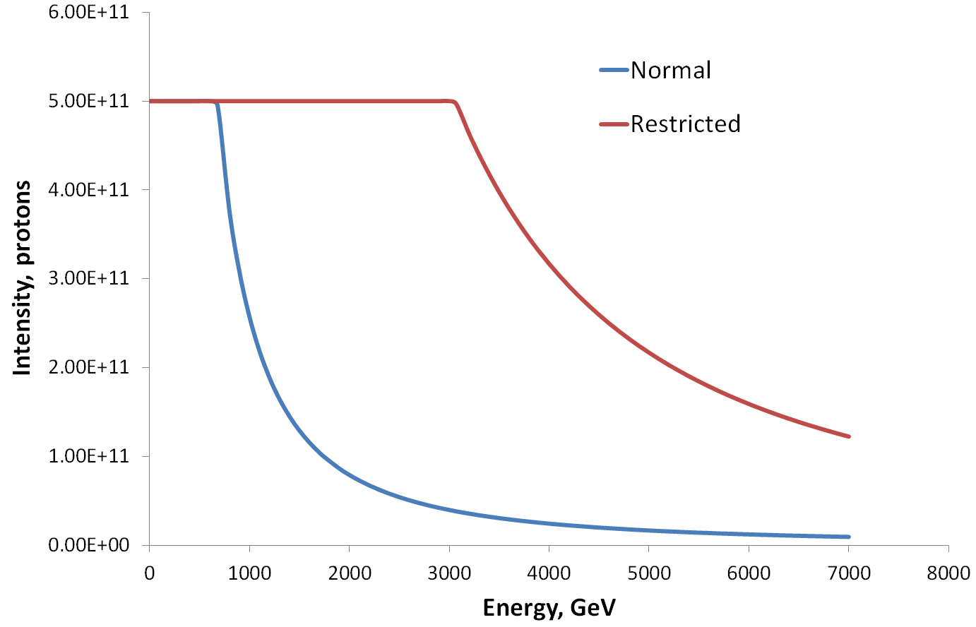
Masking and commissioning
When designing an MPS one should consider commissioning, machine experiments, operation phases where flexibility is required.
Need some way of relaxing or masking interlocks.
The concept of accelerator mode or a combination of beam intensity and energy in the interlock logic are typically used to mask out interlock channels.
Beware of failure modes introduced by this flexibility !
LHC limit for interlock masking
Accelerator modes for FLASH

Slide 33
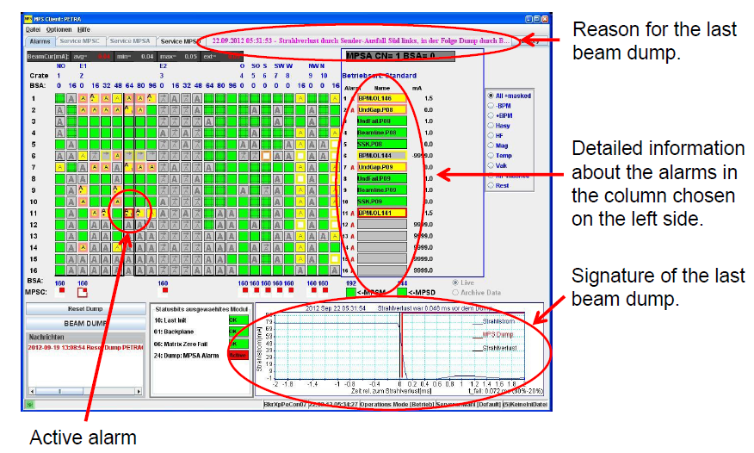
Diagnostics – post-mortem
When the MPS fires post-mortem (PM) diagnostics must be provided to identify the root cause(s) – all systems ! trigger and time reference !
For large MPS the analysis can be tedious, automatic analysis tools are developed to help the operator (and the MPS expert).
BEPCII – THOAA01
Rule based automated analysis of PM data at PETRA III
M. Bieler et al, ARW 2013
Post-operation checks based on PM data can ensure that the MPS reacted as expected, that no redundancy was lost, etc.
At the LHC automatic post operation checks (POC) are performed for the beam dumping system (equipment & beam data) – block operation is POC fails.
System ‘as good as new’.

Slide 34
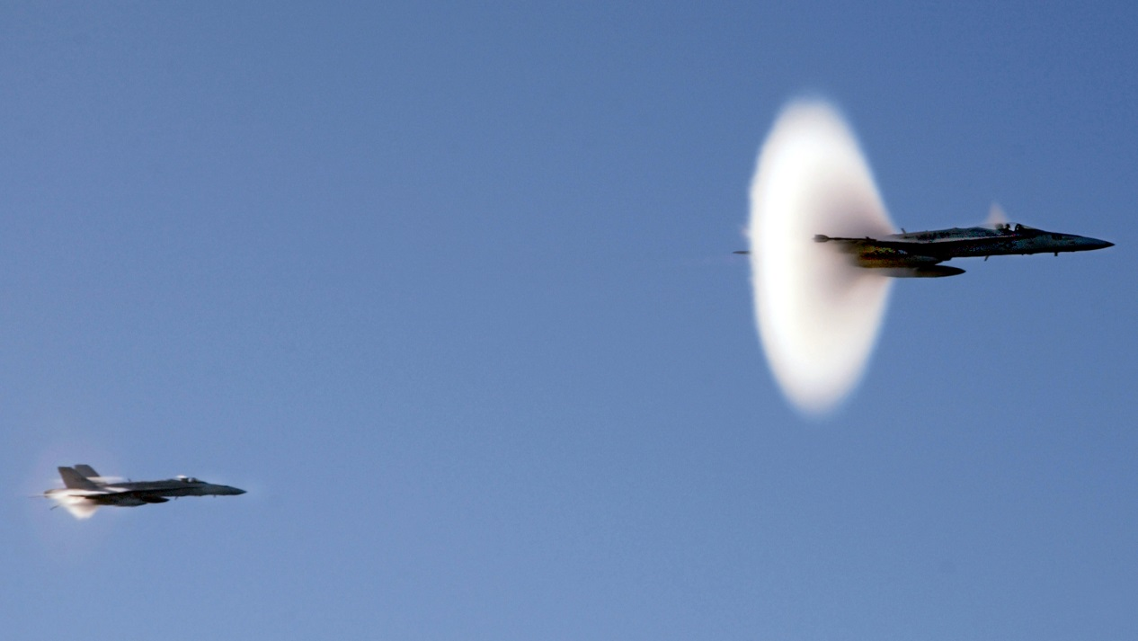
Conclusion
Requirements for high powers and large stored energy provides a steady flow of challenges for MPS.
We will soon reach limits of materials, new concepts may be required – sacrificial devices.
Monitoring of beam properties and equipment pushes to ever tighter tolerances with large dynamic ranges – instrumentation !!!
Availability is a key aspect of a modern MPS – from the design !
Accelerators and their MPS’s are preparing to pass the few 100 MJ and multi MW barrier !

