Slide 1
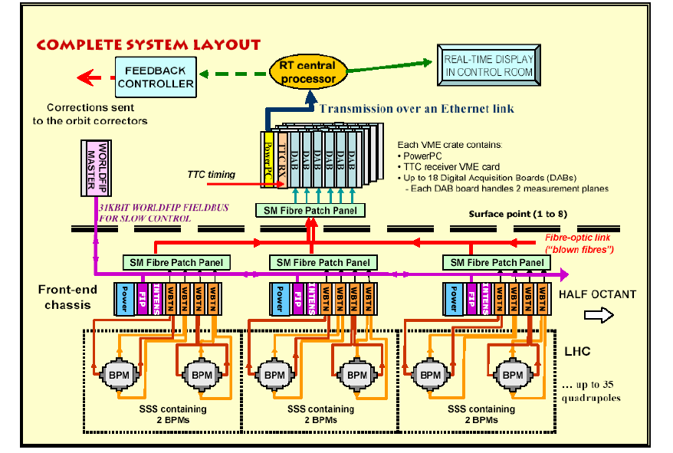
Global System Overview
BPM+FIP
Concentrator
“S.B.P.-ware”

Slide 2
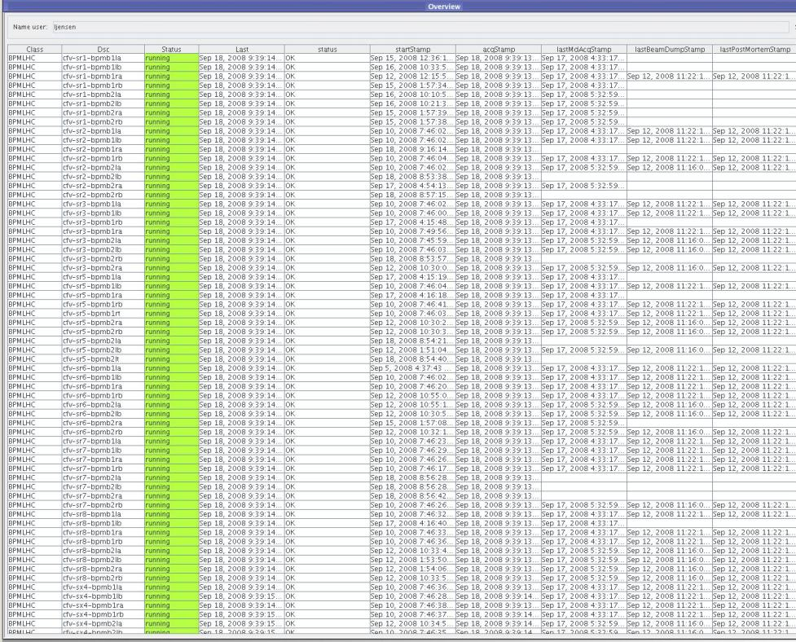
BPM FEC Overview (66 in total)

Slide 3
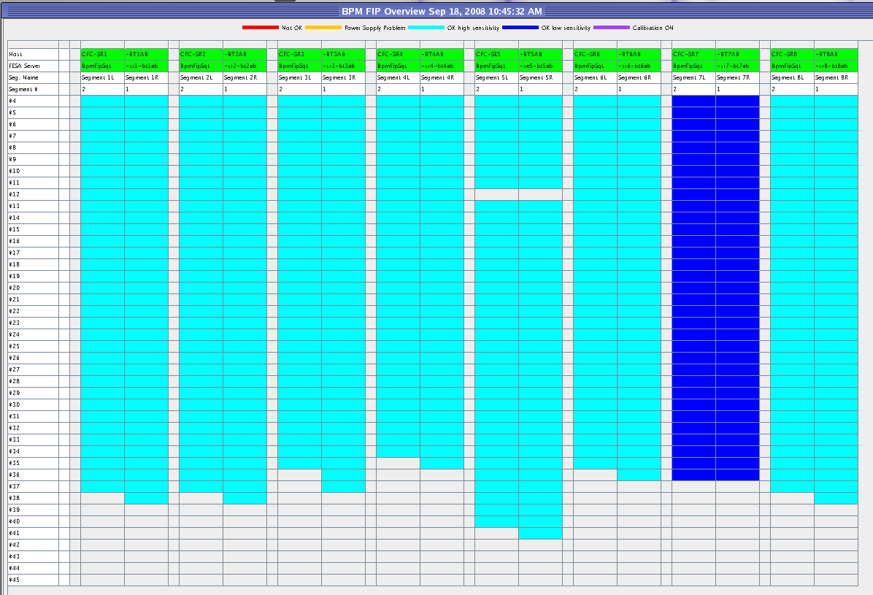
BPM FIP Overview

Slide 4
BPM Position Calibration
Parameters #1:
BPM geometrical scale factors
BPM Kf (~¼ of diameter)
X5, X3, X1 for non-linear part (only certain types)
Tilts (only for BPMS so far)
Offsets (only horizontal for BPMSW and BPMSE) so far but could be handled for all channels)

Slide 5
Geometrical factors (per BPM TYPE)
Equipment Code | BPM Diameter (mm) | Geometric Linearization Factor X^5 | Geometric Linearization Factor X^3 | Geometric Linearization Factor X | Scale Factor Kf
BPM | 49.0 | 2.300E-05 | 3.700E-05 | 1.035E+00 | 12.58
BPM_A | 49.0 | 2.300E-05 | 3.700E-05 | 1.035E+00 | 12.58
BPMR | 49.0 | 2.300E-05 | 3.700E-05 | 1.035E+00 | 12.58
BPMRA | 49.0 | 2.300E-05 | 3.700E-05 | 1.035E+00 | 12.58
BPMC | 49.0 | 2.300E-05 | 3.700E-05 | 1.035E+00 | 12.58
BPMCA | 49.0 | 2.300E-05 | 3.700E-05 | 1.035E+00 | 12.58
BPMYA | 61.0 | 8.000E-06 | 2.000E-04 | 1.022E+00 | 16.00
BPMYB | 61.0 | 8.000E-06 | 2.000E-04 | 1.022E+00 | 16.00
BPMW | 61.0 | 8.000E-06 | 2.000E-04 | 1.022E+00 | 16.00
BPMWA | 61.0 | 8.000E-06 | 2.000E-04 | 1.022E+00 | 16.00
BPMWB | 61.0 | 8.000E-06 | 2.000E-04 | 1.022E+00 | 16.00
BPMWC | 61.0 | 8.000E-06 | 2.000E-04 | 1.022E+00 | 16.00
BPMWE | 61.0 | 8.000E-06 | 2.000E-04 | 1.022E+00 | 16.00
BPMS | 61.0 |  |  |  | 15.25
BPMSW | 61.0 |  |  |  | 15.25
BPMSX | 81.0 | 2.000E-06 | 2.000E-04 | 1.014E+00 | 21.98
BPMSY | 81.0 | 2.000E-06 | 2.000E-04 | 1.014E+00 | 21.98
BPMSA | 81.0 | 2.000E-06 | 2.000E-04 | 1.014E+00 | 21.98
BPMSB | 131.0 | 3.000E-07 | 9.000E-05 | 1.010E+00 | 32.75
BPMSE | 131.0 | 3.000E-07 | 9.000E-05 | 1.010E+00 | 35.75
BPMD | 131.0 | 3.000E-07 | 9.000E-05 | 1.010E+00 | 35.75
BPMWI | 80.0 | 2.000E-06 | 4.000E-04 | 1.006E+00 | 20.49
BPMWT | 80.0 | 2.000E-06 | 4.000E-04 | 1.006E+00 | 20.49
TILT

Slide 6
BPM Position Calibration
Parameters #2:
Electrical on-line calibration
Low (negative), Middle (centre) & High (positive)
Low and high sensitivity ranges
Acquired with (IIR) closed-orbit mode every second from Java expert application (next slide)

Slide 7
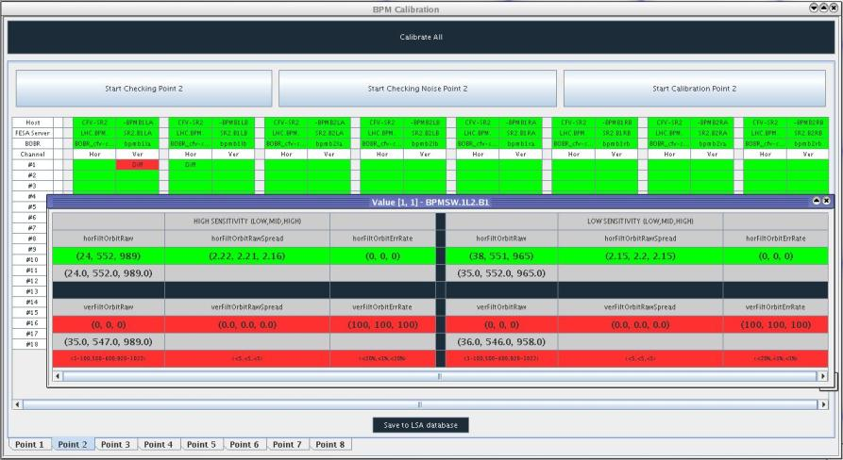
BPM Calibration #1

Slide 8
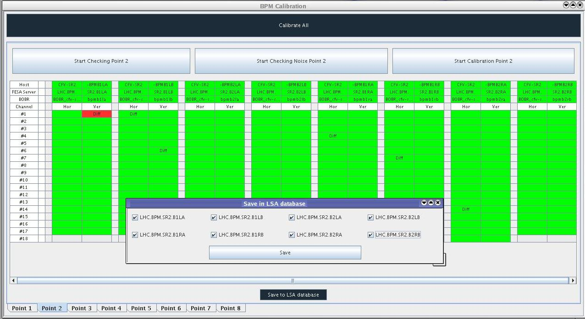
BPM Calibration -> FE + LSA

Slide 9
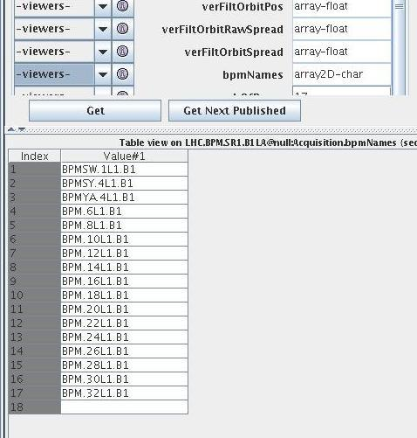
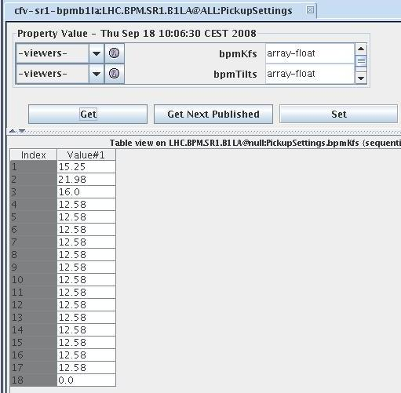
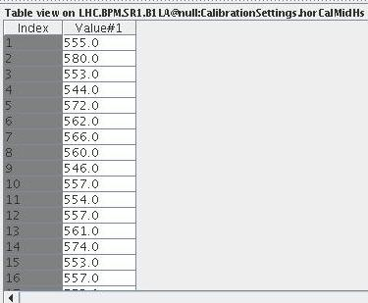
Calibration factors in front-end

Slide 10
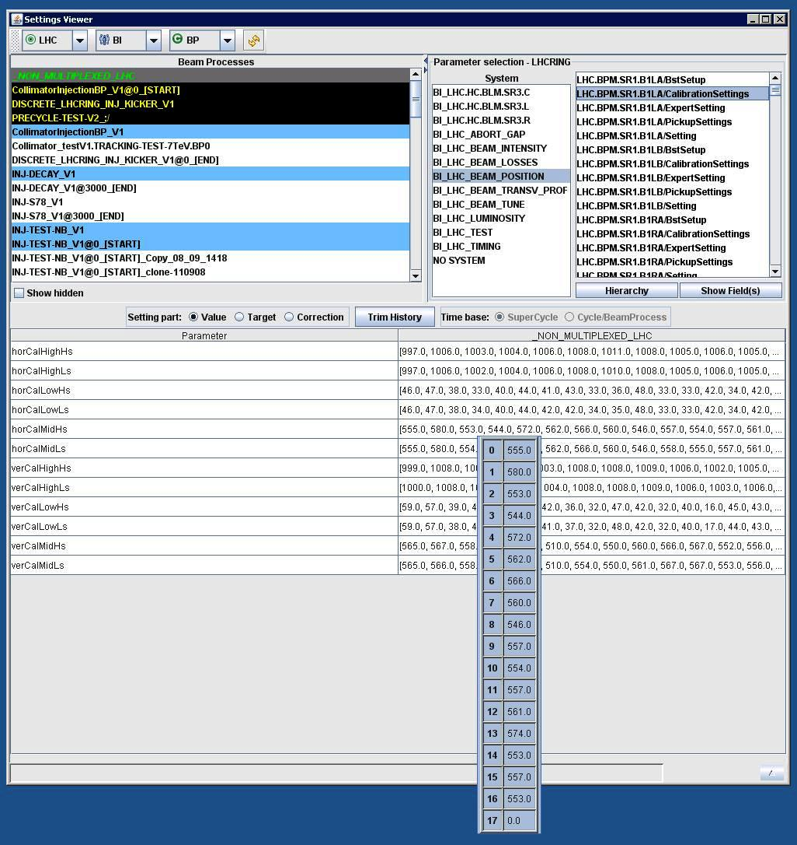
Calibration factors LSA Settings Viewer

Slide 11
Changes over one week (SX4)
Calibration performed 17.09.2008 (now active)
VME Slot | 3 | 4 | 5 | 6 | 7 | 8 | 9 | 10 | 11 | 13 | 14 | 15 | 16 | 17 | 18 | 19
horCalHighHs | 991 | 986 | 993 | 993 | 994 | 994 | 994 | 993 | 1000 | 995 | 990 | 994 | 994 | 995 | 994 | 995
horCalHighLs | 989 | 987 | 993 | 994 | 993 | 993 | 994 | 992 | 999 | 995 | 991 | 994 | 993 | 995 | 993 | 995
horCalLowHs | 29 | 35 | 29 | 20 | 26 | 21 | 18 | 19 | 36 | 27 | 36 | 28 | 33 | 30 | 22 | 28
horCalLowLs | 29 | 34 | 30 | 19 | 31 | 18 | 16 | 18 | 36 | 30 | 36 | 27 | 32 | 30 | 21 | 28
horCalMidHs | 546 | 554 | 548 | 542 | 571 | 526 | 551 | 526 | 565 | 553 | 545 | 538 | 567 | 542 | 536 | 545
horCalMidLs | 545 | 555 | 547 | 542 | 571 | 526 | 549 | 525 | 566 | 556 | 546 | 539 | 568 | 545 | 536 | 545
verCalHighHs | 995 | 992 | 991 | 998 | 992 | 991 | 995 | 992 | 1003 | 993 | 993 | 992 | 994 | 993 | 995 | 995
verCalHighLs | 995 | 990 | 991 | 997 | 992 | 991 | 993 | 993 | 1004 | 993 | 993 | 991 | 996 | 993 | 994 | 995
verCalLowHs | 26 | 41 | 18 | 32 | 31 | 11 | 28 | 18 | 41 | 24 | 35 | 21 | 23 | 40 | 20 | 38
verCalLowLs | 27 | 41 | 19 | 33 | 29 | 11 | 28 | 18 | 41 | 25 | 36 | 21 | 23 | 39 | 20 | 38
verCalMidHs | 551 | 559 | 521 | 557 | 558 | 535 | 564 | 536 | 558 | 540 | 564 | 544 | 545 | 572 | 560 | 561
verCalMidLs | 549 | 560 | 522 | 558 | 557 | 536 | 564 | 534 | 557 | 540 | 564 | 543 | 545 | 570 | 560 | 561
Difference over 1 week
horCalHighHs | -3 | -3 | 0 | -5 | -4 | -2 | -3 | -3 | -2 | -1 | -3 | -2 | -1 | -1 | -2 | -1
horCalHighLs | 28 | 22 | 37 | 30 | 13 | 42 | 14 | 23 | 20 | 24 | 20 | 32 | 19 | 30 | 26 | 31
horCalLowHs | -3 | -1 | -2 | 0 | -5 | -1 | -2 | -2 | -1 | -5 | -1 | 0 | -1 | -2 | -3 | -1
horCalLowLs | -10 | -3 | 0 | -5 | -9 | -7 | -23 | -17 | -15 | -13 | -10 | -2 | -14 | -4 | -5 | -2
horCalMidHs | 0 | -2 | 1 | -1 | -2 | -1 | -2 | 1 | -1 | -3 | -3 | -2 | -2 | -3 | -2 | -2
horCalMidLs | 2 | 8 | 5 | -5 | 1 | 14 | 0 | 3 | 4 | -2 | -1 | -1 | 5 | 4 | -1 | -1
verCalHighHs | -1 | 1 | -3 | -1 | -4 | -3 | -2 | -4 | -1 | -2 | -3 | -2 | -3 | -3 | -3 | -2
verCalHighLs | 22 | 30 | 29 | 17 | 12 | 26 | 13 | 33 | 31 | 32 | 15 | 17 | 22 | 14 | 11 | 23
verCalLowHs | -1 | 0 | -3 | -1 | 1 | -2 | -3 | -2 | 1 | -1 | -1 | -1 | -2 | -2 | -1 | -1
verCalLowLs | -22 | -7 | -6 | -14 | -19 | -5 | -22 | -4 | -12 | 2 | -11 | -19 | -17 | -15 | -22 | -11
verCalMidHs | -3 | -2 | -3 | -2 | -2 | -3 | -2 | 0 | 1 | -3 | -1 | -2 | -3 | -2 | -1 | -1
verCalMidLs | 1 | 3 | -1 | 5 | 3 | 2 | 5 | -4 | -1 | -4 | 0 | 3 | 1 | 1 | 3 | 4

Slide 12
Work on-going
Capture mode:
Phasing-in (TDC) and alignment of bunches with abort-gap (Stephane expert-application)
Reliability of front-ends with several clients and many bunches ..
Closed-orbit:
When all BPMs are correctly phased-in, compare synchronous with IIR orbit (presently used).
Post-mortem and XPOC modes:
To be checked with circulating beam
Intensity modules:
Further studies to be made, question-mark conc. absolute calibration with respect to lab-results.
Tests with higher intensity
Handling of sensitivity setting (WorldFIP) for position and intensity
Sequencer (average intensity above ~4E10 charges)
Low-level software (position+intensity)

