Slide 1
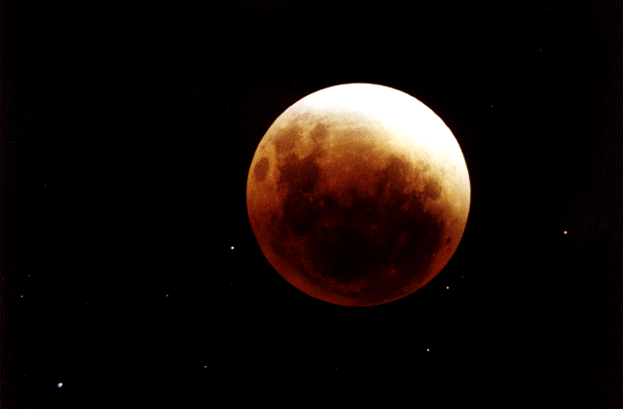
LHC Beam Energy
J. Wenninger
CERN
Beams Department
Operation group / LHC
Acknowledgments: E. Todesco

Slide 2
Outline
Beam energy
Magnetic model and field calibration
Beam energy measurements at LHC

Slide 3
Beam momentum - definitions
The deflection angle dθ of a particle with charge Ze and momentum P in a magnetic field B(s):
ds
ρ
Integrated over the circumference:
dθ
The momentum is given by the integrated magnet field:
LHC: 1232 14.3m long dipoles, 8.33 T

Slide 4
Beam momentum
Which magnetic fields / magnets contribute to the integral?
In the ideal LHC only the dipoles contribute.
In the real LHC the contributions to the integral (typical values) are:
Dipoles ≥ 99.9%
Quadrupoles few 0.01%
Dipole correctors ~ 0.01%
Higher multipoles < 0.01%
For target accuracies at the level of ~0.1%, only the dipoles and quadrupoles matter – the rest can be lumped into the systematic error.

Slide 5
Circumference and orbit length
The speed βc (and momentum P), RF frequency f_{RF} and length of the orbit L are coupled:
In the ideal case, the orbit length L matches the circumference C as defined by the magnets, L=C, f_{RF} is matched, the beam is on the design orbit.
The RF frequency is an integer multiple of the revolution period,
h = 35’640
What happens if an external force changes the circumference of the ring, or if f_{RF} is not correctly set, such that L≠C ?
L = C
L > C

Slide 6
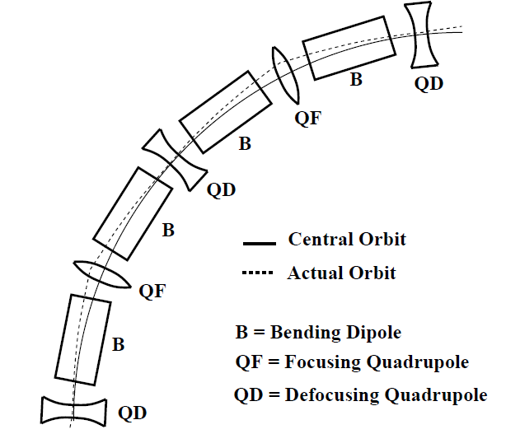
Quadrupoles and circumference
The role quadrupoles in the LHC is to focus the beams. When L=C (on ‘central orbit’) there is no bending by the quadrupoles.
No effect on the energy.
If L≠C, the beam is pushed off-axis through quads, giving a net bending in each quad. The energy change can be expressed by:
Strong amplification (for large accelerators)
α_{c} = momentum compaction factor

Slide 7
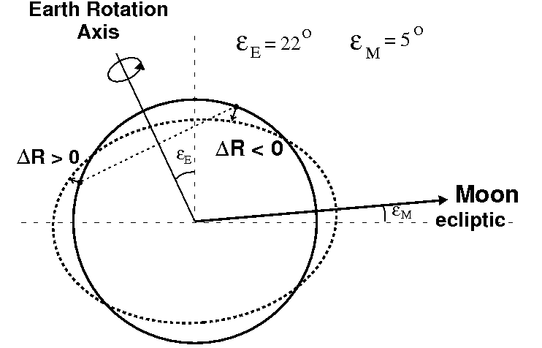
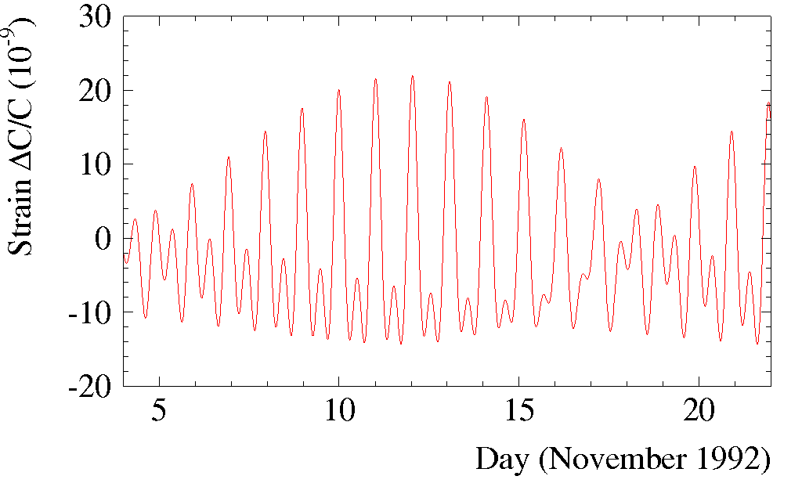
LEP classic: Earth tides
Tide bulge of a celestial body
of mass M at a distance d :
θ = angle(vertical, celestial body)
Earth tides :
Predicted circumference change
The Moon contributes ≈2/3,
the Sun ≈1/3.
NO 12 hour symmetry
(direction of Earth rotation axis).
Not resonance-driven
(unlike Sea tides !).
Reasonably accurate predictions available.
@ LHC ⇔ ΔE/E ~ 1.2×10⁻⁴

Slide 8
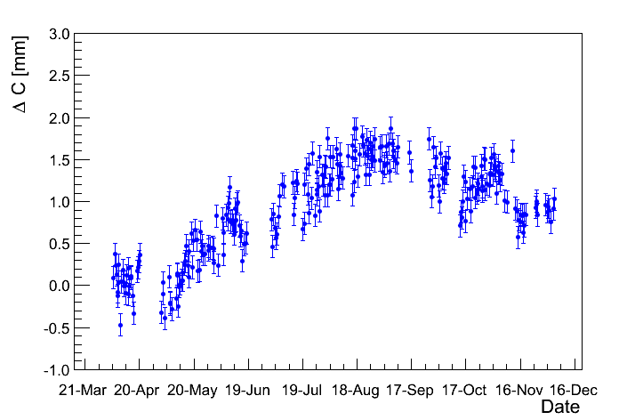
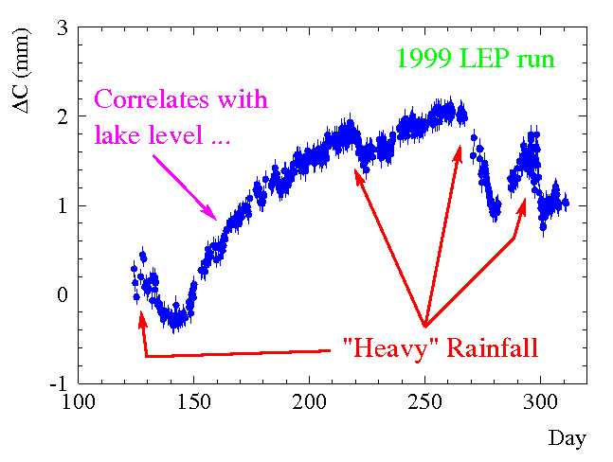
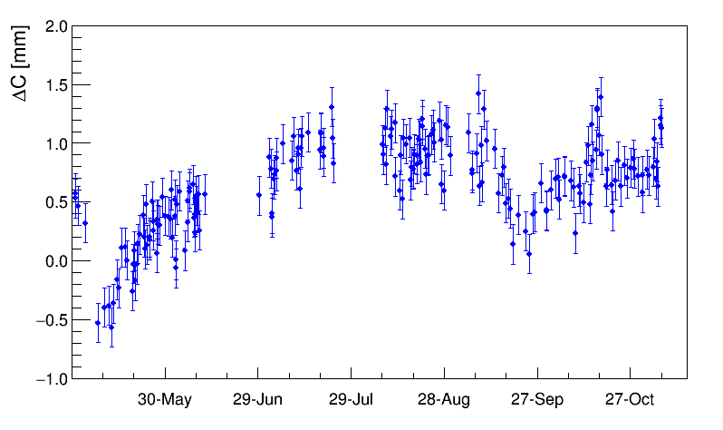
Circumference evolution
To provide energy predictions for every LEP fill, the long-term evolution of the LEP circumference had to be monitored (also done for LHC).
Mainly by observing the beam with beam position monitors (BPMs).
The LEP/LHC tunnel circumference is subject to seasonal (and reproducible) changes of 2-3 mm.
⇔ ΔE/E ~ 2-3×10⁻⁴
LHC 2012
LHC 2015

Slide 9
Energy stability
Both tidal effects and the slow circumference changes are automatically compensated by the LHC orbit feedback.
Net impact of circumferences changes < 0.01%
Impact of dipole orbit correctors is ≤ 0.02%.
The current stability of the 8 dipole power converters is ~few part per million. The stability of the current calibration (repeated ~ TS) is at a similar level.
Impact of the PC is << 0.01%
Super-conducting magnets do not suffer from temperature effects like room temperature magnets.
Beam data confirms field stability << 0.01%
For energy uncertainties on the scale of ~0.1% only the absolute calibration is important, one can neglect time dependent effects (unlike LEP !).
It is safe to assume that the energy is stable over a run to ≤ 0.02%.

Slide 10
Outline
Beam energy
Magnetic model and field calibration
Beam energy measurements at LHC

Slide 11
Magnetic model
The energy information on LHC page1, which coincides (rather well) with the energy that is set in the LHC magnets by the control system, is obtained from the magnetic model of the LHC dipoles.
The transfer function (TF, or calibration curve) between PC currents (at LHC 8 independent PCs) and magnetic field was established during the magnet testing at SM18 and in the firms.
The TF is established from:
Around 240 dipoles that were measured at 1.9 K across the entire field & current range (few 100 A to 12’000 A),
All 1232 dipoles measured at room temperature at a current of 8.5 and/or 10 A.

Slide 12
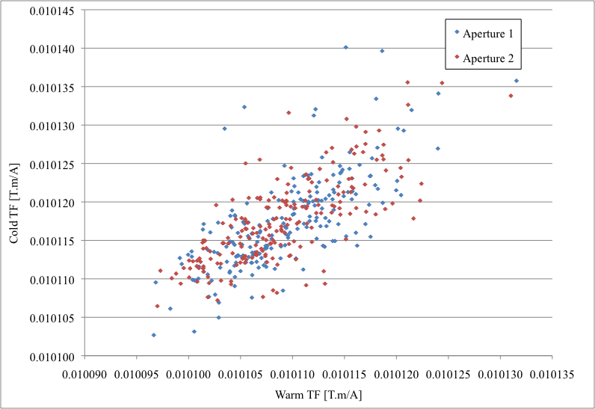
Magnetic model – cold-warm
The TF is build using data from the 1.9 K data to define the full shape along the cycle. This includes the geometric TF (~ what you expected from an ideal magnet) and various ‘error’ components like saturation of the iron, magnetisation of the cable etc.
The geometric component is based on the 1.9K measurements for the magnets measured in SM18 . For the other magnets it is based on the RT measurement corrected for the warm-cold correlation of the magnets measured at 1.9K – in the form of an offset of 8x10⁻⁶ Tm/A.
Correlation 1.9K – room T
<geometric TF> (1.9K) = 0.010117 Tm/A
Magnet-2-magnet spread ~0.06%

Slide 13
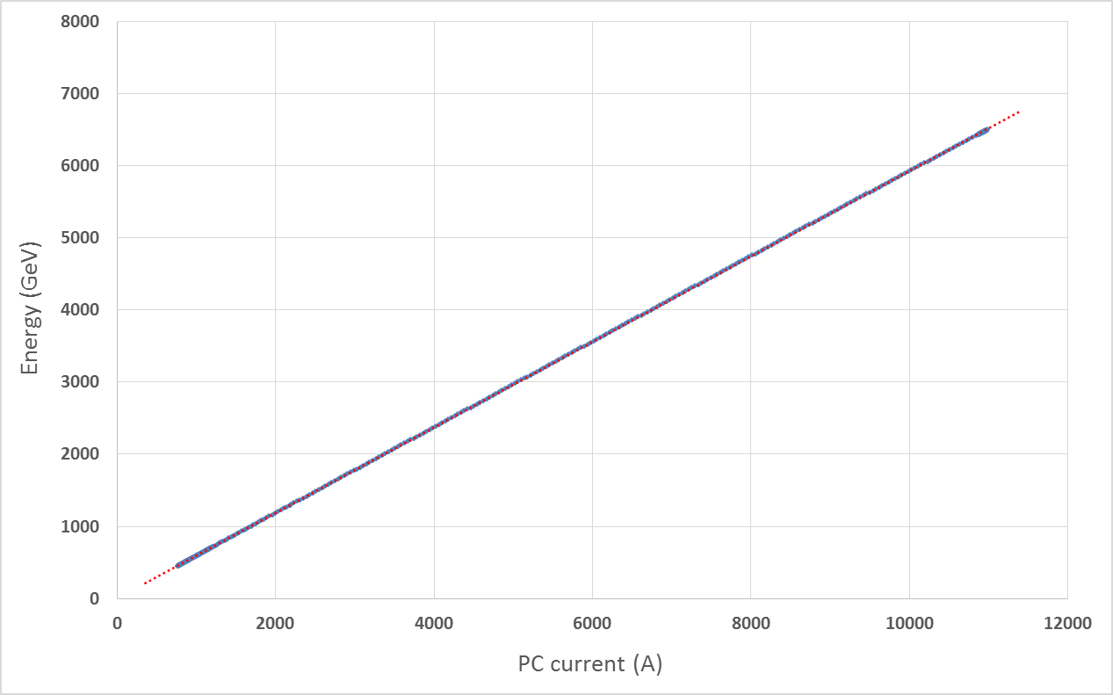
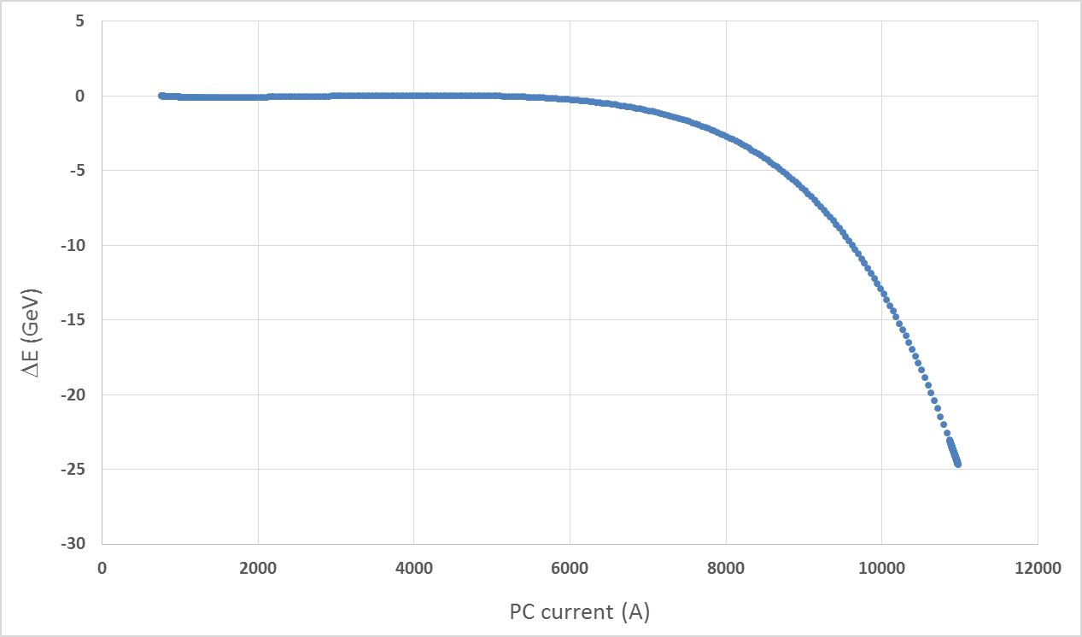
Dipole transfer function
The energy versus current TF (2016 ramp settings) for one of the 8 sectors (extracted from the LHC controls DB).
Deviation from the straight line (slope at 5 kA) of the TF. The saturation at high current is significant for energy calibration.
At 6.5 TeV the deviation is ~0.4% (0.6% at 7 TeV).
Iron saturation

Slide 14
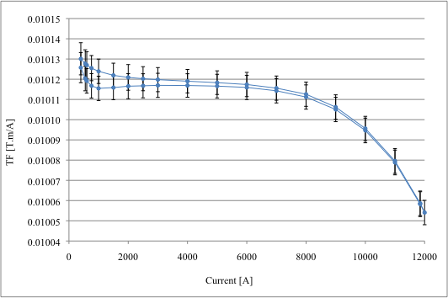
Dipole transfer function
The final dipole transfer function deviates from a straight line by -0.6% due to iron saturation at high field (> 5 TeV).
The systematic error on the TF is estimated to ~ 0.1%.
The energy difference between ring1 and ring2 is estimated to < 0.01%.

Slide 15
Outline
Beam energy
Magnetic model and field calibration
Beam energy measurements at LHC

Slide 16
Proton-ion calibration principle (1)
At the LHC there is currently only one method to determine the energy with the beam with an ‘interesting’ accuracy based on the comparison of the revolution frequency of protons and ions.
To confirm independently the magnetic model numbers
The speed β (and momentum P), RF frequency f_{RF} and circumference C are related to each other:
The speed β_{p} of the proton beam is related to P:
An ion of charge Z circulating in the same ring, on the same orbit, has a momentum ZP and a speed β_{i} given by:
2 unknowns (C & β/P)
Provides a 2nd measurement to extract the 2 unknowns (C & β/P)

Slide 17
Proton-ion calibration principle (2)
The 2 equations for β_{p} and β_{i} can be solved for the proton momentum P:
for Pb⁸²⁺ μ ≈ 2.5
Momentum calibration principle:
Inject protons into the LHC, center the orbit such that L=C. Measure the RF frequency.
Repeat for Pb ions.
The frequency difference Δf gives directly the energy.
➔ This is the method that is used at the LHC

Slide 18
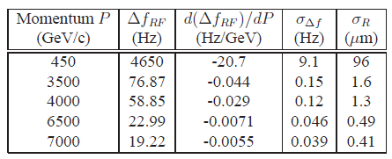
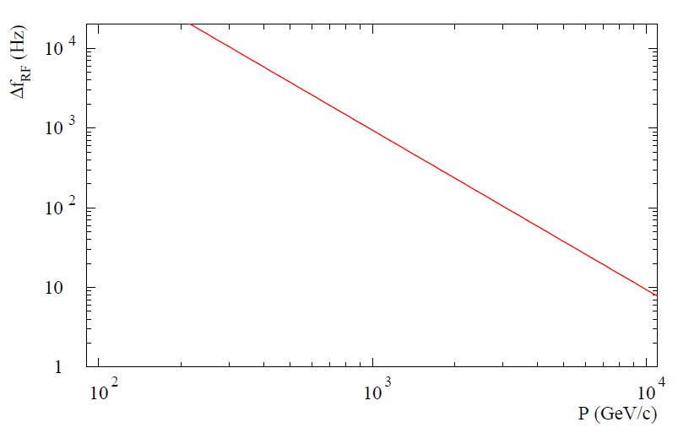
Scaling with energy
When ions become very relativistic, the difference wrt protons decreases, The frequency difference scales ∝ 1/P²:
~4.5 kHz
Proton – Lead
~60 Hz
~20 Hz
Target errors to reach 0.1% uncertainty on the energy.
Error on radius difference between p-Pb σ_{R} ~ 1 μm !
LHC
The LHC beam position monitor system works rather well down to 20 μm, but one micron accuracy is a challenge (wrt systematic errors).

Slide 19
Proton-Lead
Before the p-Pb run in 2013, proton and Lead ions were never present at the same time in the ring.
For an accurate energy measurement all effects that could modify the ring circumference had to be controlled at the μm level – no chance to get an accurate measurement at high energy.
Accurate measurements at injection were possible.
With p-Pb the situation became more favorable. Since we only have to know the relative radial position of p and Pb, tides and other geological effects do not bias the measurement.
But it remains a delicate measurement - two rings !
The p-Pb run in 2013 was used to measure the energy parasitically to the physics run. Every fill provided a measurement.

Slide 20
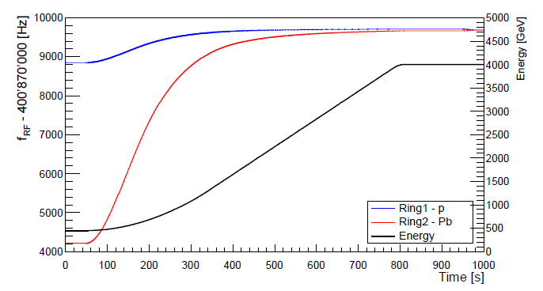
Proton-Lead cycle
Injection: the RF frequency difference is large (~4.6 kHz). Each beam runs at the frequency that maintains it centered in the magnets. The RF systems of the 2 rings are unlocked.
Flat top: the two beams are forced on a common frequency and re-phased to collide at the IPs. The RF systems are locked.

Slide 21
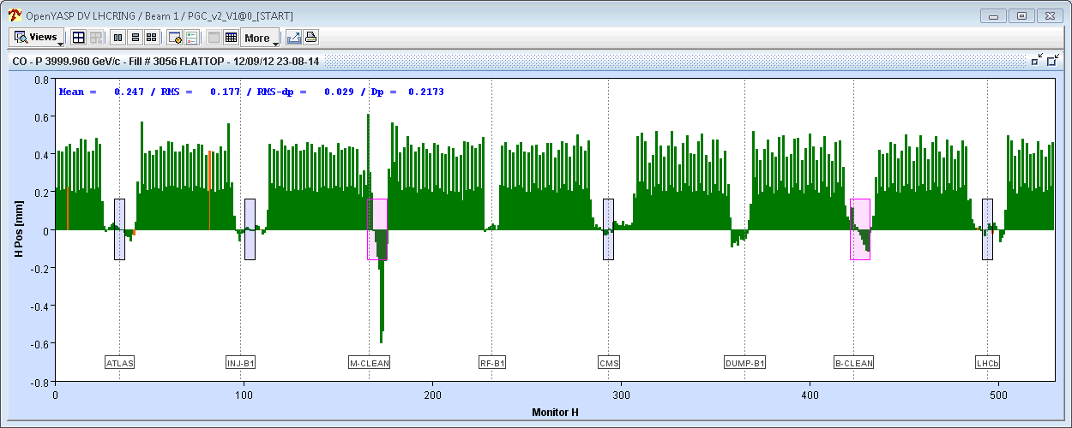
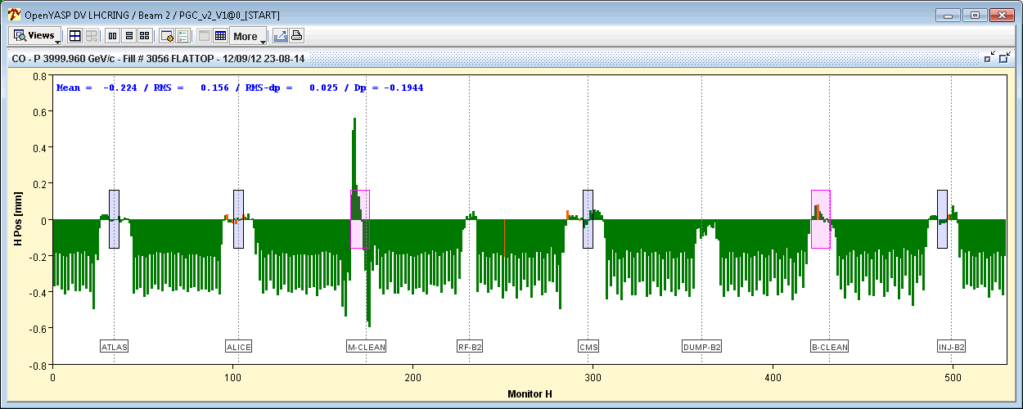
Orbit shifts at flat top
After the RF manipulations on flat top, both beams are forced to run at the same RF frequency
The protons move outwards, Pb inwards – due to the speed difference !
The frequency difference is extracted from the beam position data.
Orbit shifts induced by forcing the same RF frequency
Protons – B1
Lead – B2
1.6 (mm)
x
LHC circumference

Slide 22
Systematic BPM errors
The frequency offset are be biased by offsets of the BPMs.
Mechanics (~0.1 mm alignment wrt quadrupoles) & electronics.
Offsets (δ_{f1} , δ_{f2}) can be different for ring 1 and ring 2.
p-Pb
Pb-p
x
δ_{f1}
δ_{f2}
R1
R2
R1
R2
Δf_{pPb} = Δf + (δ_{f1} + δ_{f2})
Δf_{Pbp} = Δf - (δ_{f1} + δ_{f2})
2 Δf = Δf_{pPb} + Δf_{Pbp}
Averaging results for p-Pb (Δf_{pPb}) and Pb-p (Δf_{Pbp}) configurations cancels the static offsets !

Slide 23
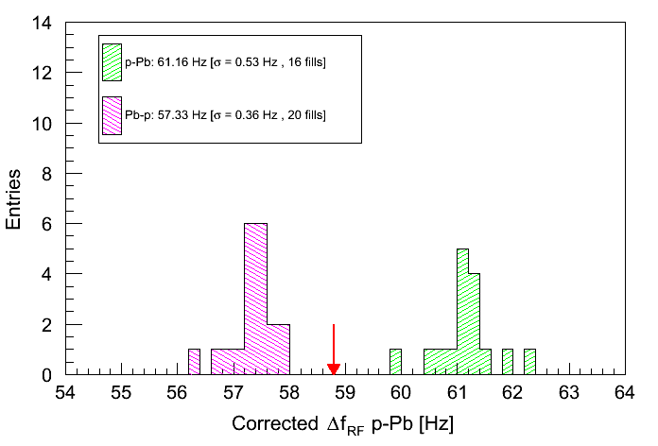
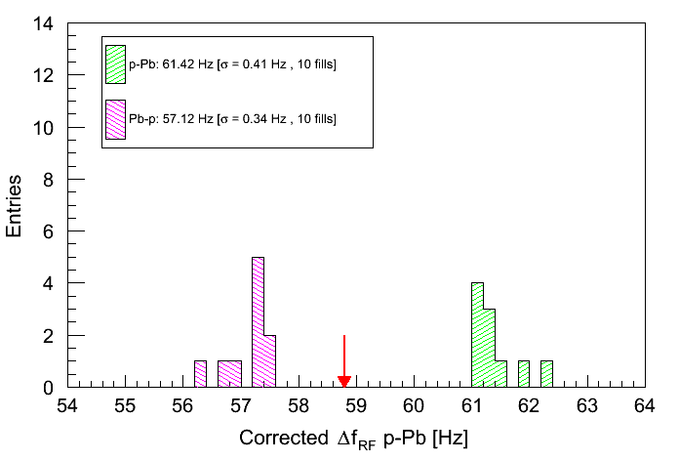
Frequency to energy
Changing the selection of BPMs and the quality cuts has little influence on the results.
From the most reliable set of fills (around the BPM scale calibrations):
Systematic error: selection cuts, intensity dependence, scale error.
All fills
(after cuts)
Resulting energy and error:
10 fills / period
(around BPM cal.)
Deviation wrt magnetic model (4 TeV):
-0.35 ± 0.52%

Slide 24
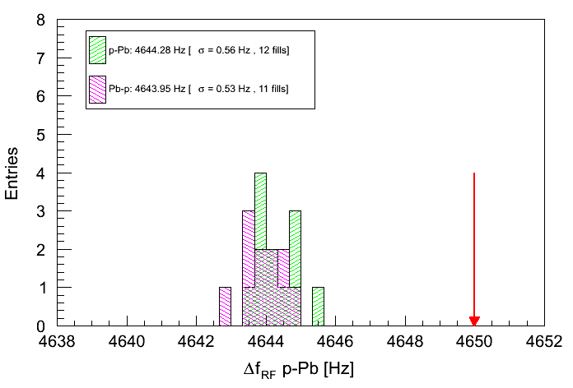
Energy at injection
Frequency difference at injection, assuming a conservative 2 Hz error:
10 fills / period
(around BPM cal.)
Very precise measurement (as expected).
Deviation wrt magnetic model:
+0.06 ± 0.03%
450GeV
Independent verification of the TF at injection. The deviation is consistent with the estimated accuracy of the magnetic measurements.

Slide 25
Energy measurement summary
The energy measurements are consistent with the magnetic model within the estimated uncertainties.
At injection the agreement is at 0.1% level – within the estimated errors.
At 4 TeV the 0.5% uncertainty of the beam measurement is dominated by the systematic errors – result is in agreement with magnetic model.
At the end of the 2016 run, the coming p-Pb run provides an opportunity to re-measure at 6.5 TeV.
Requires inversion of the beams (or a dedicated measurement).
With the increased BPM accuracy after LS1, there is good hope to obtain a similar relative uncertainty despite the higher energy (and smaller signal).
Independent estimates based on the corrections applied to for optics, tune etc at high energy are consistent with an energy uncertainty of ~0.1%.
Not real energy measurements !

Slide 26
Status and next step
Independent energy measurements at the LHC are currently unlikely to achieve uncertainties below 0.5% at high energy.
The magnetic model of the LHC is estimated (for the dipole field) to be accurate to ~0.1%.
All beam energy measurements confirm the energy predicted from the magnetic model, to 0.1% at injection !
Time dependent effects are negligible on the 0.1% scale.
The goal for the (very) near future is to re-evaluate all errors and provide an ‘official’ uncertainty based for example on the direct energy measurement at injection combined with magnetic model interpolation. The error is expected to be at the level of 0.1%.

