Slide 1
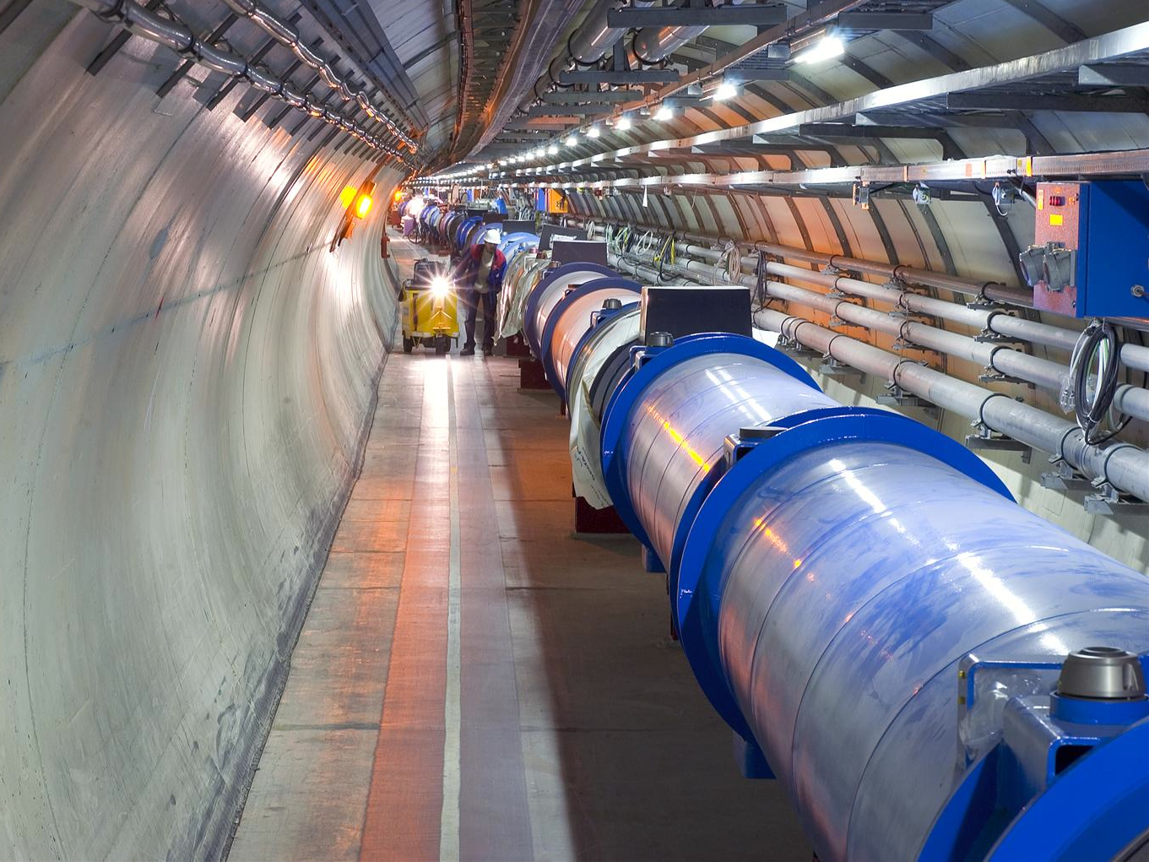
LHC status and perspectives for 2012
J. Wenninger
CERN
Beams Department
Operation group / LHC

Slide 2
Outline
Proton operation in 2011
Proton operation in 2012
Energy
β*
Intensity
Radiation, turn-around
Performance projections

Slide 3
Luminosity
Recall the formula for the luminosity (head-on collision):
(Round beams)
f is the revolution frequency (11.25 kHz), γ = E/m,
k is the number of colliding bunch pairs,
N is the bunch population,
F is a geometric (loss) factor (≤ 1) from the crossing angle, F ≈ 0.95 in 2011,
ε is the normalized emittance, β* the betatron (envelope) function at the IP,
σ is the beam size at IP:
(Round beams)

Slide 4
Injector beams
50 ns spacing is used as operationally since the successful vacuum condition for electron clouds (‘beam scrubbing’) in April.
Progressive increase of the bunch number → June.
The 50 ns beam has the highest luminosity potential.
25 ns beam was anyhow not ready in the LHC (→ later).
LHC beam parameters (SPS extraction)
Spacing | N | ε [μrad]
150 ns | 1.1 x 10¹¹ | 1.6
75 ns | 1.2 x 10¹¹ | 2.0
50 ns | 1.6 x 10¹¹ | 1.8
50 ns | 1.45 x 10¹¹ | 1.6
25 ns | 1.2 x 10¹¹ | 2.7
Limit
Present param.

Slide 5
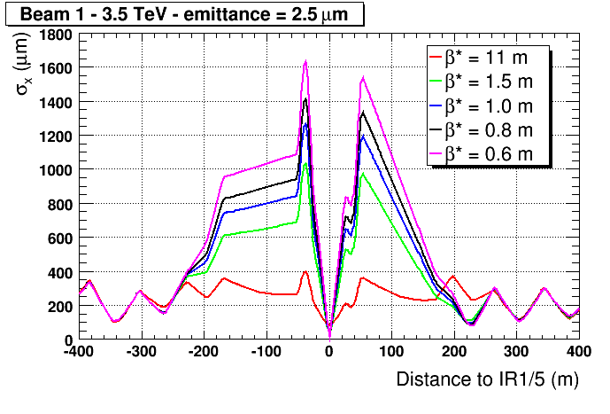
Limits on β*
β* is constrained by aperture and beam size in the triplet quadrupoles, space is needed for:
the beam envelope (12σ for tertiary collimators TCT),
a 2σ margin from TCT to triplet ,
the crossing angle –separation of the beams at the parasitic encounters.
TCT
Triplet
Triplet
TCT
≥14 σ
12 σ
~ 7 mm

Slide 6
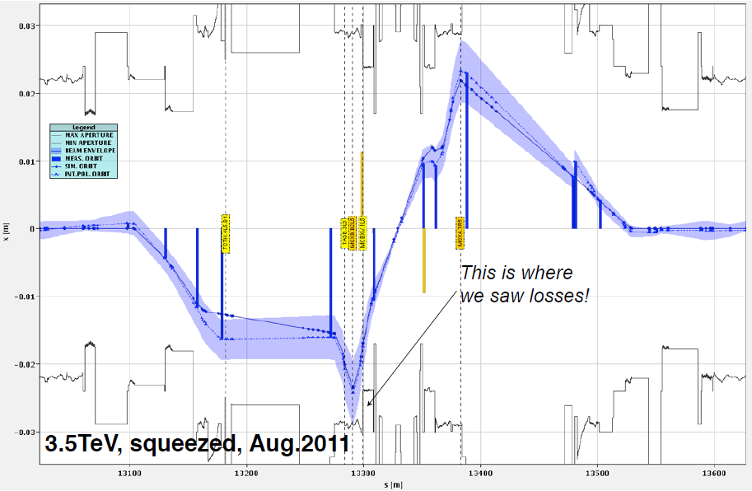
Limits on β*
Interpolating aperture measurements performed at INJECTION in 2010/11, and taking into account the 2010 experience lead to select:
Aperture measurements at 3.5 TeV in IR1/5 end of August paved the way for smaller β*:
β* = 1.5 m for startup 2011
β* = 1 m
after August technical stop
(commissioned in less than a week)

Slide 7
From 2010 to 2011
Main changes in 2011:
No change of the beam energy: 3.5 TeV.
Reduction of β* ↔ better understanding of the triplet aperture.
Faster ramp, faster squeeze.
50 ns bunch spacing.
Parameter | 2010 | 2011 | Nominal
N ( 10¹¹ p/bunch) | 1.2 | 1.45 | 1.15
k (no. bunches) | 368 | 1380 | 2808
Bunch spacing | 150 | 50 | 25
ε (μm rad) | 2.4-4 | 1.9-2.4 | 3.75
β* (m) | 3.5 | 1.5 → 1 | 0.55
L (cm⁻²s⁻¹) | 2×10³² | 3.5×10³³ | 10³⁴

Slide 8
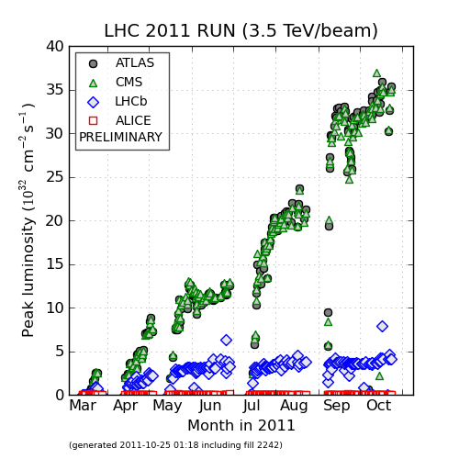
Luminosity 2011
Peak luminosity
3.6×10³³ cm⁻²s⁻¹
1380 bunches
β* 1 m
Reduce ε,
increase N
50 ns
increase k
increase N
LHCb luminosity limited to ~3.5×10³² cm⁻²s⁻¹ by leveling (beams collide with transverse offsets)
75 ns

Slide 9
Luminosity and energy
The reach in β* depends on beam size in the triplets where we have the aperture limits:
(Approximate) luminosity scaling with energy
Scaling the 3.5 TeV performance to 7 TeV yields a luminosity of 1.4×10³⁴ cm⁻²s⁻¹ - design !

Slide 10
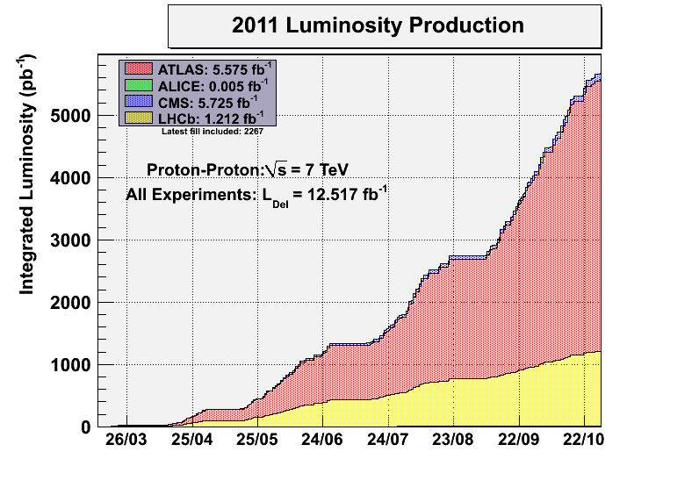
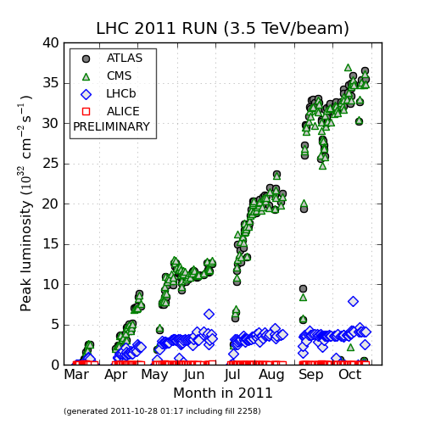
Luminosity 2011
Integrated proton luminosity 2011 now > 5.5 fb⁻¹
Best week : 0.58 fb⁻¹, theoretical max ~1 fb⁻¹
~0.4 fb⁻¹/week
0.15 fb⁻¹/week

Slide 11
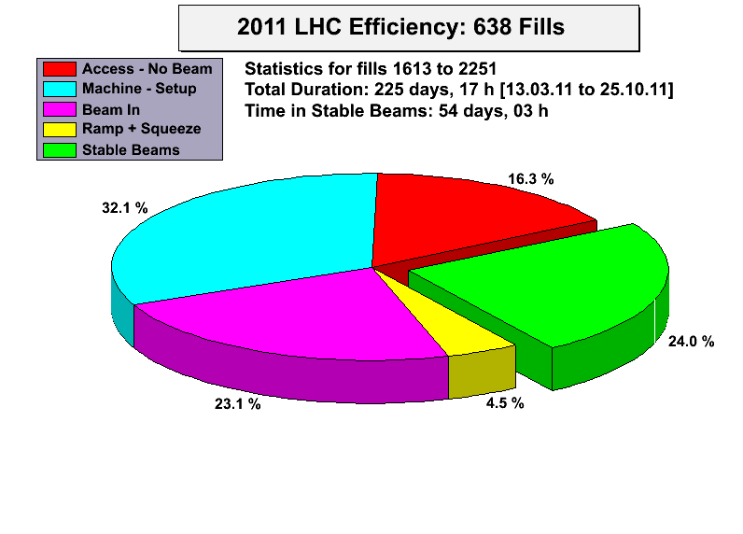
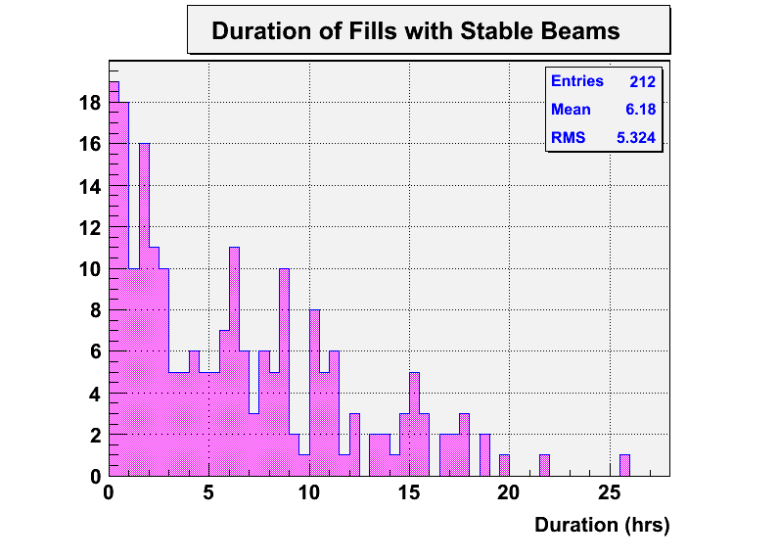
Efficiency
‘Scheduled loss’ of days:
18 days of technical stops,
10 days of scrubbing run,
~17 days of MD.
Lost ~ 12 days due to cryogenics issues (frequently knock on from another issue, like electric network glitch) between July and September
Effective no. of days for physics:
225 – 45 = 180 days.
>> efficiency for stable beams : 30%
It would be nice to reach 40-45%...
Av. 6.2 hours

Slide 12
Outline
Proton operation in 2011
Proton operation in 2012
Energy
β*
Intensity
Radiation, turn-around
Performance projections

Slide 13
Disclaimer
The projections presented here are extrapolations that have to be confirmed by a detailed analysis of limits.
Final values for β* etc will come out of the Evian (Dec 2011) and Chamonix (Feb 2012) Workshops.
And of course there are all the surprises, good and bad, that we encounter during operation…

Slide 14
Energy reach and CSCM
sector | Emax
12 | 4.5TeV
23 | unknow
34 | 4.8TeV
45 | 3.6TeV
56 | 5.8TeV
67 | 4.8TeV
78 | unknow
81 | unkown
Energy reach is limited to 3.5 TeV due to risk of bad (= high resistance) splices in the busbar connections of the main circuits.
M. Koratzinos
The CSCM (Copper Stabilizer Continuity Measurements) is a method for measuring the resistance of all busbar connections with limited risk → determine the maximum safe energy sector by sector.
Conditions similar to a quench, but no stored energy in the magnets – thermal run away can be stopped ‘easily’.
Measurements are performed at 20 K when the magnets are not superconducting – current bypasses magnets via the diodes.
Require modifications to power converters and protection systems.

Slide 15
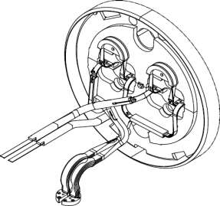
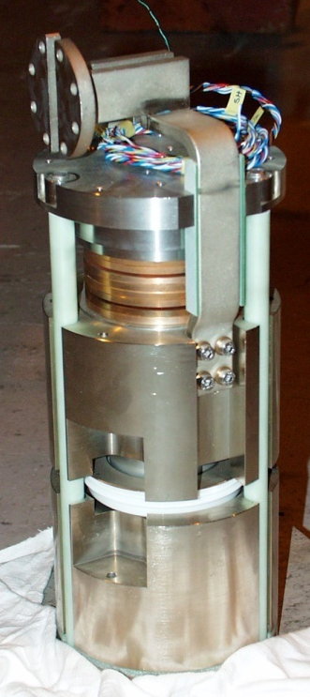
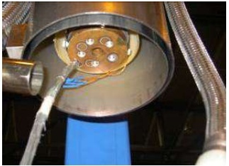
CSCM measurements
All main circuits (RB, RQD, RQF)
All interconnection splices
All current lead-busbar connections at the DFB
All bypass diode paths
A. Siemko TE/MPE
H. Thiesen – 16 August 2011 – TE-TM
Notes:
----- Meeting Notes (19/08/2011 18:52) -----
Explain current path and blue and red magnets

Slide 16
Energy
Because the CSCM requires extensive work on the powering and interlocking of the main circuits, the measurements cannot be made on all sectors during the winter break.
Type test on one sector under discussion – decision expected soon.
Decision to run at 3.5 or 4 TeV to be taken before Xmas? Overhead for 4 TeV:
A few days in hardware commissioning.
Essentially no overhead for beam commissioning.
→ Change to 4 TeV can be absorbed in the current draft schedule.
≈30% higher
L and pile-up

Slide 17
Outline
Proton operation in 2011
Proton operation in 2012
Energy
β*
Intensity
Radiation, turn-around
Performance projections

Slide 18
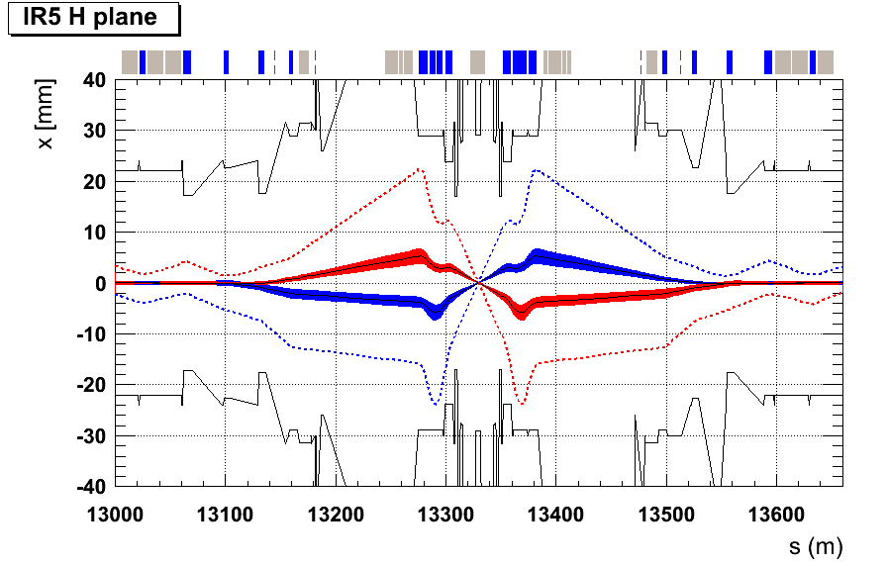
Beta*
Reduction of β* is limited by the triplet aperture, the collimator settings and the margin of 2σ that is used for orbit and optics tolerances.
=> 1 m for a crossing angle of 120 μrad.
TCT @ 12 σ
TCT @ 12 σ
1σ beam envelopes
12σ extreme beam envelopes
≥ 2σ margin to triplet
emittance = 3.5 μm,
β* =1m

Slide 19
Lower β*m- collimation
β* could be lowered further in 2012 if the collimators are set tighter around the beams.
Tight settings were tested in MDs, and operation should be possible, but more delicate since a significant beam halo is then touching the primary collimators.
Settings in sigma
(ε = 3.5 μm)
Collimator family | 2011 | Tight
TCP-IR7 (primary) | 5.7 | 4.0
TCSG-IR7 (secondary) | 8.5 | 6.0
TCLA-IR7 (absorbers) | 17.7 | 8.0
TCT IP1/5 (tertiary) | 11.8 | 9.3
TCSG-IR6 (secondary IR6) | 9.3 | 7.0
TCDQ-IR6 (dump protection) | 9.8 | 7.5
2.5σ extra margin in the triplet for β*
Further gains could be obtained by reducing the margin for optics and orbit to 1-1.5σ (from 2σ).

Slide 20
β* reach in 2012
In 2012 we may gain a margin equivalent to 3σ at β*=1m that can be used to squeeze further.
For example, assuming:
TCTs at 9.3σ,
Triplet margins of 1.5σ,
Minimum beam separation (from Xing angle) of 8σ,
=> β* reach of ≈0.85 m at 3.5 TeV
If the assumptions are varied within some range, then:
0.8 m ≤ β* ≤ 0.9 m at 3.5 TeV.
and
0.7 m ≤ β* ≤ 0.8 m at 4 TeV.

Slide 21
Outline
Proton operation in 2011
Proton operation in 2012
Energy
β*
Intensity
Radiation, turn-around
Performance projections

Slide 22
50 ns beam - injectors
The 50 ns beam brightness is ≈ constant => N ∝ ε.
Emittance
N/ε ~ constant
Max. N in the LHC
N (10¹¹)

Slide 23
50 ns beam - LHC
The constant brightness of the beam on LHC luminosity.
Emittance blowup of ~30-50% in the LHC – not understood.
>> potential gain if this blow-up can be reduced !
How did we manage this?

Slide 24
High intensity beam issues
With 50 ns operation and with stored intensity of ~2x10¹⁴ protons (1380 bunches) issues related to high intensity have started to surface:
Vacuum pressure increases,
Heating of the beam screen temperature,
Heating of injection kickers, collimators,
Losses due to (supposed) dust particles (UFO),
RF beam loading,
Beam instabilities leading to emittance blow-up.
Those effects have sometimes slowed down the pace of the intensity increase, but none has for the moment completely stopped the progress.

Slide 25
High intensity beam stability
High bunch / beam intensity can trigger instabilities in the beam. They are stabilized among other things with:
Transverse feedback system (ADT),
Octupole magnets (use non-linear fields to break the coherence of the particle motion).
The intensity thresholds for instabilities tend to be lowered with:
tighter collimator and absorber settings (impedance),
reduced crossing angles (observed experimentally, long range beam-beam interaction),
in the presence of e-clouds.
Precise predictions are difficult to obtain due to the interference of the various effects – so far not a limit for operation.

Slide 26
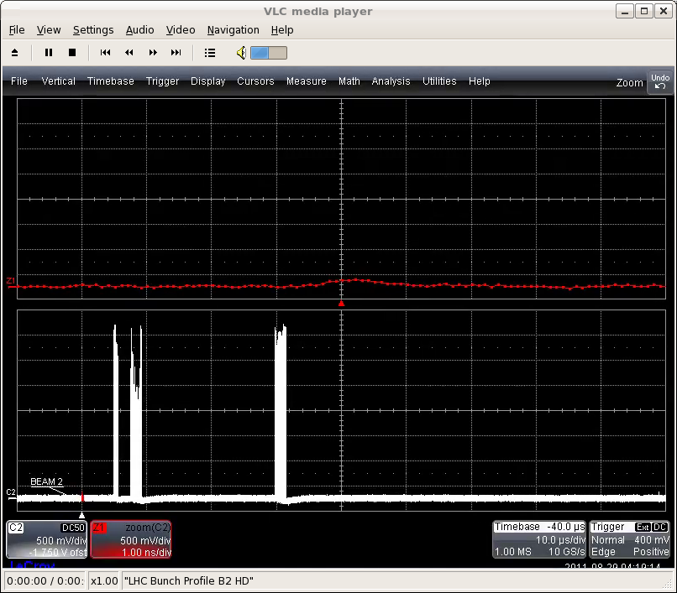
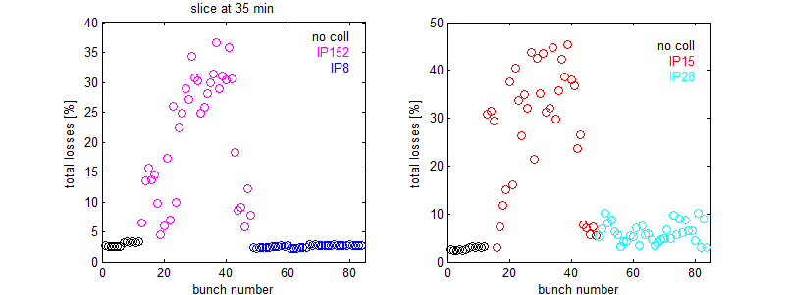
Beam instability observations 2011
Squeeze to 1 m with N~1.2x10¹¹, reduced (100 μrad) crossing angles and tight collimation → back to 120 μrad and standard collimation.
Standard operation at 1 m when the average bunch intensities started to approach 1.5x10¹¹ → increased octupole magnet strength.
Beam loss during 1 m squeeze with 100 μrad Xing angle

Slide 27
Vacuum - electron clouds
Since LHC switched to trains, electron cloud are with us.
E-clouds induced pressure rise and beam instabilities (→ large emittance).
Can be conditioned away… by e-clouds !
In April 50 ns beams (1080b) were used to condition (‘scrub’) the vacuum chamber at injection to prepare operation at 3.5 TeV.
Further improvement during intensity increase at 3.5 TeV.
Secondary Emission Yield (SEY) :
2.2 1.7 1.3
Bunch N+2 accelerates the e-,
more multiplication…
Bunch N+1 accelerates the e-,
multiplication at impact
Bunch N liberates an e-
e-
e-
++++++
++++++
++++++
N+2
N+1
N
e-
Initial
After 50 ns
scrubbing
Requirement for
25 ns operation

Slide 28
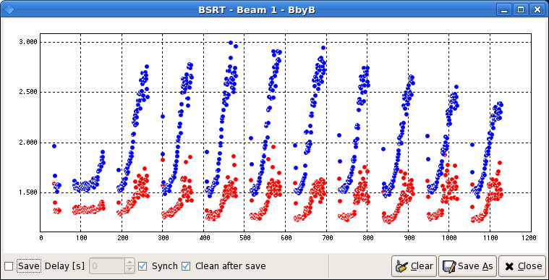
Blow up from e-clouds
Example of bunch by bunch transverse 25 ns beam – October 2011
With strong electron cloud activity…
Horizontal
Vertical
Emittance
Bunch Id
LHC 8:30 meeting

Slide 29
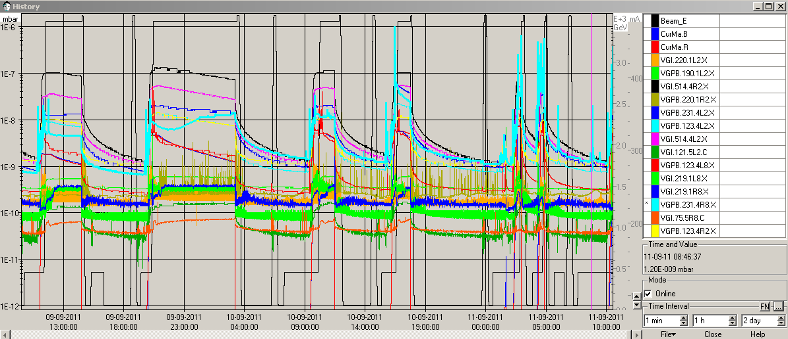
Vacuum spikes
Vacuum conditions in IR2 and IR8 have been periodically so poor that they lead to beam dumps from beam losses.
Causes of the vacuum spikes are not well understood, could be linked to gas at the warm-cold transitions of the stand-alone cryostats, e-clouds…
This issue is coming and going… has also appeared around CMS recently.
Example of vacuum issue in IR8
10⁻⁶
10⁻⁷

Slide 30
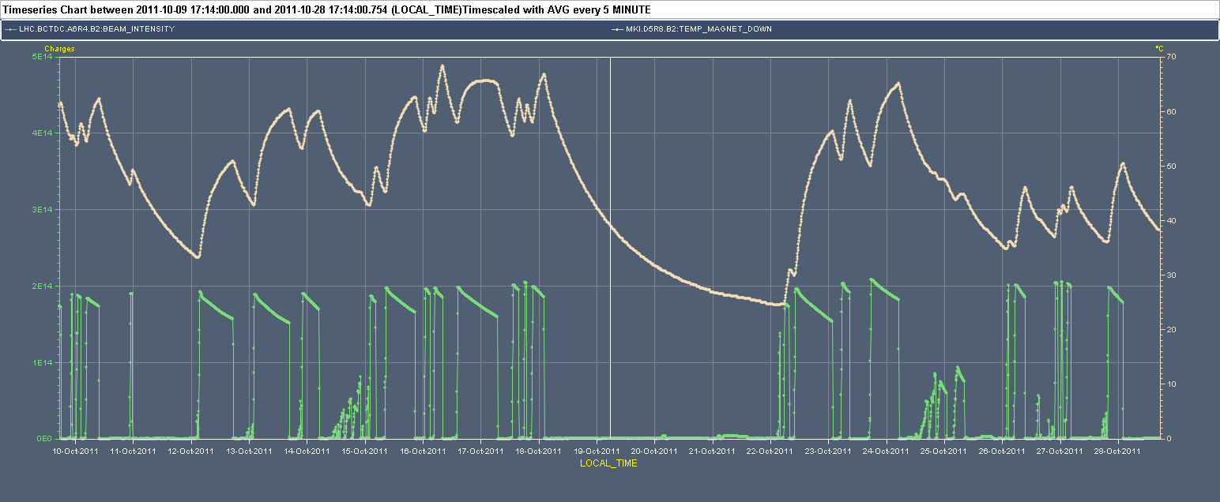
Beam induced heating
The high intensity bunches led to heating of:
absorber blocks and collimation placed close to the beam,
injection kickers,
beam screens (cryo, partly through e-cloud effects).
So far the situation is under control. Possible improvement by increasing the bunch length beyond the current 1.25 ns (+- 2σ).
Abort gap population to be watched…
70
Kicker Temperature
(deg)
Intensity
2x10¹⁴
30

Slide 31
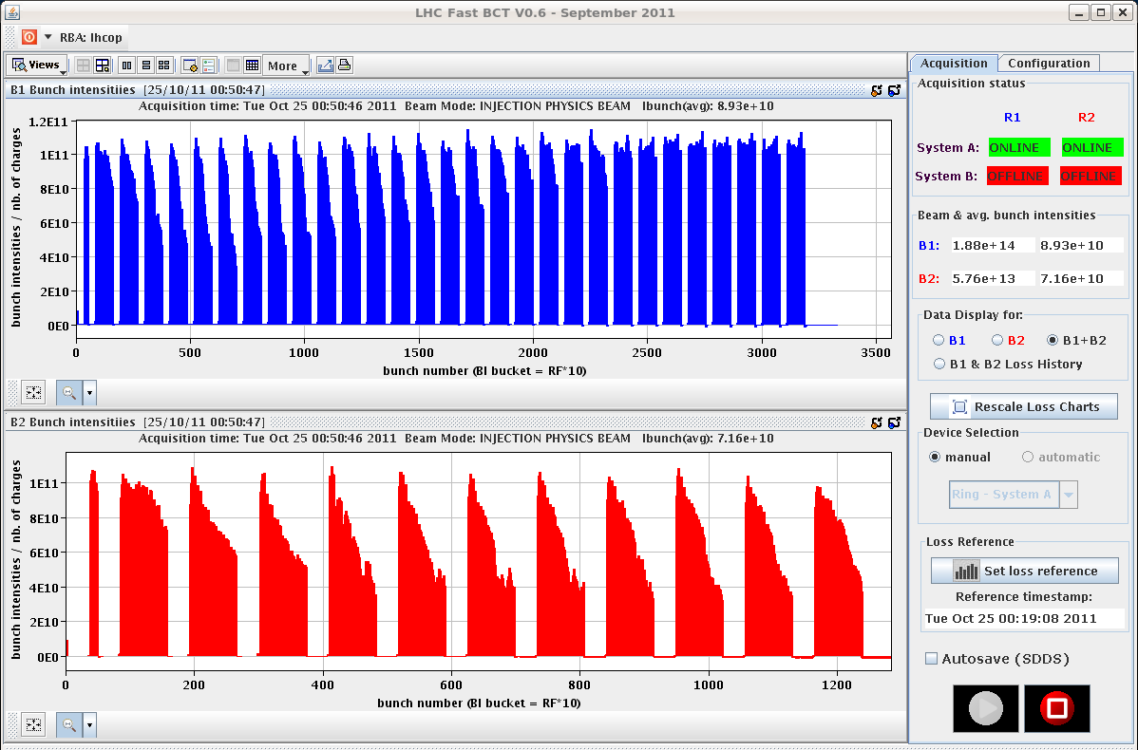
25 ns beams
25 ns beams of up to 2096 bunches were stored at 450 GeV.
Beams suffer from heavy e-clouds (stability, lifetime). Cryo system operating at the limit due to heat load from e-clouds.
Poor vacuum conditions slow down progress – as expected. Significantly more (few days?) scrubbing required at injection.
But no evident show-stopper for 25 ns – progress is pretty fast !
2096 bunches in beam1

Slide 32
50 versus 25
Assuming similar emittance blow-up in the LHC:
Bunch spacing | N/bunch | ε @ 450 GeV SPS [μm] | ε @ 3.5 TeV [μm] | Relative Luminosity
50 | 1.6 x 10¹¹ | 1.8 | 2.6 | 1.15
50 | 1.4 x 10¹¹ | 1.6 | 2.4 | 1
25 | 1.2 x 10¹¹ | 2.7 | 3.5 | 1
?
We expect 25 ns to be more difficult:
Larger emittance : injection.
Smaller spacing : e-cloud (→ longer scrubbing run), vacuum.
Long range beam-beam (twice as many encounters) → higher β* ?
Larger stored energy.
But it ~halves the number of events per crossing….
In any case we will probably use 25 ns in 2012 for vacuum chamber scrubbing (even if not used for physics).

Slide 33
Outline
Proton operation in 2011
Proton operation in 2012
Energy
β*
Intensity
Radiation, turn-around
Performance projections

Slide 34
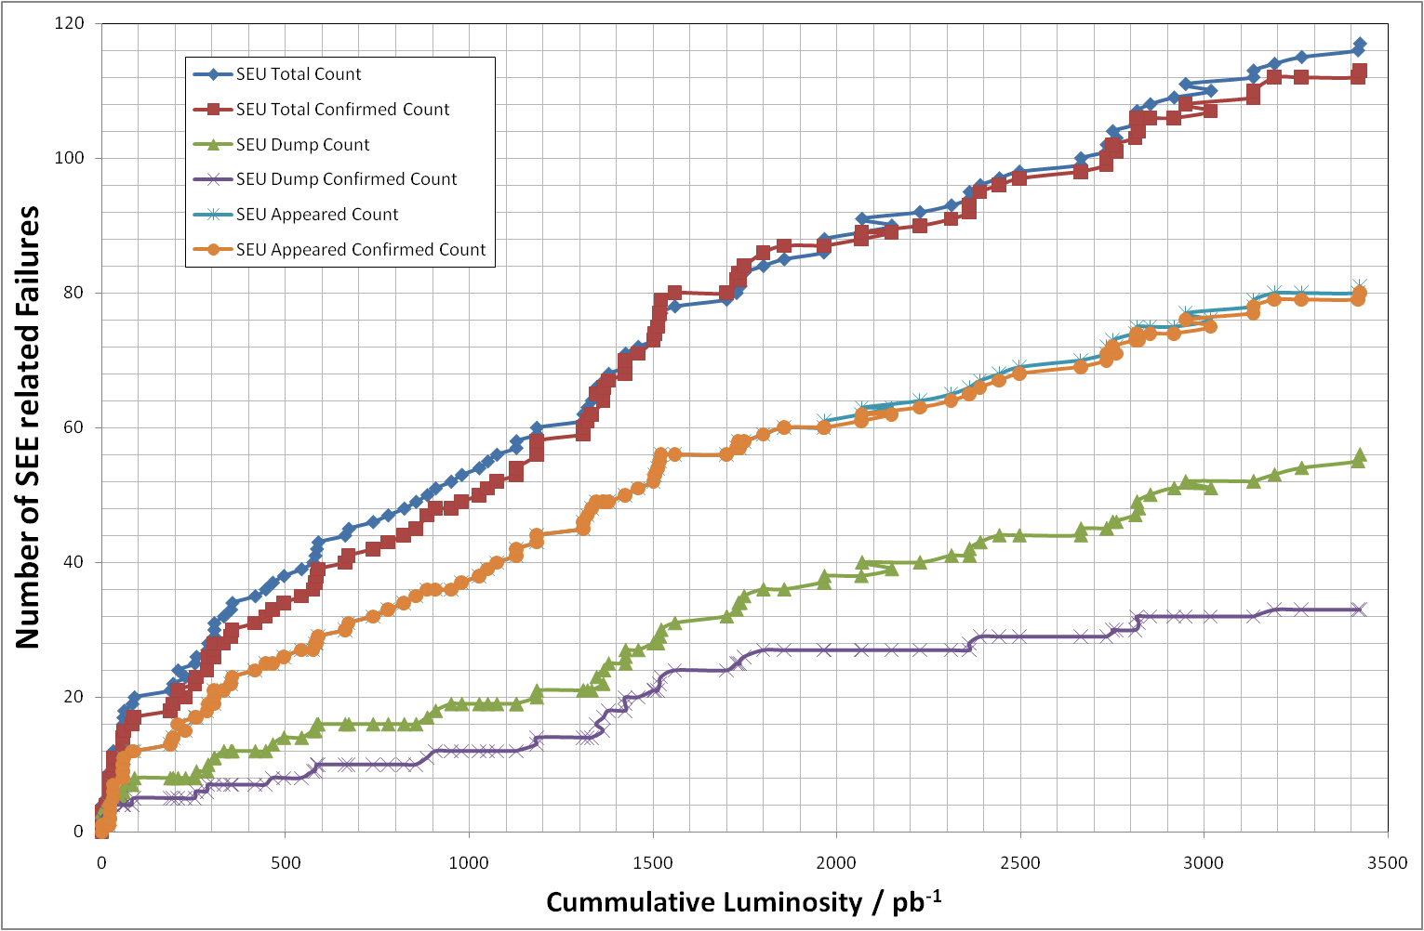
Radiation to electronics (R2E)
With the increasing luminosity tunnel electronics starts to suffer from the (expected) SEE (Single Event Errors).
In particular the quench protection ad cryogenics systems.
M. Brugger
Slope: ~1 SEE dump per 60 pb⁻¹

Slide 35
R2E Situation
2011 operation:
Most critical equipment : QPS and cryo.
Mitigation through better firmware (QPS), special reset procedures (cryo), signal filtering (RF) etc. SEEs rates from cryo have been reduced a lot.
Presently the fill length is basically defined by R2E effects!
In many cases, even if the fill is not dumped, we have to give access for local resets in the tunnel.
2011/12 Christmas Break (and Technical Stops):
Relocation of most critical elements.
Additional shielding of most critical areas (UJ’s in Pt1).
The QPS equipment will remain exposed in 2012 despite firmware and electronics improvements – in particular in the area at the entrance of the arcs in Pt1 and Pt5.

Slide 36
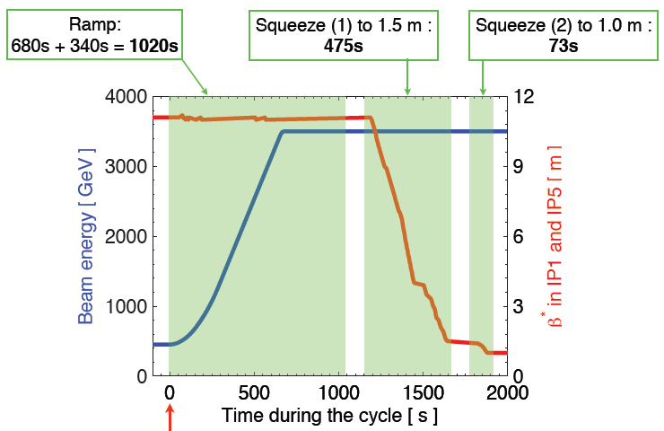
Turnaround - 2011
*
2011 ramp and squeeze length is 1568 s.
(*) : Persistent
current decay
S. Redaelli
In 2012 we may combine the ramp and part of the squeeze (down to ~3m) and remove the waiting time on flat top (*).
Total gain: ~ 750 seconds / fill → ~3-4 days gained over a run.

Slide 37
Outline
Proton operation in 2011
Proton operation in 2012
Energy
β*
Intensity
Radiation, turn-around
Performance projections

Slide 38
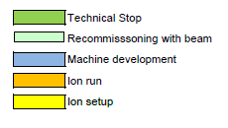
Preliminary 2012 Schedule
3 weeks of setup with beam.
2+ weeks for initial intensity ramp up, scrubbing.
20 weeks of HI proton operation (May-Oct)

Slide 39
Performance in 2012
Peak performance – 50 ns beam.
Possible gain from better emittance control not included.
Parameter | Value | ΔL/L (%) | E (TeV)
β* | 0.8-0.9 (m) | 10-25 | 3.5
Intensity | 1.6x10¹¹ | 10
Total |  | 20-35
β* | 0.7-0.8 (m) | 25-40 | 4
Intensity | 1.6x10¹¹ | 10
Emittance | Shrinks with E | 15
Total |  | 60-75
Performance of 25 ns some ~10-20% lower. Depends on:
β* reach (possibly higher value), emittance in physics…

Slide 40
Integrated luminosity 2012
Estimated figures – with some gain in efficiency.
Cryo systenm downtime can easily remove 10% !
Performance | Weekly int. luminosity (fb⁻¹) | 2012 Int. luminosity (fb⁻¹)
Good weeks October 2011 | 0.45 | 9
ΔL/L +35%, 3.5 TeV (*) | 0.6 | 12
ΔL/L +75%, 4 TeV (*) | 0.8 | 16
(*) assuming gain in peak L → gain int. L.
>> Int. luminosity in the range of 8-15 fb⁻¹

Slide 41
Summary
The peak performance in 2011 exceeded our most optimistic expectations – we are now in routine ~3.5x10³³ cm⁻²s⁻¹ regime.
Operation of the beams themselves is smooth, yet we have trouble with the machine availability (radiation !)
Limited 0.4-0.5 fb⁻¹ / week
The energy in 2012 will be 3.5 or 4 TeV. No decision so far…
Peak luminosity could increase by 20-75% depending on β*, energy, bunch spacing – better estimates by February.
Integrated luminosity in 2012 ~8-15 fb⁻¹ in reach.
The machine favors 50 ns over 25 ns as the performance is similar/better with probably fewer issue.
Thank you for your attention !

Slide 42
Spares

Slide 43
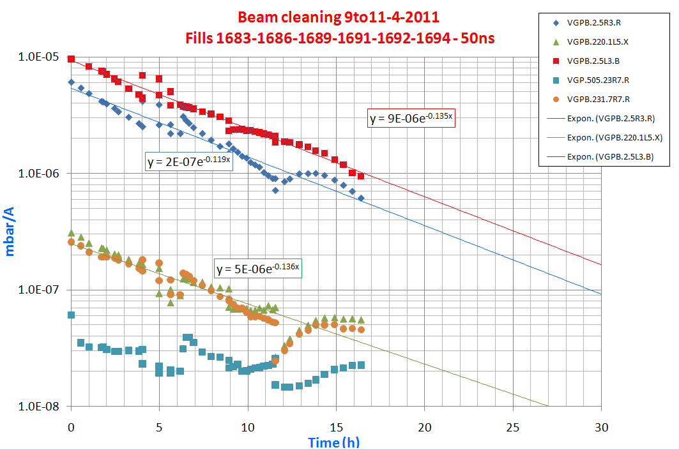
Vacuum cleaning with beam
Pressure decrease (normalized to intensity) as a function of effective beam time in April – very effective vacuum cleaning.
Gain one order of magnitude/15 hours.
Common vacuum chamber
regions around experiments
are most critical due to
the overlap of the beams.
During intensity ramp up, additional (and progressive) cleaning occurred in the background.
J.M. Jimenez

Slide 44
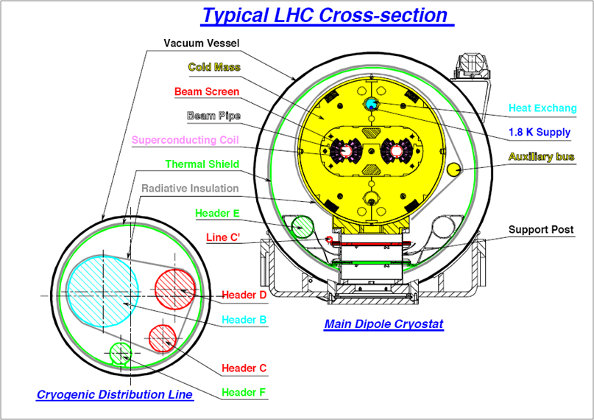
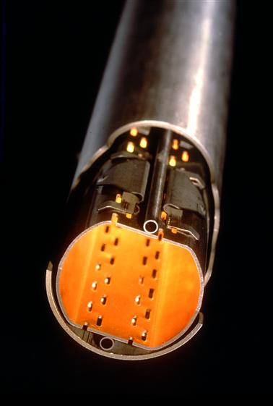
LHC Dipoles & Beam Screens
Beam screen as seen by the beam
Slots (3% surface coverage)
Beam Screen cooling pipes
Cold Bore (2K)

Slide 45
Beam screen temperatures
The beam screen (BS) shields the magnet cold bore from the beams.
Gases are trapped on the cold bore (colder than BS).
In the presence of beam, the beam screen maybe be heated by
vacuum pressure increase / electron clouds,
RF heating from EM fields.
Beam screen as seen by the beam
In some cases (triplets) out-gassing from the BS has been observed – very careful T control during technical (or cryo) stops.
Part of the effect could be correlated to (too) short bunches at 3.5.
Increased bunch length blow-up.
Cold Bore (2K)

Slide 46
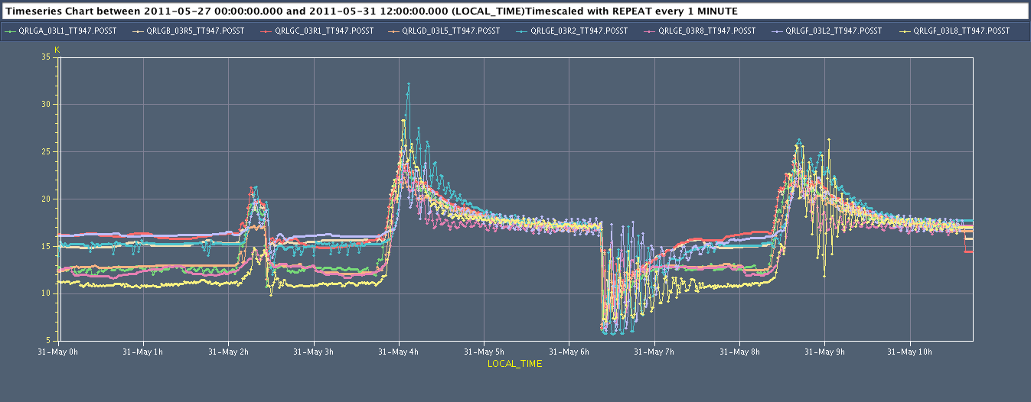
IT beam-screen temperatures
Triplet BS temperature tricky to stabilise at injection and in the ramp.
Fine tuning/manual intervention by cryo operators.
Effect no fully understood.
Injection
/ramp
3.5 TeV stable beams
dump
BS T (K)
25 K
17 K
Courtesy S. Claudet

Slide 47
UFO status
Very fast beam loss events (~ millisecond) in super-conducting regions of the LHC were THE surprise of 2010 – nicknamed UFOs (Unidentified Falling Object).
Beam dumps triggered by UFO events:
18 beams dumps in 2010,
11 beam dumps in 2011, last beam dump mid-July 2011.
All but one dump at 3.5 TeV.
Things are ‘calming down’ at 3.5 TeV, but the situation is worrying for future 7 TeV operation:
Extrapolation to 7 TeV predicts ~ 100 dumps / year.
Due to lower quench thresholds and larger deposited energy density.

Slide 48
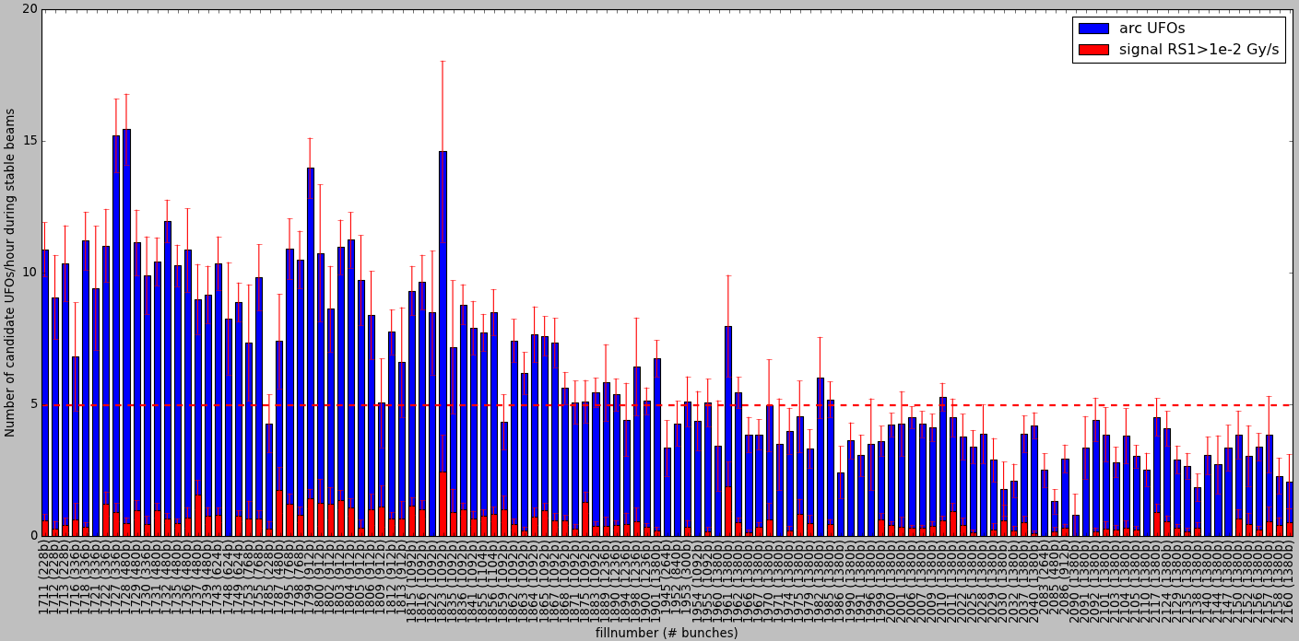
UFO rate in 2011
5827 candidate UFOs in cell 12 or larger during stable beams for fills longer than 1 hour.
Techical Stop
(09. – 13.05.2011)
Techical Stop
(04. – 08.07.2011)
Techical Stop
(29.08. – 02.09.2011)
Fill number
UFO Rate ~ slowly decreasing to ~ 3-4 / hour

Slide 49
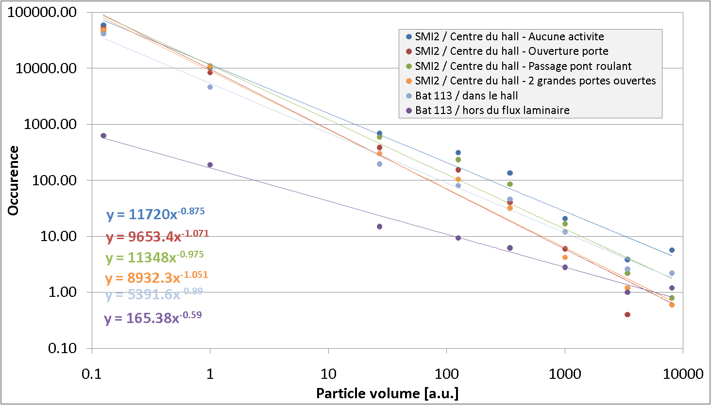
Dust particles
BLM loss distribution for 3670 arc UFOs
Most likely hypothesis for UFO: small ‘dust ‘ particle falling into the beam (1-100 μm).
UFO loss amplitude distribution is consisted with measured dust particle distributions in the assembly halls…

Slide 50
UFO distribution in ring
3.5 TeV 3686 candidate UFOs.
Signal RS05 > 2∙10⁻⁴ Gy/s.
Red: Signal RS01 > 1∙10⁻² Gy/s.
450 GeV 486 candidate UFOs.
Signal RS05 > 2∙10⁻⁴ Gy/s.
The UFOs are distributed around the machine. About 7% of all UFOs are around the injection kickers.
.
Mainly UFOs around injection kickers (MKI)
>> we are focusing on the understanding of UFO at the MKIs

Slide 51
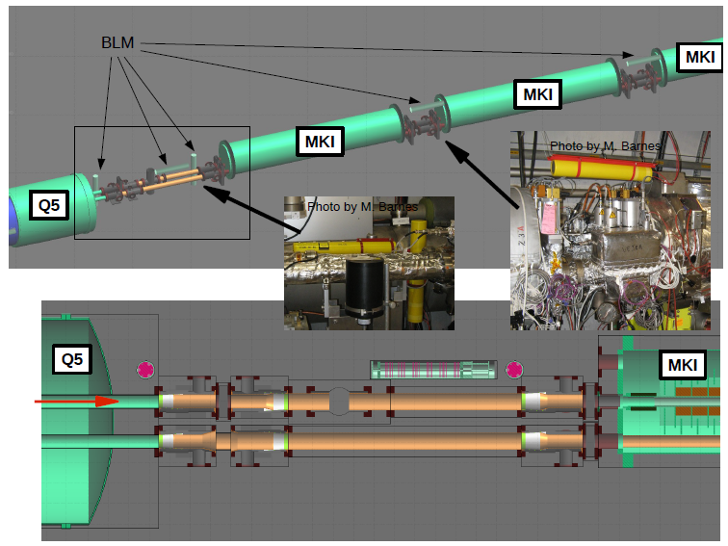
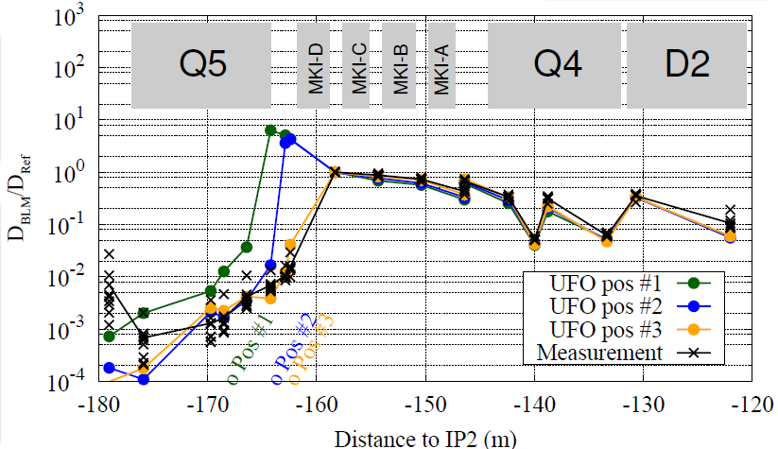
Studies of injection kicker UFOs
Detailed FLUKA model of the injection region to reproduce UFO losses and help localizing the source(s).
Spare MKI that was removed from the LHC last year will be opened for dust analysis.

Slide 52
The diode story
Quench propagation tests have been performed during the technical stops. Very positive outcome:
Quenches did not reach the joint at 3.5 TeV. Operation at 3.5 TeV is safer than had been estimated.
But there were some ‘worrying’ side results on the DIODEs:
Resistances of the diode leads are up to 15 times larger than measured during cold tests in SM18, and seem to strongly increase with the current.
The observed spread in the resistance of 12 diodes leads is very large (factor 20), much larger resistances are likely to be present in some of the other 4000 diode leads of the machine.
The results are irreproducible, and correct simulation is presently not possible due to the large number of unknowns.

Slide 53
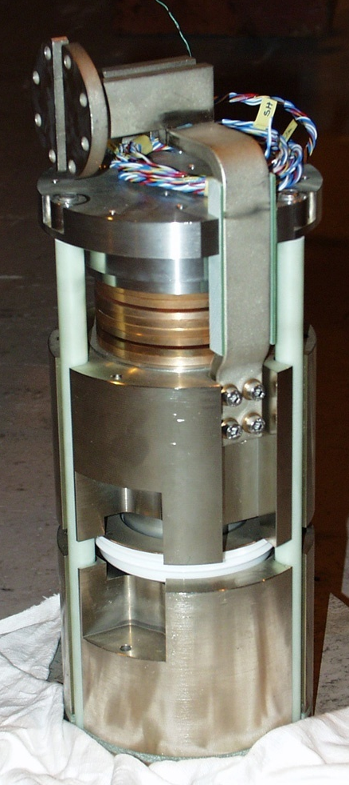
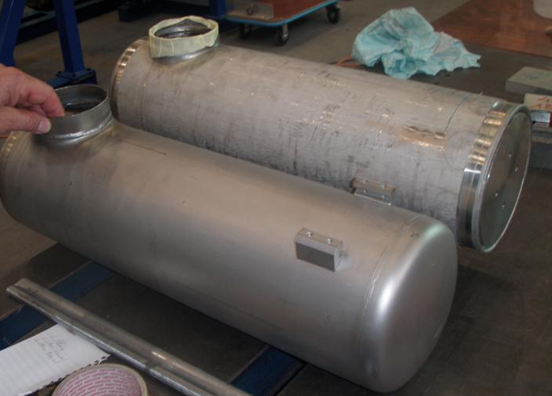
The diode
‘Half moon’ contact
Diode is used as current bypass in case of a quench
Lower diode busbar
Main busbars
Upper diode busbar
(partially flexible)
Upper
heat sink
‘Half moon’ contact
towards diode
Lower
heat sink
Diode box,
Helium contents : ∼5 l

Slide 54
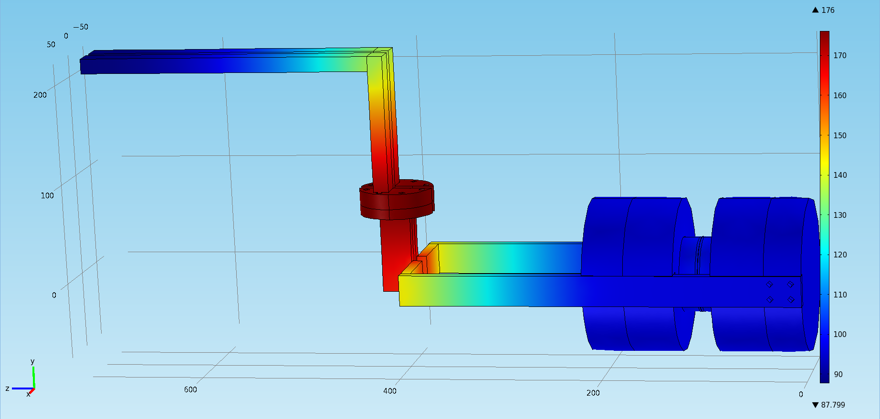
High current quench simulation
Comsol output for the final temperature after a 6 kA quench with R_{c,moon}=40 μΩ
(adiabatic conditions)
A. Verweij
90 K
180 K
95 K
If the anomalous resistance is located at the half-moon connection, there is a risk of melting down at 7 TeV

Slide 55
Diode studies
Cold test in SM18 on several diodes (2011).
Warm test of diodes (ongoing).
Tests in SM18 on magnet+diode (2012).
Proposal to warm up a short section and remove a diode from the machine.
The CSCM project for splice measurements (that is described next) could probe the resistances of all the installed diodes.

Slide 56
CSCM current cycle
T=20 K (DT to be defined)
H. Thiesen TE/EPC
I
Trip by mQPS
t_{plateau}
I_{plateau}
4-6 kA
Fast ramp down
if V>V_{thr}
Fast
Power
Abort
if V>V_{thr}
dI/dt
500 A/s
dV/dt to open
the diodes
500 A
H. Thiesen – 16 August 2011 – TE-TM
t1
t2
t
60 s
PC in voltage mode
PC in current mode

Slide 57
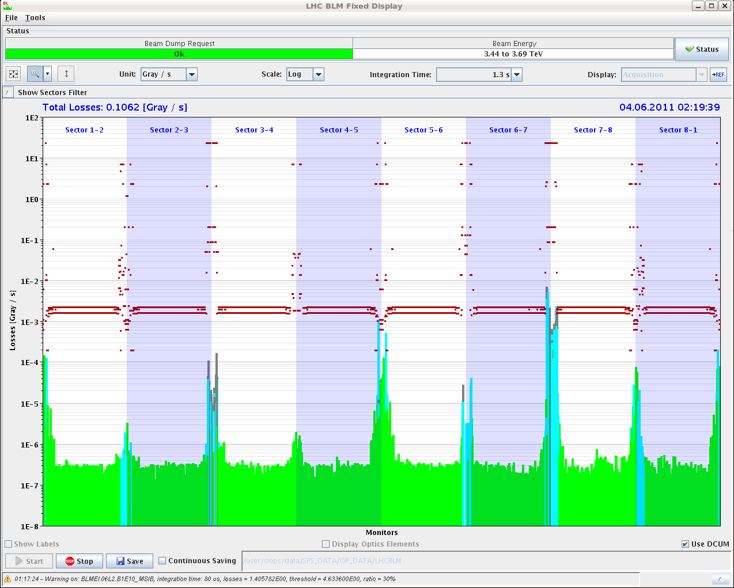
Radiation induced problems
With the increasing luminosity tunnel electronics starts to suffer from the (expected) SEE (Single Event Errors).
In particular the quench protection ad cryogenics systems.
Collisions points
Collimators
Loss rate
S

Slide 58
Ion beams
The Pb ion beam details are still under discussion.
Most likely scenario:
Bunch spacing of 200 ns (nominal = 100 ns – also possible).
358 bunches (24 per injection), ~350 colliding pairs per experiment.
Intensity ~1.2x10⁸ ions / bunch.
β* = 1 m in ATLAS, CMS and ALICE (if aperture OK !).
ATLAS & CMS standard crossing angles (120 μrad).
 | 2010 | 2011
Spacing (ns) | 500 | 200
Colliding pairs (ATLAS) | 131 | 356
β* (m) | 3.5 | 1
Luminosity (cm⁻²s⁻¹) | 3x10²⁵ | ~3x10²⁶

Slide 59
P-ion test
Issue with mixed p-ion mode is the difference in revolution frequencies at injection (4.5 kHz). At 3.5 TeV the frequencies can be forced to be equal (differences very small, few 10’s Hz).
The beams slip one wrt the other: locations of (parasitic) collisions move longitudinally. Possible source of poor lifetime.
At 3.5 TeV, the frequencies are locked together and the beams must be cogged longitudinally to collide at the right place.
An injection test of protons into ring 1 and Pb into ring 2 is foreseen during the next MD (before the ion run).
Then – depending on the ‘smoothness’ – tests of:
Ramp and cogging at 3.5 TeV.
Test of very low intensity collisions – but unlikely to provide stable beams conditions (time constraints).

Slide 60
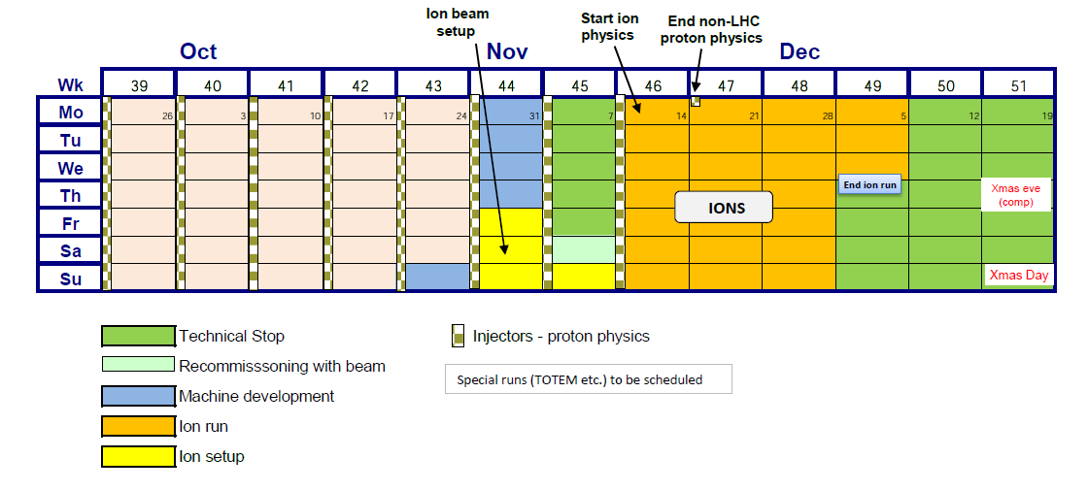
Ion run schedule
Success oriented planning given that the p-ion test is taking place more or less at the same time.
Duration of p-ion not well defined…
We should be able to reach 50-80 μb⁻¹ (2010 : 8 μb⁻¹)
p-ion test (tentative)

