Slide 1
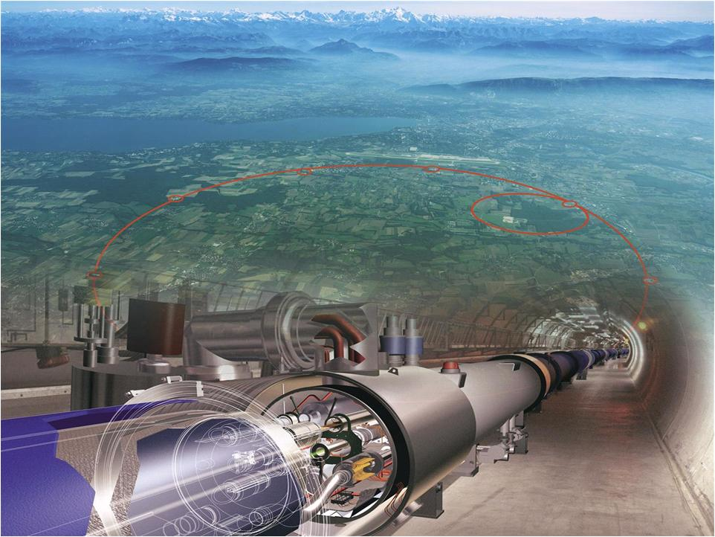
The Large Hadron Collider and the Higgs
  IPAC12 Teacher‘s day
  24. Mai 2012
  Jorg Wenninger

Slide 2
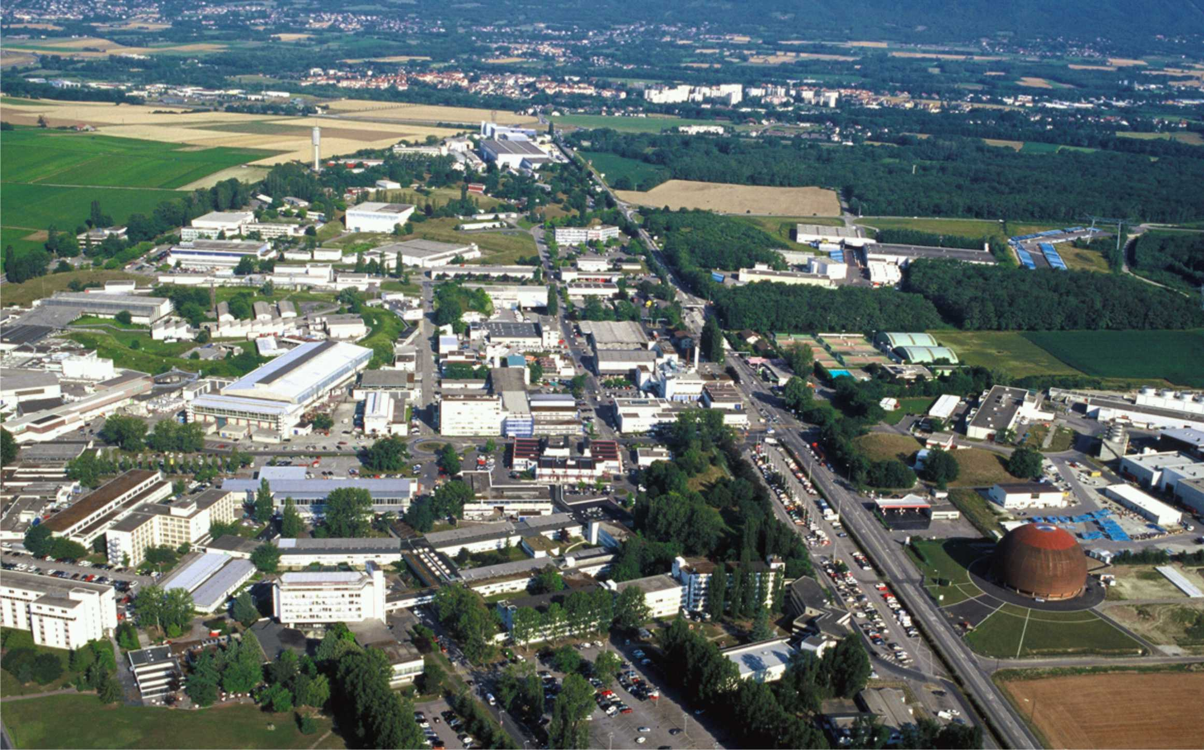


CERN
Founded in 1954 by 12 countries
Today: 20 member states
About 10’000 users from all over the world
Annual budget: approximately 1 Billion US $
2400 permanent staff – 1000 fellows/students

Slide 3
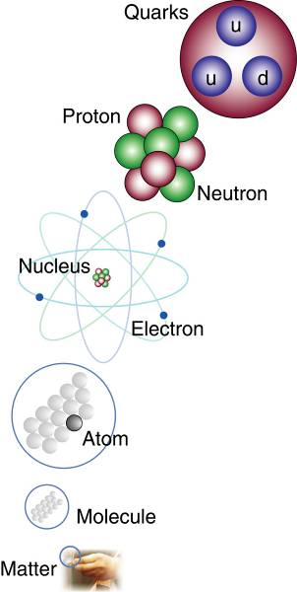
Research at CERN
The central research mission of CERN is the study of elementary particles and of their interactions.
We are all made of particles!

Slide 4
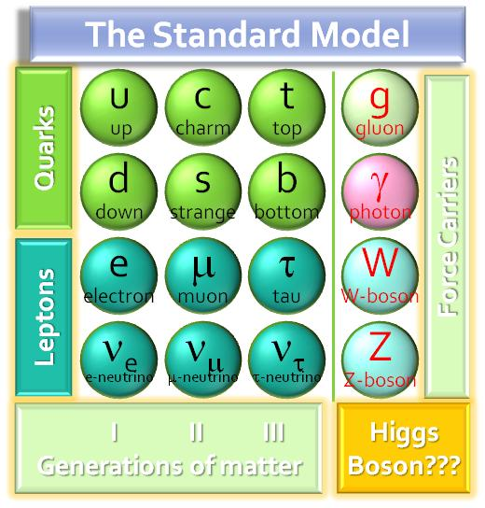
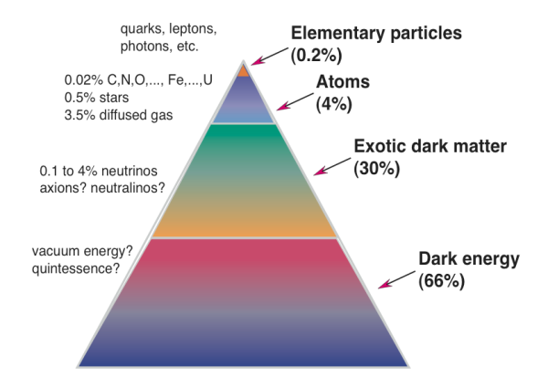
Open Questions in Particle Physics
Why so many particles?
Why so many forces?
What is the origin of mass?
Why do tiny particles weigh the amount they do?
Why do some particles have no mass at all?
What is 96% of the universe made of?
What is Dark Matter? Dark Energy?
Why is there no more antimatter?
Where does gravity fit in?
LHC
will possibly
give some
answers

Slide 5
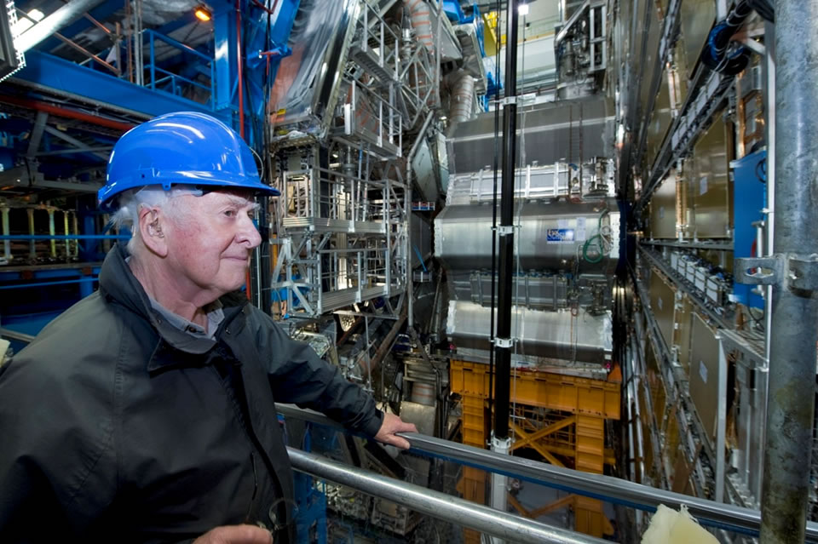
Higgs
Back in the 1950’s and 1960’s, particle theorists had problems to build theories with the correct interactions that would at the same time allow particles to have … a mass.
A serious problem !
In 1964 P. Higgs proposed a mechanism to solve this ‘problem’. This required the existence of a new particle, the Higgs (boson), which is ‘giving’ mass to particles.
Particle physicists are still hunting it - there is no prediction concerning the mass of the Higgs itself !
P. Higgs visiting the ATLAS detector

Slide 6
CERN’s most Famous Invention
Where the WEB was invented in 1989
to meet the communication needs of particle physicists!
http://public.web.cern.ch/public/
http://...

Slide 7

The Large Hadron Collider
The Large Hadron Collider (LHC) is the most powerful instrument ever built to investigate the structure of matter (particle properties) and forces.
Four gigantic underground caverns to host huge detectors
The highest energy of any accelerator in the world
The highest collision rate of particles
Tunnel of 27 km circumference 100 m underground

Slide 8


Slide 9
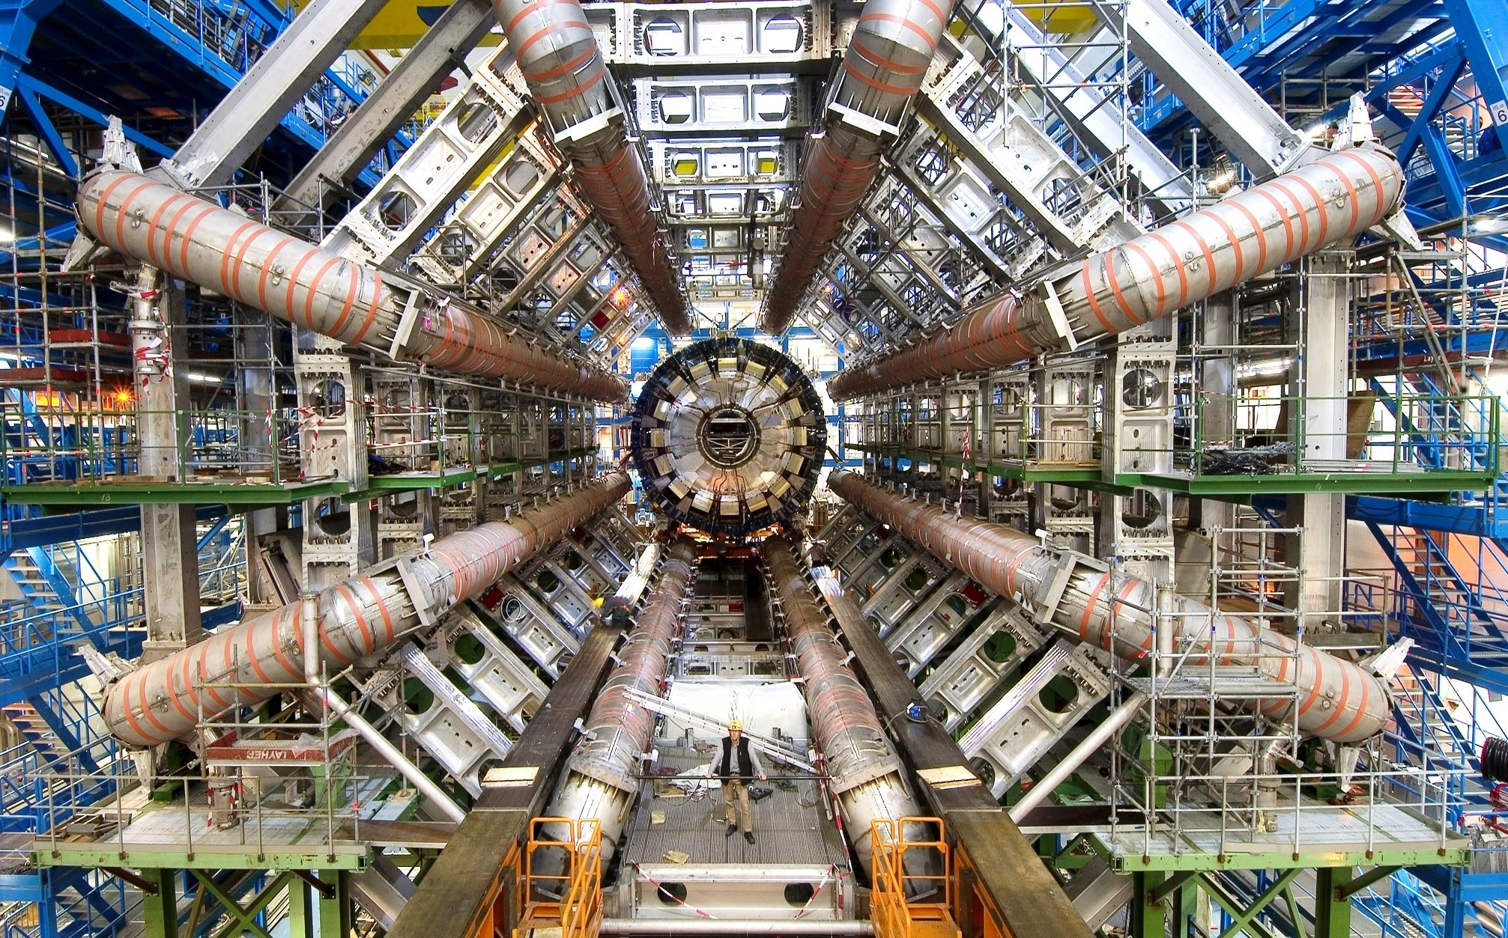

ATLAS
Notes:
Size of ATLAS 46 m long, 25m wide, 25m high.

Slide 10
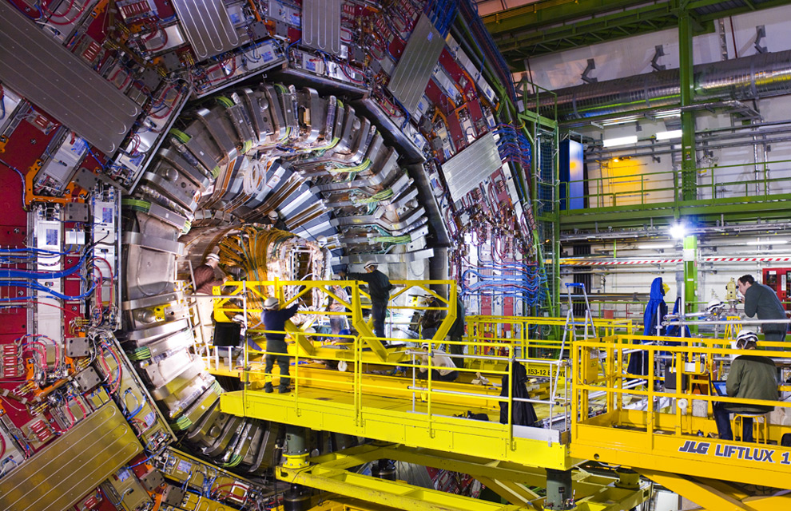

CMS

Slide 11
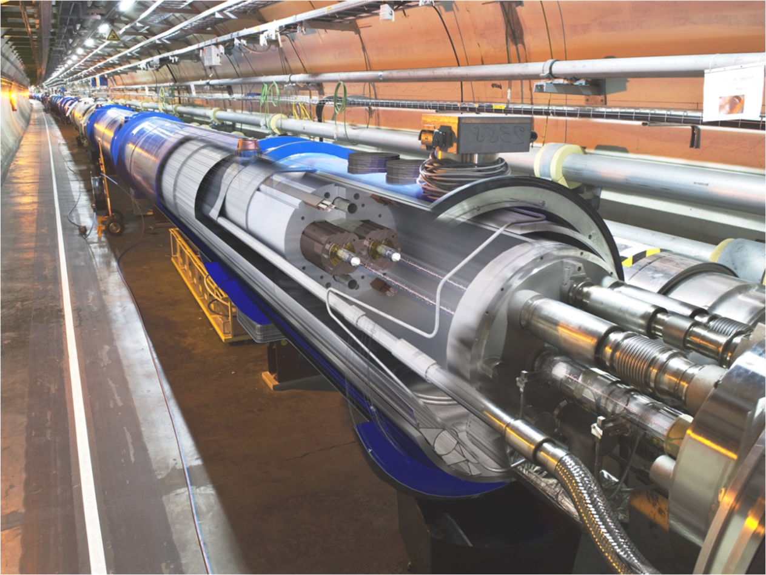
The LHC Accelerator
The LHC accelerates protons to unprecedented energy of 7 TeV (v = 99.9999991% of speed of light). But we presently operate at 4 TeV.
Super-conducting magnets must be used to bend the particles around the ring.
Since super-conductivity appears only a low temperatures, the entire accelerator must be cooled.
The LHC operates at a temperature (-271.2ºC, -456.2ºF, 1.9ºK) colder than outer space 2.7ºK.

Slide 12
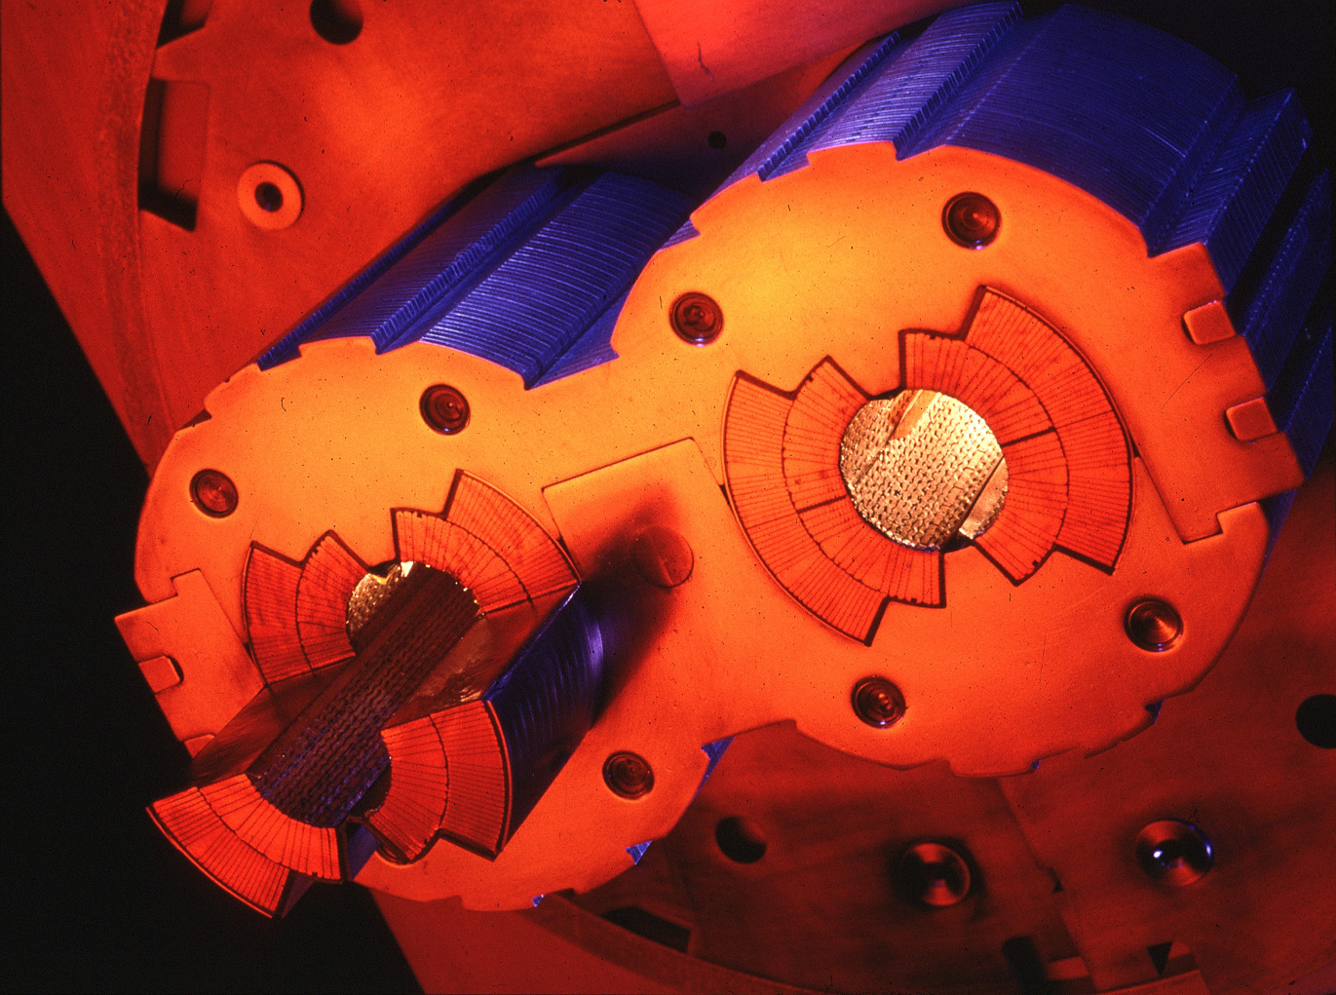
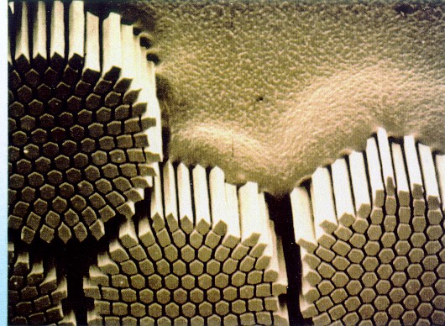
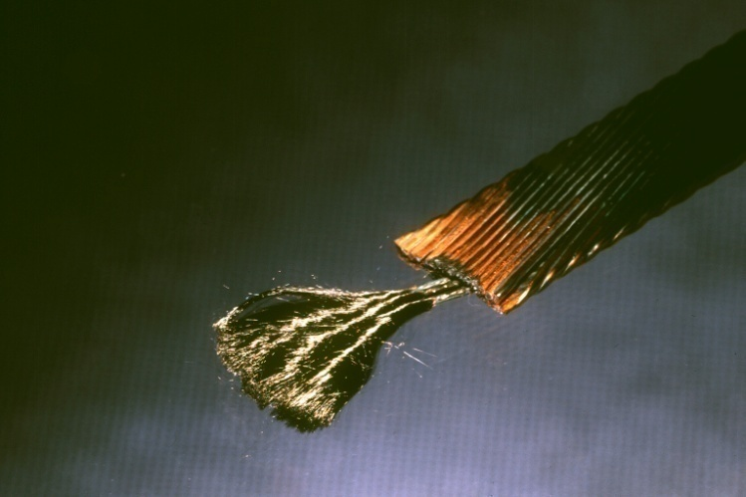
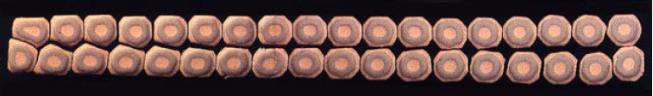
Super-conducting Magnets
A mixture of Niobium and Titanium is used as superconductor for the LHC.
The magnetic field reaches 8.3 Tesla, 4 times higher that in an iron magnet.
At 1.9 K the superconductor has no electric resistance – energy consumption only to cool the magnets.

Slide 13
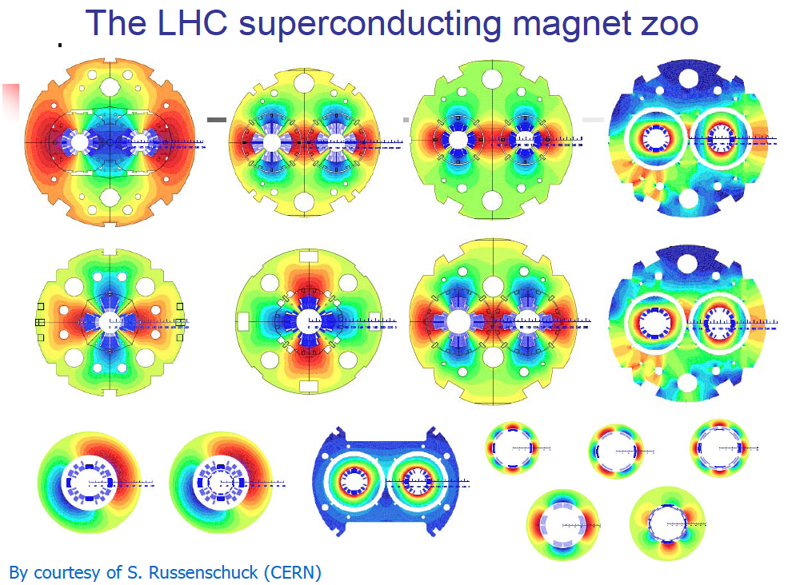

Slide 14
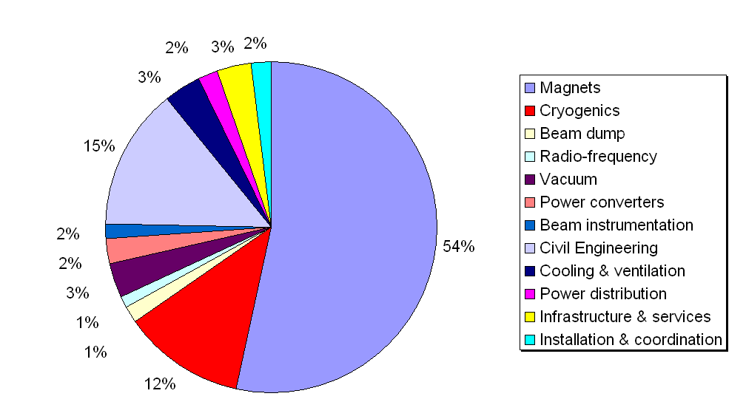
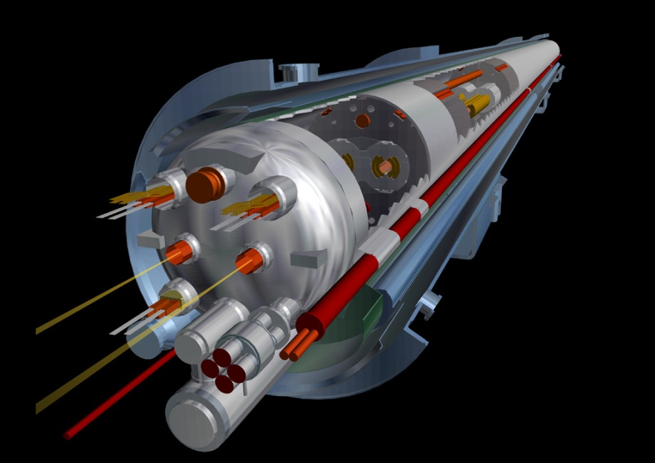
Costs
LHC accelerator: around 2.5 billion US $ (material+external work)
Manpower + detectors: 5-6 billion US $
Magnet+cryogenics = 66%

Slide 15

The Beams
The LHC operates with 2 beams of particles that travel in opposite directions.
  Either protons or heavy nuclei (for the moment we have Lead) – ‘hadrons’.
Within the LHC the protons are grouped in small packets called ‘bunches’. Presently there are 1380 bunches at a typical distance of 15 m / 49 ft.
Each bunch:
  is 40 cm / 16 inch long,
  contains up to 140 billion protons,
  has its width squeezed to the size of a human hair (75 micrometers) at the points where it collides with other bunches inside the experiments.

Slide 16
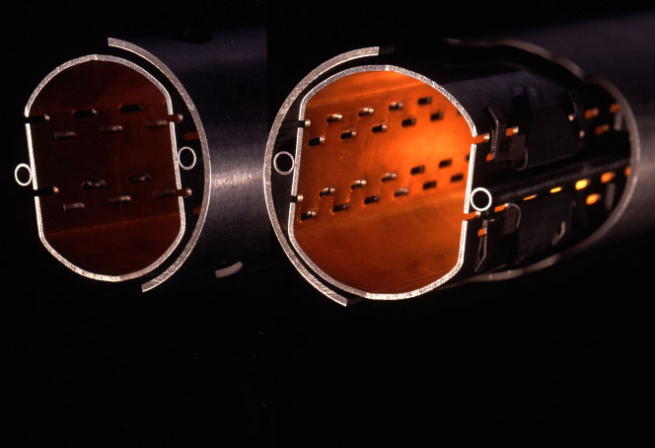
A Cold and Dark Place
The protons travel inside a vacuum chamber (to avoid collisions with the gas !) at a pressure around 10⁻¹³ atmosphere – lower than the pressure on the Moon.

Slide 17
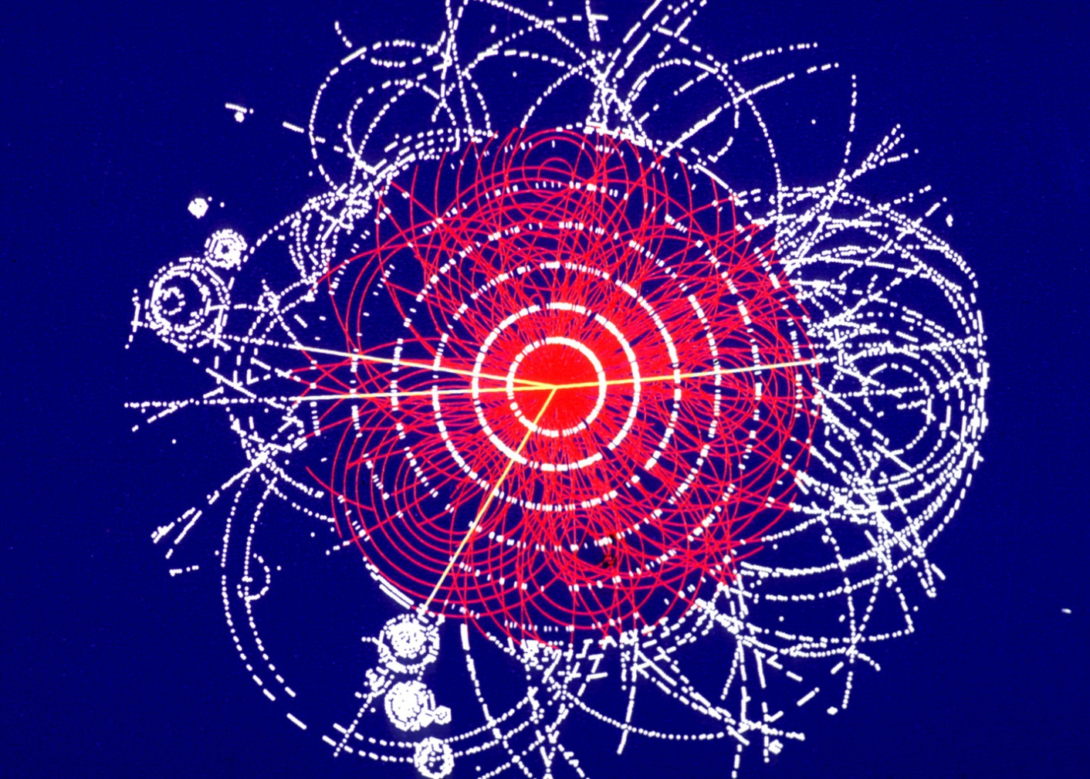
The quest for the Higgs Boson
The energy of the protons in the LHC is about 100 million times the energy of the electrons in your old cathodic TV tube (do you still have one?).
The 2 proton beams produce presently 400 million collisions per second in each experiment.
The experiments have to filter out (trigger) the interesting collisions. They can only process a few hundred collisions per second !
We expect only 1 Higgs in
1,000,000,000,000 Collisions

Slide 18

Where is the Vacuum Chamber?

Slide 19
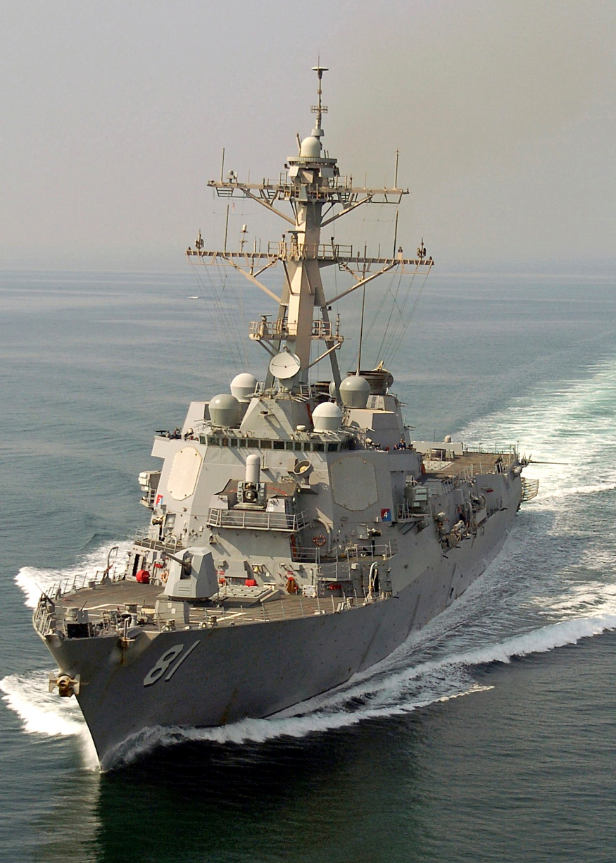
Small Particles, Lot’s of Energy
Each LHC beam weights only … 0.3x10⁻⁹ g !
But the energy stored in each beam can be as large as the kinetic energy of US Navy destroyer USS Winston S. Churchill launched at 15 mph!
Presently we operate at modest 7 mph…

Slide 20

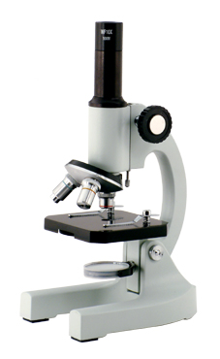

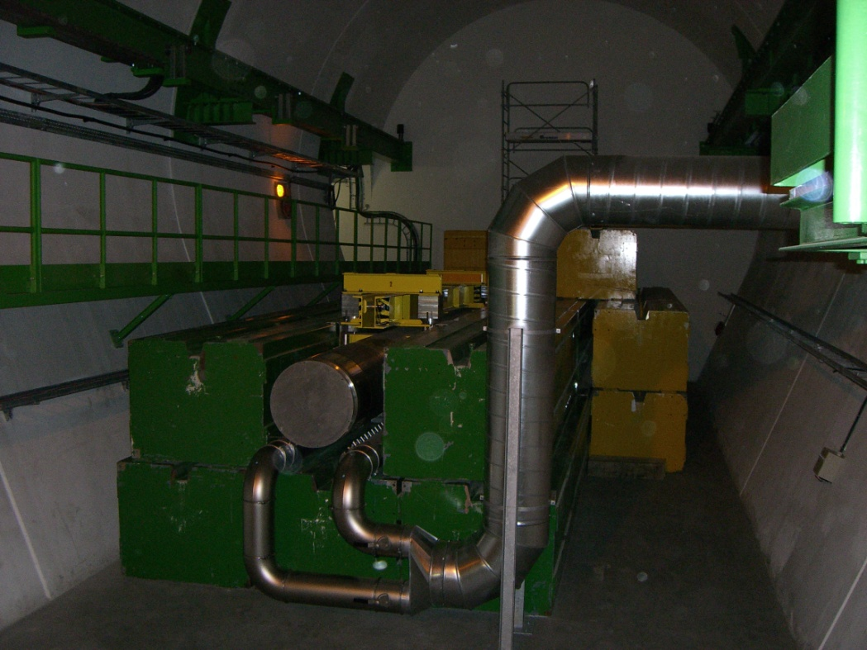
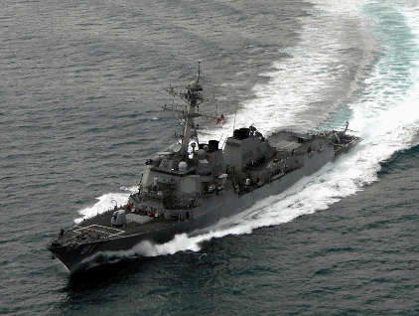

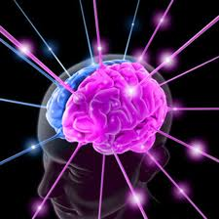
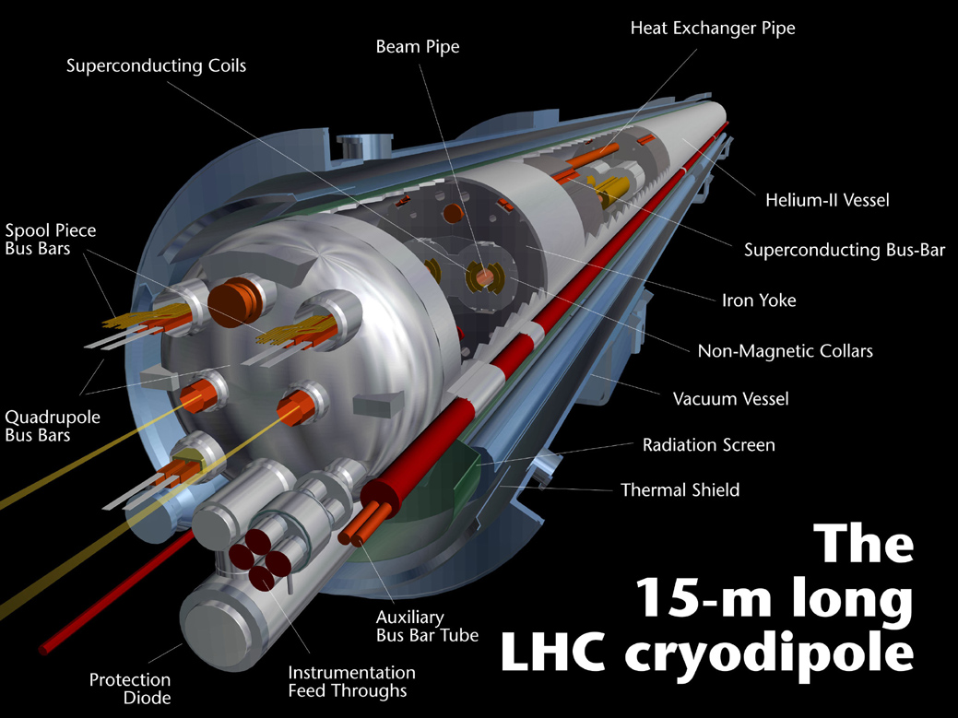

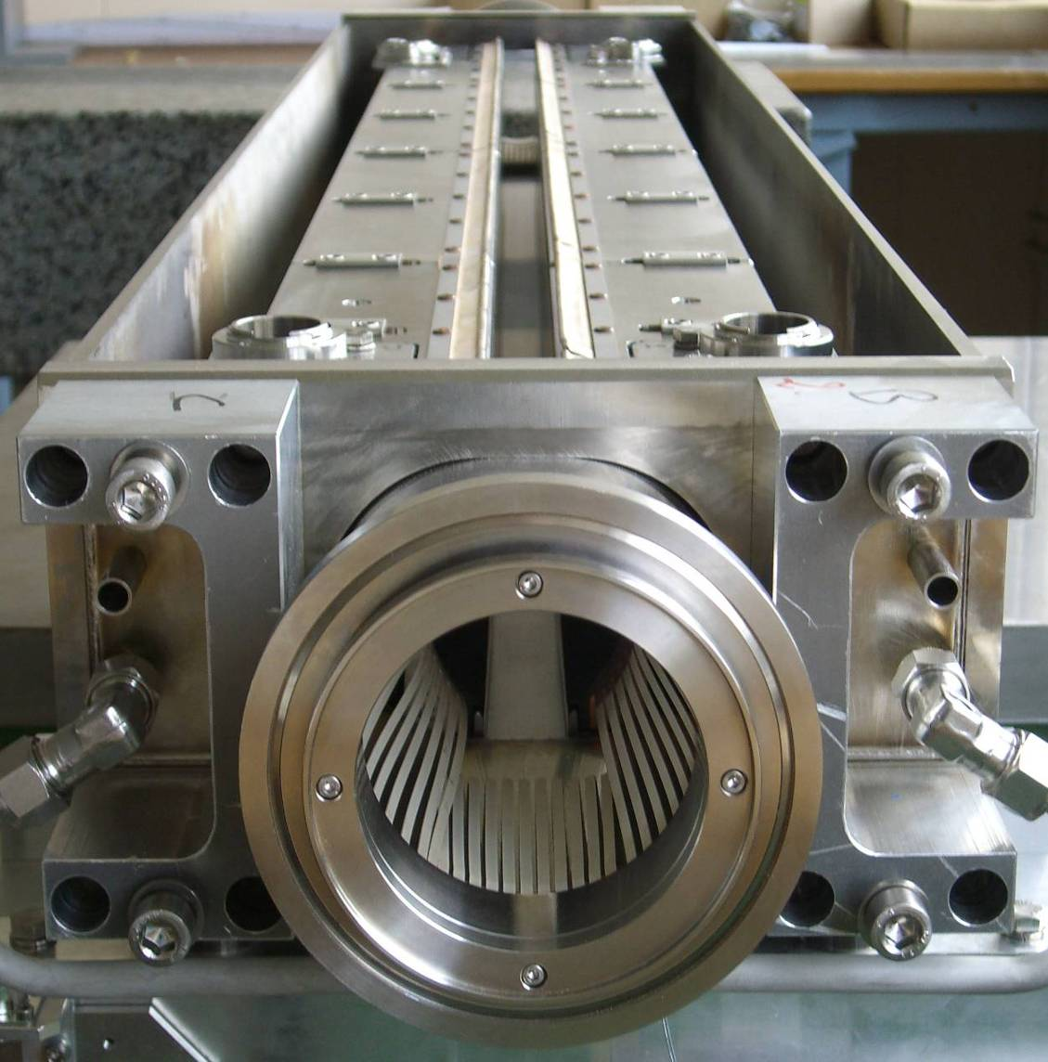
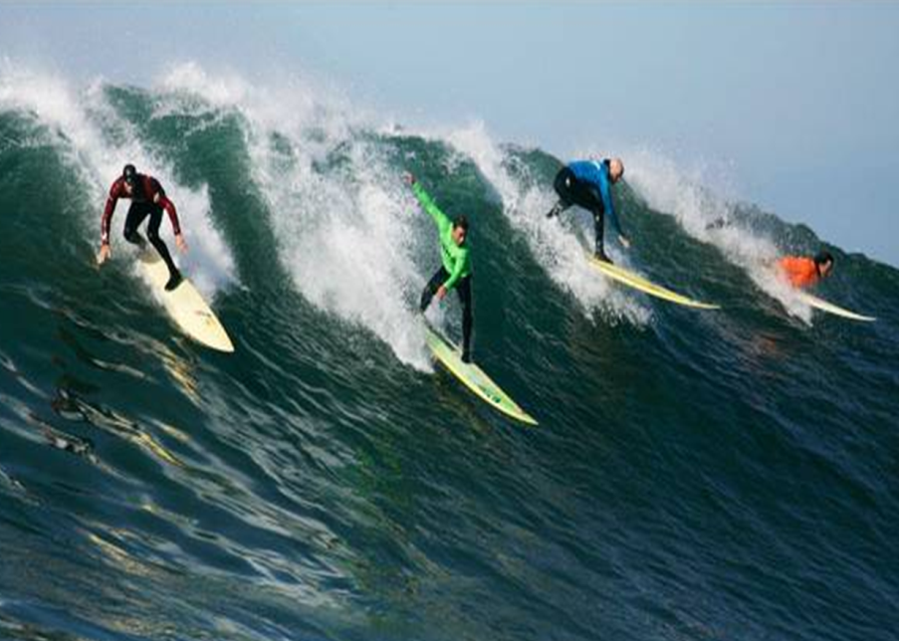
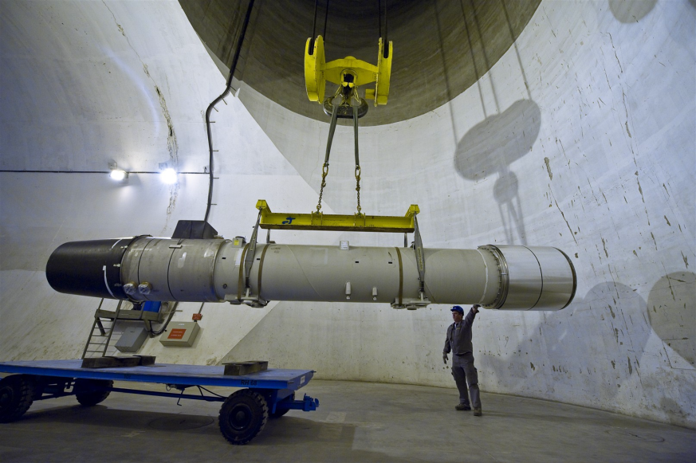
Accelerator for Pedestrians
Quadrupole-
magnet
Quadrupole-
magnet
Beam dump
Dipolemagnet
RF Cavity
Dipolemagnet
Experiment
Collimator
Injection
LHC Dipolemagnet
Collimator
LHC Quadrupolemagnet
RF Cavity
Collimator
Collimator
1.2 m
Dipolemagnet
Collimator
Dipolemagnet
Collimator
Collimator
Quadrupole-
magnet
Quadrupole-
magnet
Beam dump
Beam dump
Opening
A control system to produce the highest number of collisions in the safest way…
Beam
courtesy of
M. Pojer

Slide 21
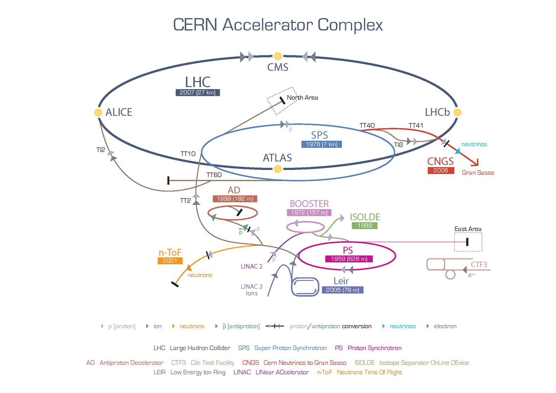
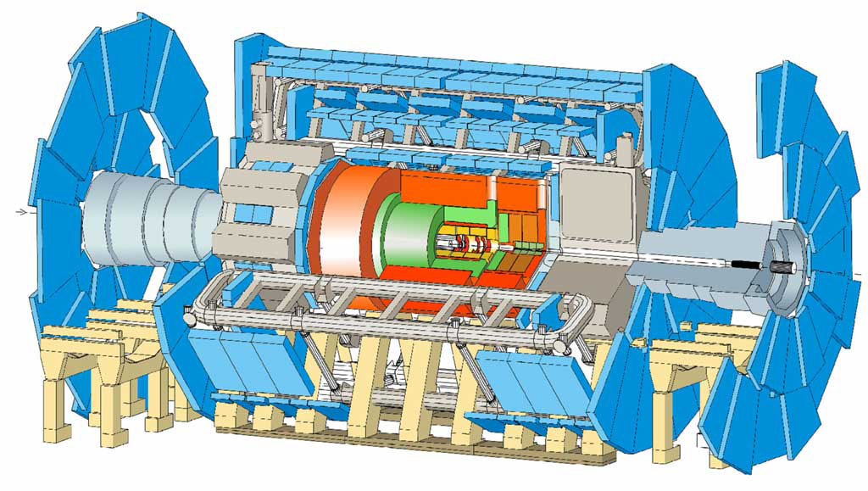
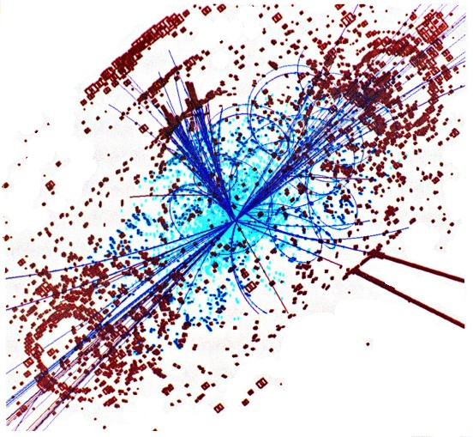
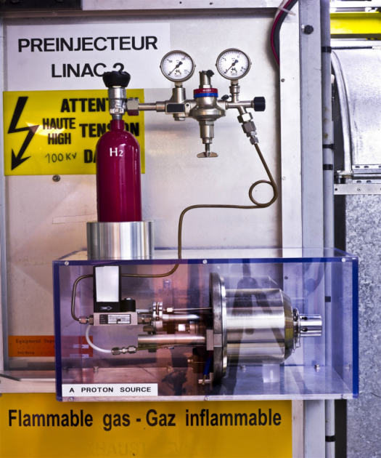
CERN Accelerator Complex
courtesy of
M. Pojer

Slide 22
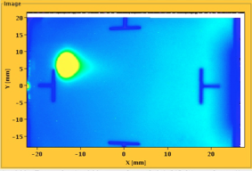


LHC Timeline
August 2008
First Injection tests
September, 10 2008
Both beams circulating
2008
2009
2010
2011
September, 19 2008
Incident
Accidental release of 600 MJ stored in one sector of LHC dipole magnets

Slide 23

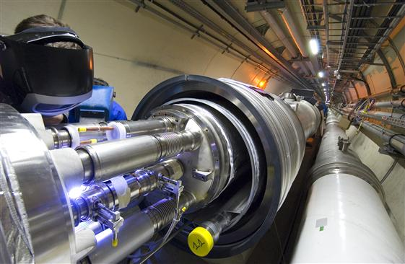
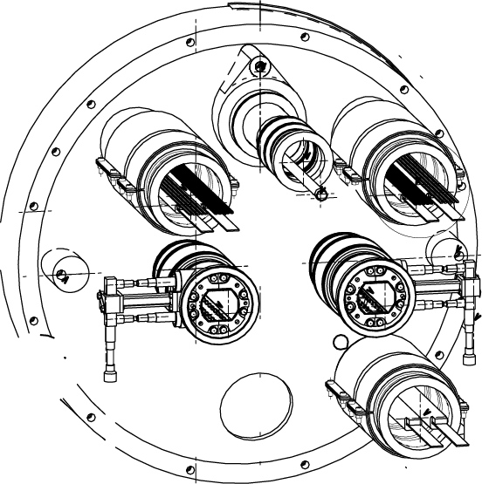
Incident September 19th
Quadrupole-dipole interconnection (27R3)
Vacuum chamber
Superconducting cable
interconnection

Slide 24
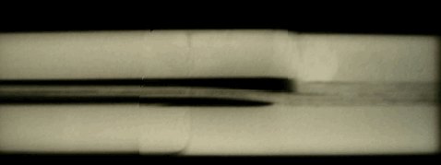
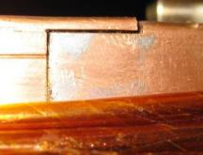
Interconnection Problems
Bad joint
Solder
No Solder
wedge
bus
bus
U-profile
bus

Slide 25
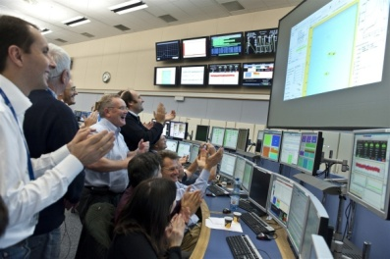
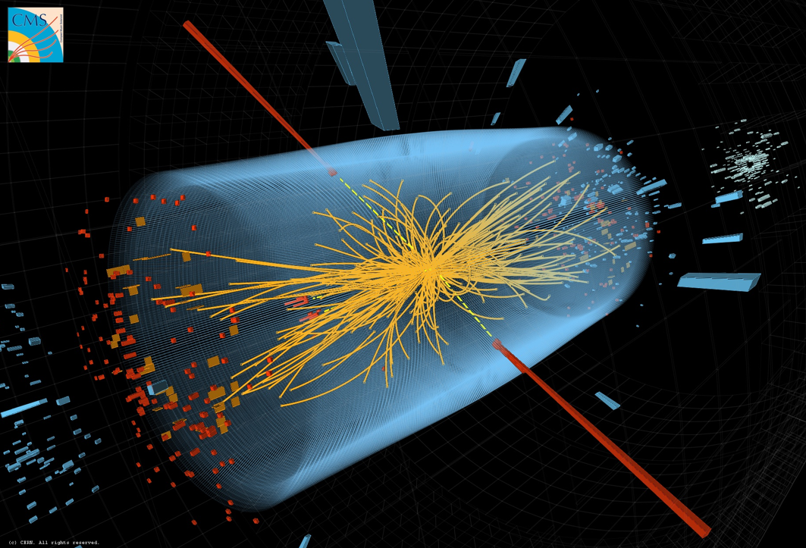
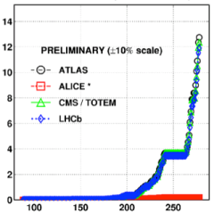
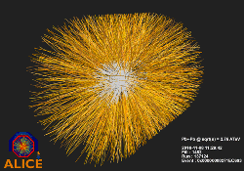
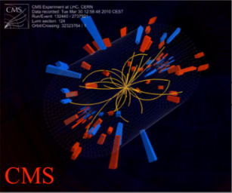
LHC Timeline
August 2008
First Injection tests
November 29, 2009
Beams back
November, 2011
Higgs candidates
June, 28 2011
1380 bunches
October 14, 2010
248 bunches
September, 10 2008
Both beams circulating
1380
2008
2009
2010
2011
March 30, 2010
First collisions at 3.5 TeV
September, 19 2008
Incident
Accidental release of 600 MJ stored in one sector of LHC dipole magnets
November 2010
Ion run

Slide 26
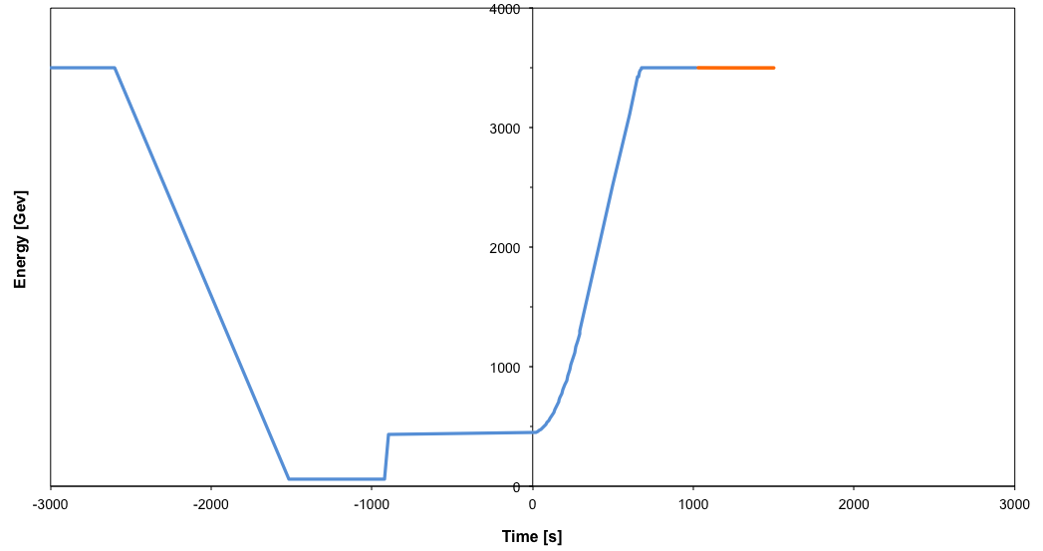
Nominal Cycle
Fastest turn around: 2h7m in 2011.
Beam dump
Squeeze
Stable beams
Collide
Ramp down | 35 mins
Injection | ~30 mins
Ramp | 12 mins
Squeeze | 15 mins
Collide | 2 mins
Stable beams | 0 – 30 hours
Ramp
Ramp down/precycle
Injection

Slide 27
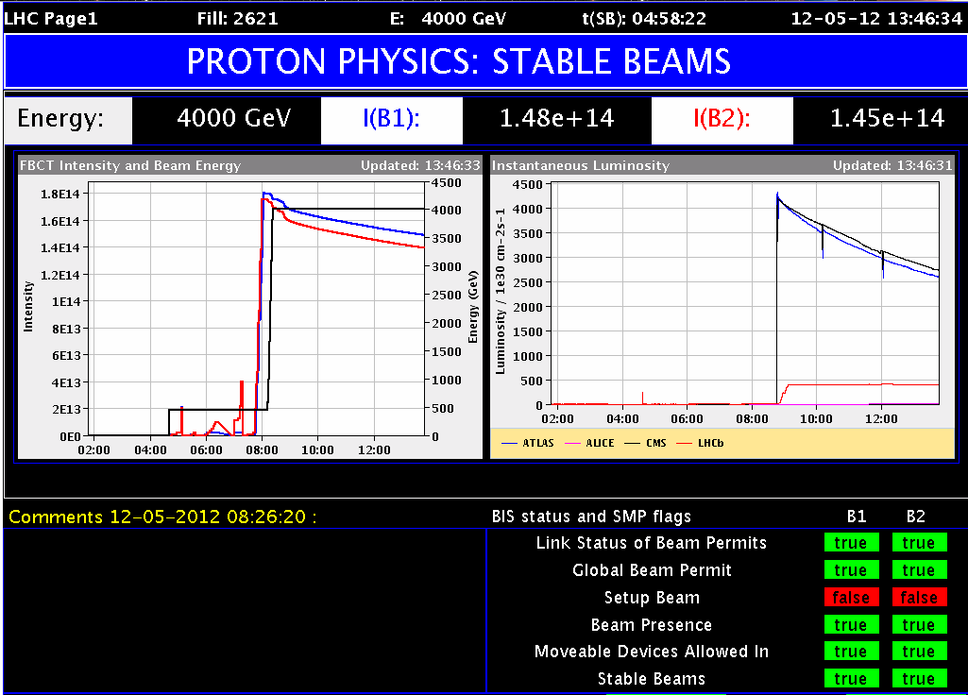
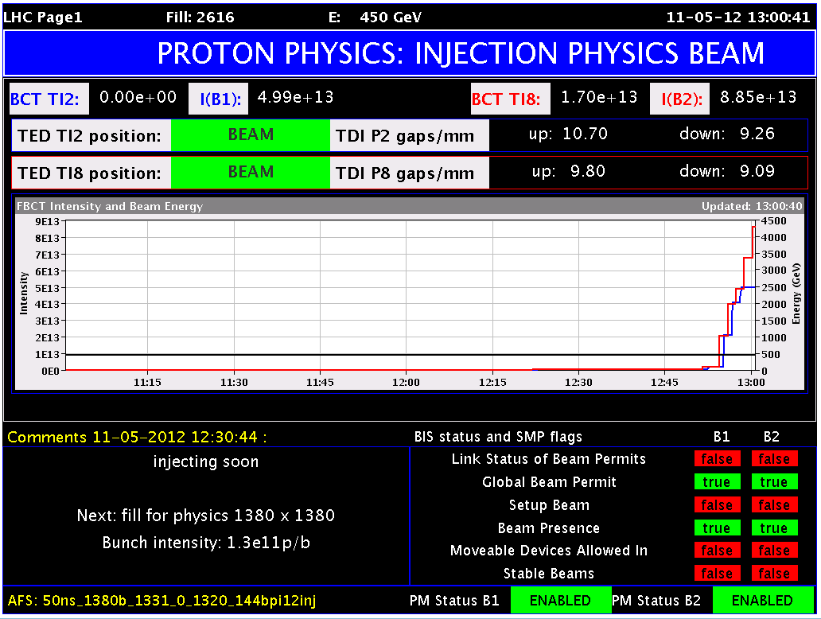
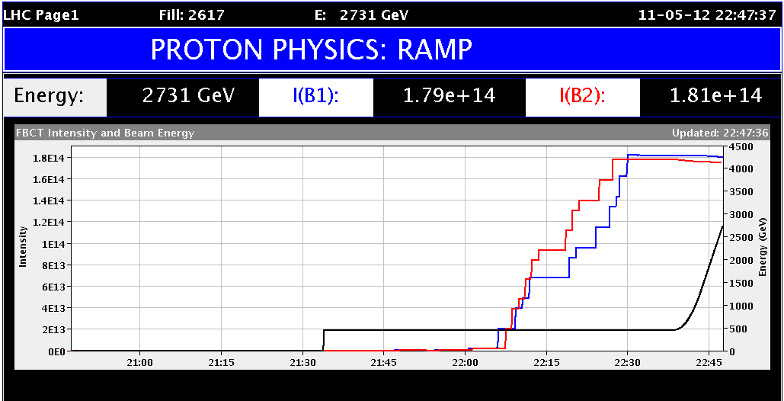
Follow us live @
http://op-webtools.web.cern.ch/op-webtools/vistar/vistars.php?usr=LHC1

Slide 28
What about the Higgs ?
As mentioned before, we expect about 1 Higgs particle for every 1000 billion collisions… This would mean 1 Higgs every few hours in ATLAS and in CMS.
But this is not the end of the story. The Higgs particle decays immediately, and it’s the decay products that are recorded in the detectors of the experiments.
Unfortunately many totally un-interesting processes can mimic a Higgs particle, the experiments have to develop selection algorithms that fish out the really ‘clean’ collisions.
But after selection, there are not many candidate collisions left… So the experimenters must be patient or ask the colleagues from the LHC machine (like me) to deliver more and more beams…

Slide 29
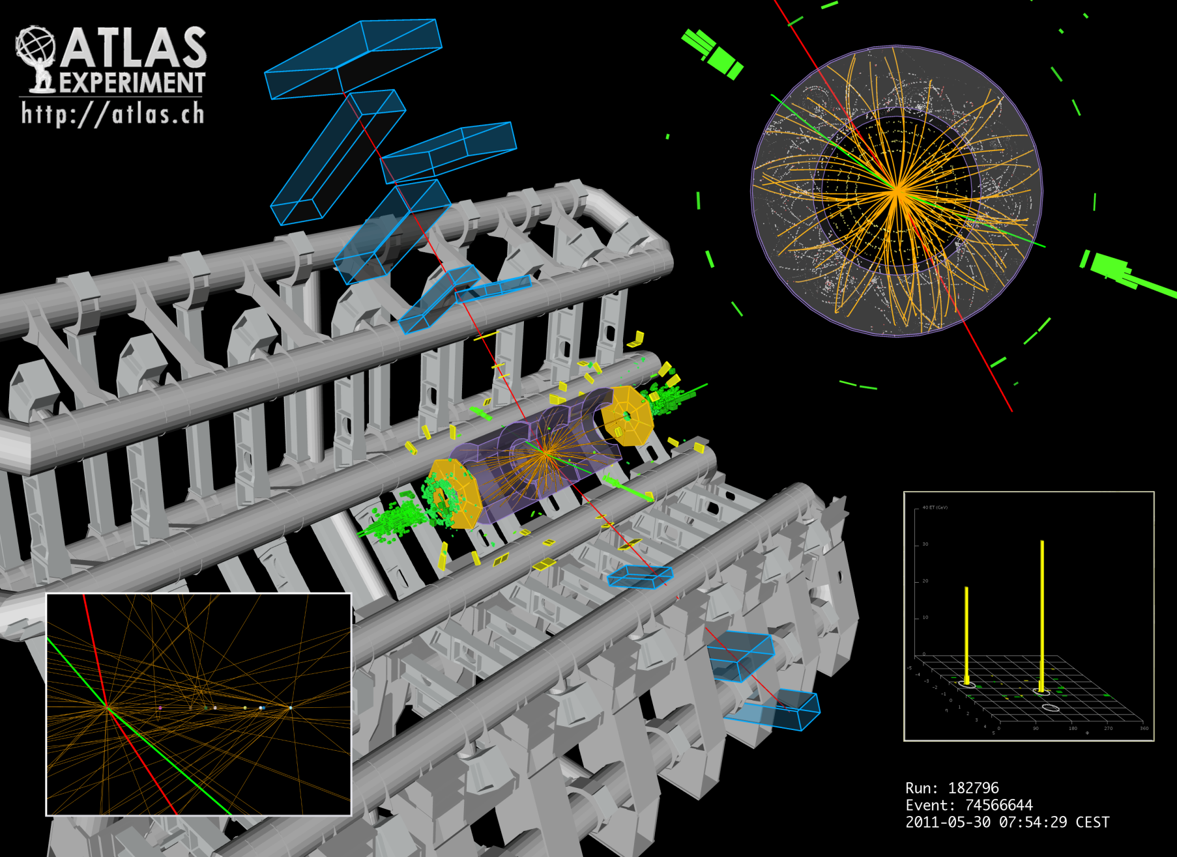
A Higgs Candidate
H --> e⁺e⁻μ⁺μ⁻
Courtesy ATLAS/F. Gianotti

Slide 30
And another One…
H --> γγ
Courtesy CMS/G. Tonelli

Slide 31

The next Event
Presently there is no certainty – a Higgs approx 125 heavier than a proton may or may not exist. More collisions must be collected by the experiments this year to confirm.
The 4th July is also an important date for particle physics – new results are expected including events collected on 2012.

Slide 32
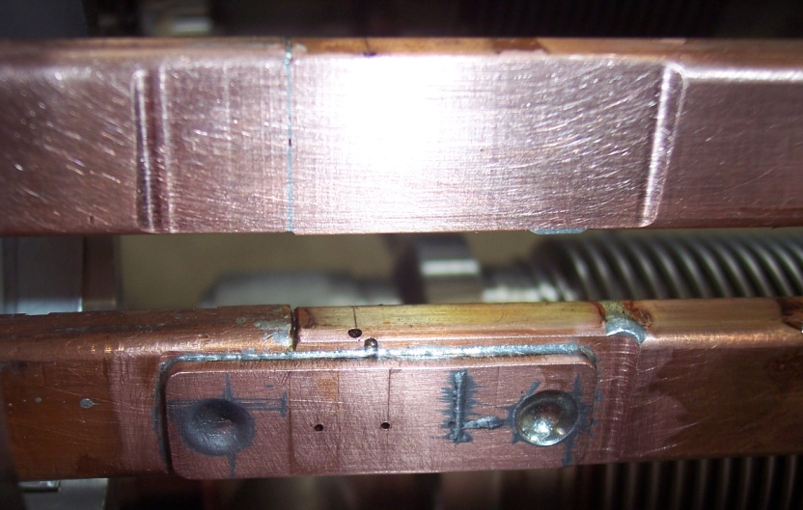
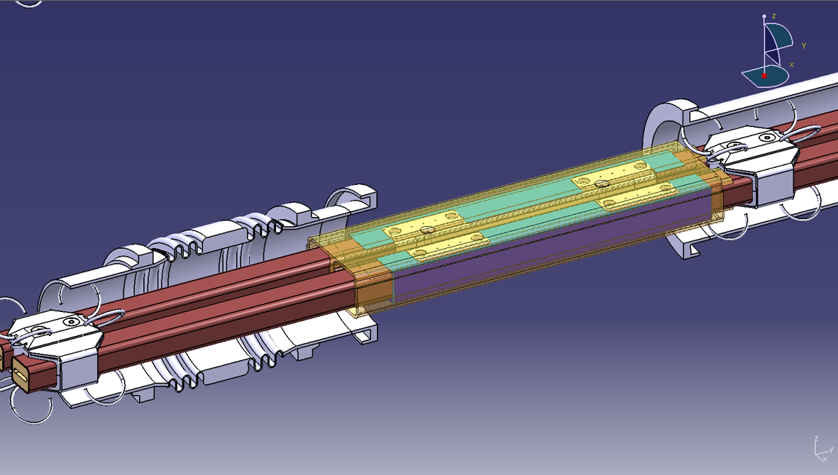
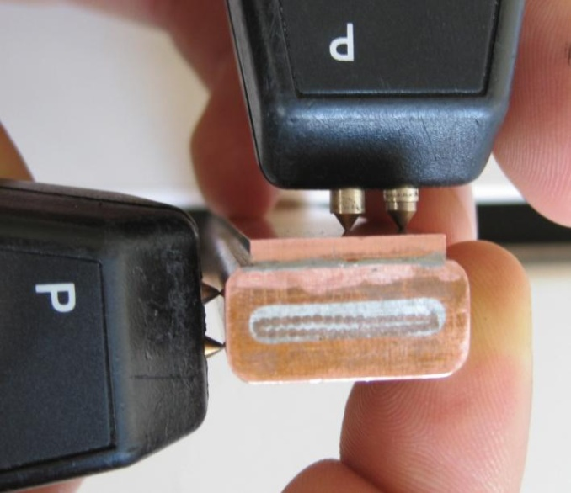
The next Years @ LHC
Since the accident of September 2008 the LHC has been operated at ½ its nominal energy.
In November 2012 the LHC will be stopped for approximately 1 ½ years to perform a complete repair of the defect soldering.
Towards the end of the Summer of 2014 the LHC will come back online at its full energy for the next adventure of particle physics.

Slide 33
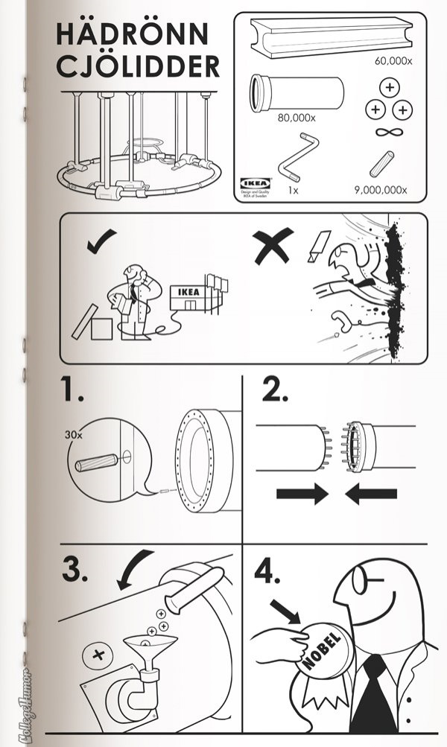
Thank you for
your attention!
Jorg Wenninger
CERN BE/OP
Jorg.Wenninger@cern.ch
Office: +41 22 76 75379

Slide 34
Backup slides

Slide 35


Accelerator concept
In principle, in an accelerator charged particles are accelerated, guided and confined by electromagnetic fields and four are the fundamentals elements:
  Dipole magnets (bending)
  Quadrupole magnets (focusing)
  RF cavities (accelerating)
  The experiments
In reality, there is much more…
MQT trim quadrupole
MQS skew trim quadrupole
MO lattice octupole
MSCB sextupole (skew sextupole) + orbit corrector
MCS spool piece sextupole
MCDO spool piece octupole + decapole

Slide 36





Bending
→
→
→
→
Centripetal Force
Lorentz force
ρ
Magnetic rigidity
LHC: ρ = 2.8 km fixed by LEP tunnel!
B field
LHC:
B = 8.33 T ⇒ E = 7 TeV
p
F force
B
p
F

Slide 37



Focusing
N
S
F_{y}
B_{y}
F_{x}
S
N
Transverse focusing is achieved with quadrupole magnets, which act on the beam like an optical lens.
Linear increase of the magnetic field along the axes (no effect on particles on axis).
Focusing in one plane, de-focusing in the other!
x
y

Slide 38


LHCb

Slide 39


ALICE

Slide 40

Ferromagnetic iron
Non-magnetic collars
Superconducting coil
Beam tube
Steel cylinder for Helium
Insulation vacuum
Vacuum tank
Supports
Weight (magnet + cryostat) ~ 30 tons, length 15 m
Rüdiger Schmidt
40

Slide 41




TOTEM and LHCf

Slide 42

Interconnections
24.000 sc cable joints
10.000 between magnets

Slide 43

LHC Repairs in Detail
14 quadrupole magnets replaced
39 dipole magnets replaced
204 electrical inter-connections repaired
Over 4km of vacuum beam tube cleaned
New longitudinal restraining system for 50 quadrupoles
Almost 900 new helium pressure release ports
6500 new detectors and 250km cables for new Quench Protection System

Slide 44

LHC Page 1
Energy
Fill number
Machine mode
Beam mode
Beams intensity
Luminosity in the 4 exp.
Beam intensities over time
Post-mortem enabled in case of dump
Reduced intensity for setup

Slide 45







Operating the Machine
Filling
Beams dumped
Beams in collision
Ramp
down
Squeezing the
beam sizes
Pre-injection
flat bottom
Ramp up
Injection
STABLE BEAMS

