Slide 1
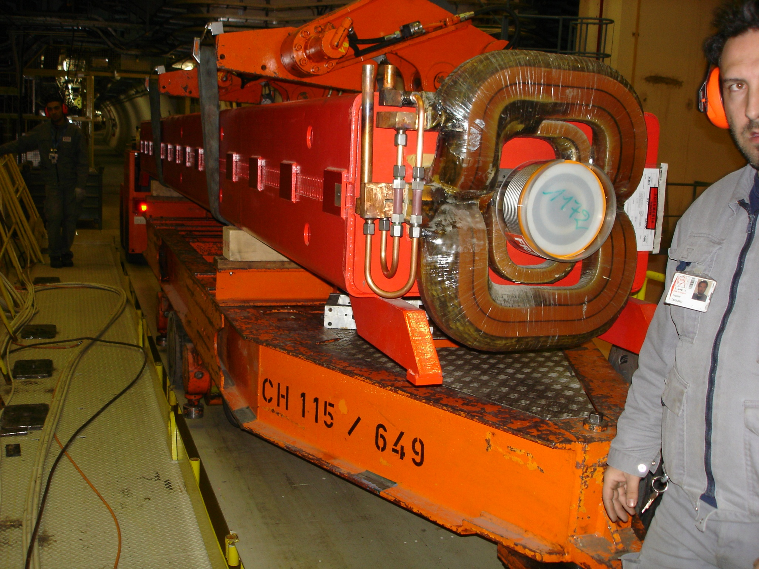
MTTR & Spare Policy for the LHC Injectors & Exp. Areas
MAGNETS
FOR
SPS & BEAM LINES

Slide 2
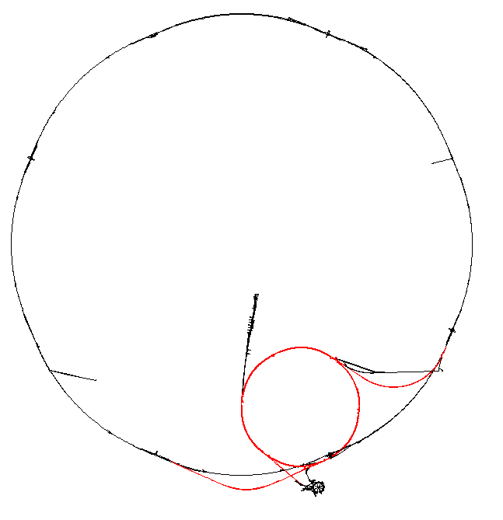
MTTR & Spare Policy for the LHC Injectors & Exp. Areas
SPS & BEAM LINE
MAGNET SYSTEMS
For the LHC

Slide 3
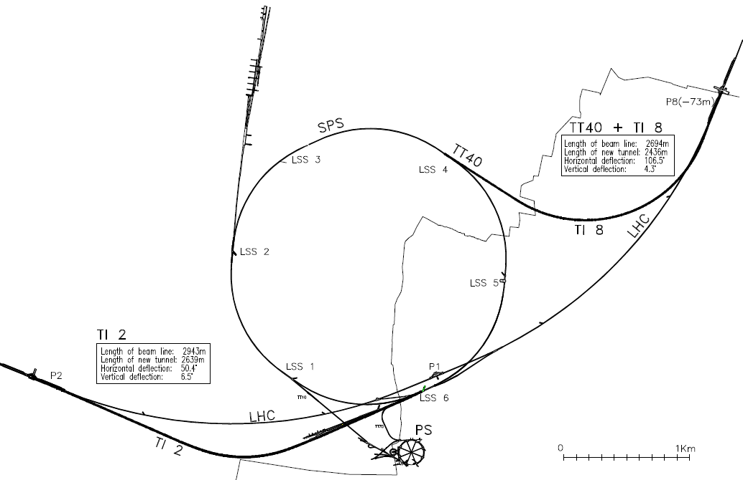
SPS as LHC Injector : Overview of the Complex
SPS as LHC injector incorporates:
TT10 Beam Transport Tunnel from PS extraction (TT2) to SPS Injection Point in Sextant 1
SPS Main Ring
TT40/TI8 Injection Tunnel for the LHC Beam 2;
TT60/TI2 Injection Tunnel for the LHC Beam 1;
13500 m of Beam Lines
2200 Magnetic Elements on the LHC way
In addition, 809 Magnets installed in the North Exp. Area & in the CNGS
SPS Bending Peak Field: 2.02 T @ 5750 A (450GeV/c)

Slide 4
3515 Magnets for the SPS Complex (80 families)
Beam Transfer & North Exp. Area:
Specific Reliability & Spare issues adressed during PS/SPS Days on 24.01.2007. (1)
Specific to SPS Main Ring & Injection Lines
Mixed Use
Specific to SPS North Exp. Area & CNGS

Slide 5
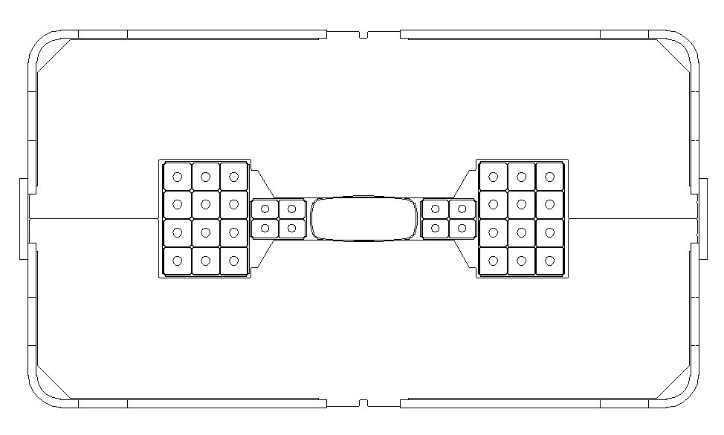
SPS Main Dipole MBB
Magnet Technology in Use
SPS:
Separated Function Machine
108 FODO Periods
744 Bending Dipoles
TI2 & TI8: similar principle (Half cells of 4 dipoles between focussing/defocussing quadrupoles)
Magnet Technology:
Laminated Steel Yokes
H Shaped Dipoles
Welded Structures
Water Cooled Copper Coils (excl. Air Cooled Orbit Correctors)
Fibreglass/Epoxy Insulation

Slide 6
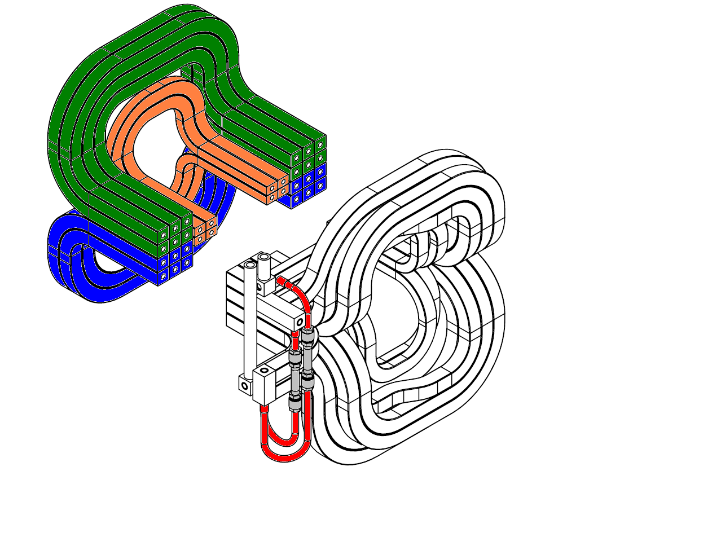
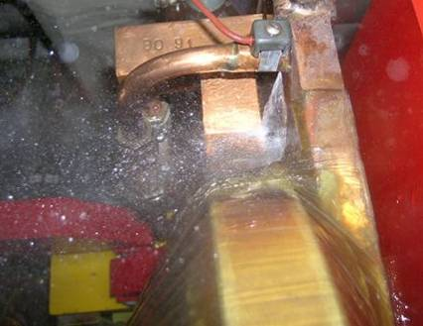
Reliability / Ageing Problems
Failures requiring magnet exchange + overhaul:
Vacuum Chamber (Leaks)
Coil Interturn Short Circuits
Short-Circuit (Coil with Yoke)
Waterleak (Erosion induced)
Ageing problems requiring preventive replacement:
Degradation of the soft shimming, inducing coil movements. (fatigue on vacuum chamber inside dipoles, fatigue on coil conductor inside quadrupoles)

Slide 7
Spare Policy
Above Threshold: Policy of having continuous magnet rebuild activities with minimum spare units available.
Large stock of coils + vacuum chambers
Refurbishment of radioactive coils
Machining of radioactive components
Threshold determining the need of Refurbishment Workshops.
Based on the Return of Experience (REX) Reliability of the equipment
Below Threshold: Policy of having enough spares for the expected lifetime of the complex
Existing facility for rebuild at CERN
Facility discontinued or interrupted

Slide 8
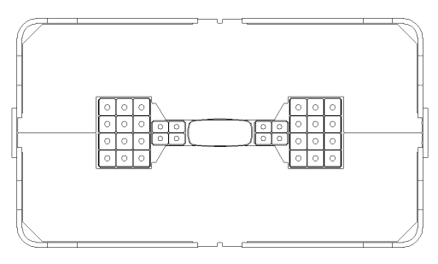
REX Reliability of the SPS Dipoles
744 Main Dipoles in operation since 1975
76% are still in operation as installed (567 magnets)
The reliability of the SPS magnets is relatively good (>99 %/year) and relatively stable over the past 33 years.
Need to understand the evolution of failure rates and the effects of preventive replacements (Bathtub Curve for each magnet component)
Failure Rate
Λ(t)
Infant Mortality
End of Life Wear Out
Useful Life
Time t

Slide 9
REX Reliability of the SPS Dipoles (II)

Slide 10
Impact of Magnet System Failures
Limited Impact:
No cryogeny, no explosive gas, no pressurized vessels, few flammable materials,…
Low Risk of severe injury or of loss of life (heavy handling, high voltage)
Risk of contamination is not significant
Moderate Impact:
exposure of personnel to radiation
production of radioactive waste (damaged components)
Possible major impact: Scientific Program

Slide 11
Mitigation of Failure Impact
Impact of magnet failures on the Scientific program can be mitigated by:
Reducing the failure rate
Extending the lifetime expectancy of the components
preventive exchange of magnets during shutdowns
Requires Magnet Rebuild Facilities
By means of specific curative actions once a problem is detected
Requires a consolidation fund
Minimizing the MTTR
.
MTTR follows the dictates of the cool down time (remanent radiation levels), of the method of access for the heavy equipment, of the distance for the transport & of the restoration of the vacuum in the sector.
Minimizing MTTR can conflict with the reduction (mitigation) of the exposure of the personnel to radiation.

Slide 12
M - T - T - R
MTTR: Interpretation & Objectives
Minimum Time To Repair
Maximum Recovery
Mean Respond
Replace
MTTR (Repair) | MTTR (Replace)
4 hours | 20 hours
Magnet Cooling Faults Leaks Water Pressure Faults Overheating Magnet Interlock Faults Specific Electronic Faults Imbalance current detector Null Field Probes | Magnet Exchange Note: Specific issues for the MTTR (Mean Time to Respond): although the acknowledgement of the fault is usually very quick, the initiation of the mitigation can be postponed due to various reasons: AB/OP (Physics priority) SC/RP (Safety) « Trivial »matters (nights, week-ends)

Slide 13
MTTR: Return of Experience
Breakdowns in SPS Complex :
2006: 35 interventions (27 in Target & North Areas), 4 magnets exchanged
2007: 26 interventions (13 in Target & North Areas), 5 magnets exchanged
Objectives: remain below actual statistics (hereunder)

Slide 14
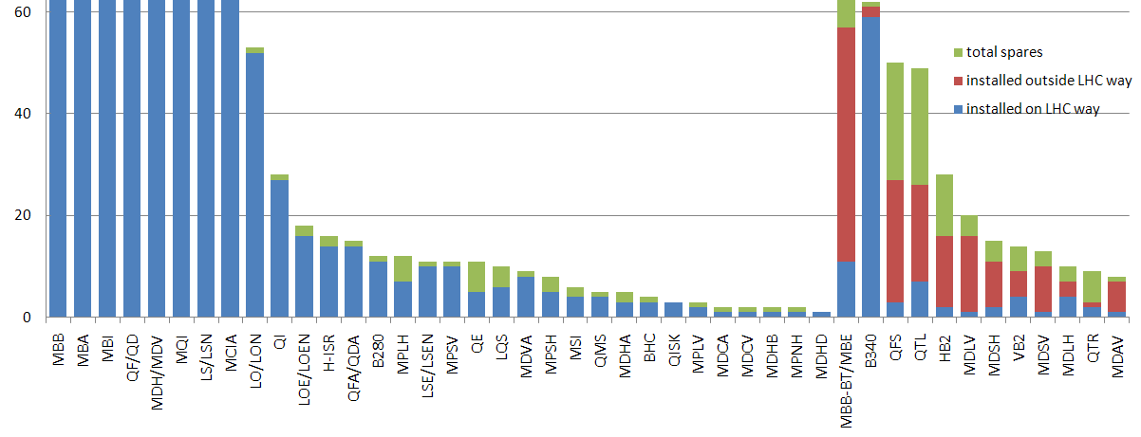
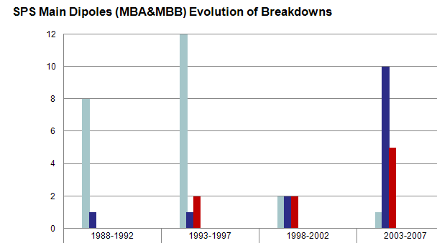
Conclusions
Spare magnets are available: no specific risk detected on the way to LHC for most of the magnet families
SPS main magnets remain our top priority and require
A close monitoring of the performance
An early detection of a possible accumulation of faults (waterleaks + shorts + vacuum faults) It is vital and it will require immediate action
To have spare coils and/or refurbished coils available
Other largely populated magnet families (MBIs, MQIs for TI2 & TI8) will require
To assess soon the reliability of the new design and determine the need of new refurbishment workshops
Erosion induced Waterleaks
Coil Shorts

Slide 15
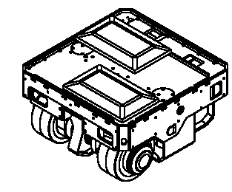
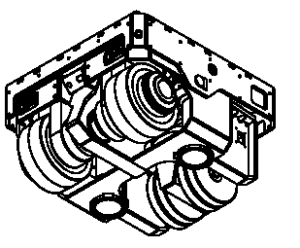
Annex: Identified other potential risks
Failure of Associated Ancillary Equipment would have an important impact:
SPS Main Busbar system (4x SPS circumference), powering dipoles and quadrupoles could still suffer a major damage (as in 1983, flashover). Mitigation: raw material is available, estimated MTTR<2weeks
Water-Cooled Cables, linking Power converters in surface with the underground SPS main busbar system, and TI2 and TI8 MBI Dipoles could suffer a breakage of the inner cooling duct leading to waterleaks & electrical insulation failure (as in 1993 for SPS, and in 1998 for LEP) (→ No mitigation solution ?)
Magnet Installation Vehicles, using modern electronic and software controlled will require special maintenance in the future. Those are the only vehicles able to install/remove most of the magnets (and the TED dumps) in the Tis, in the CNGS but also in the LHC Main Ring

