Slide 1
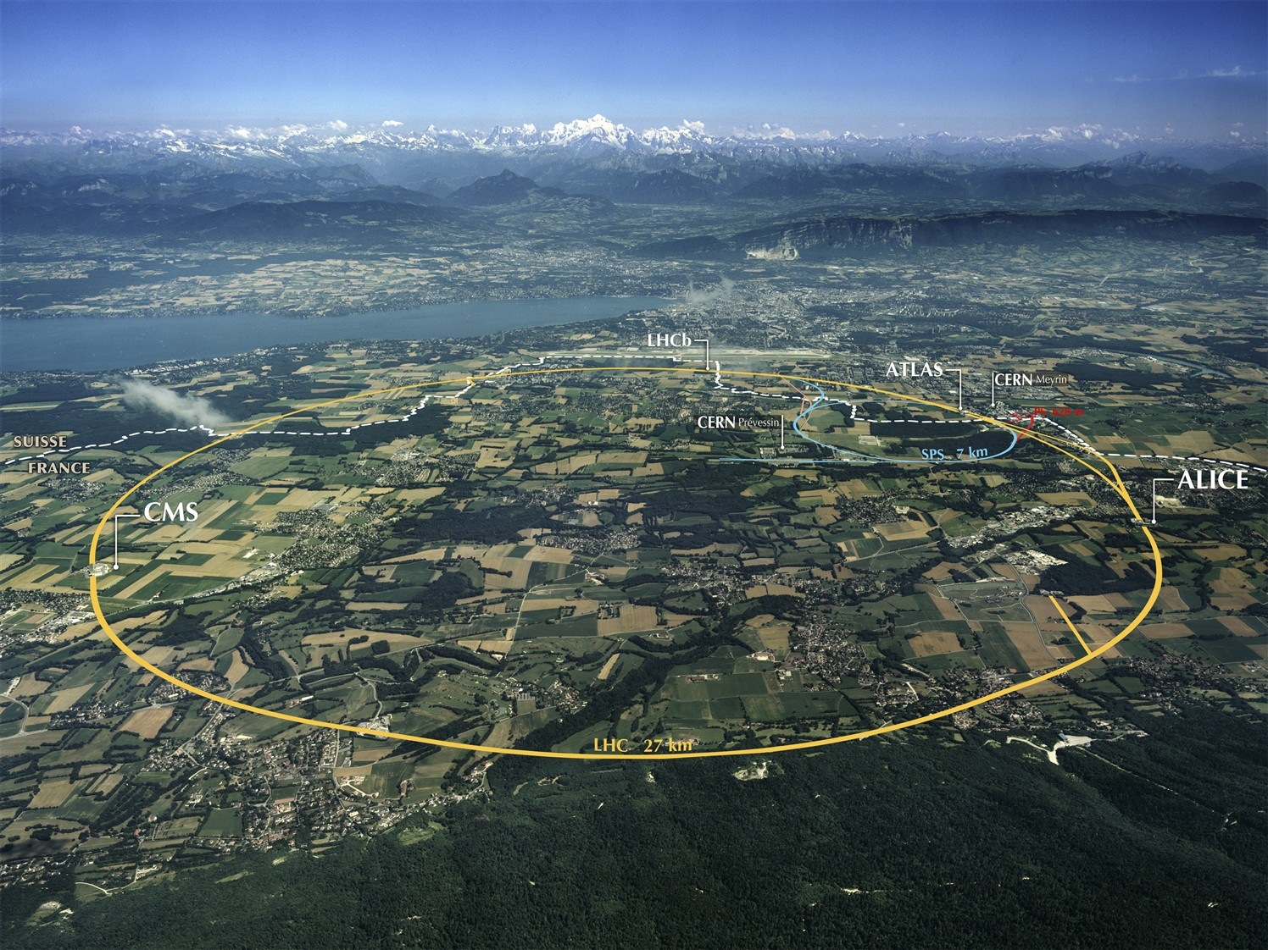
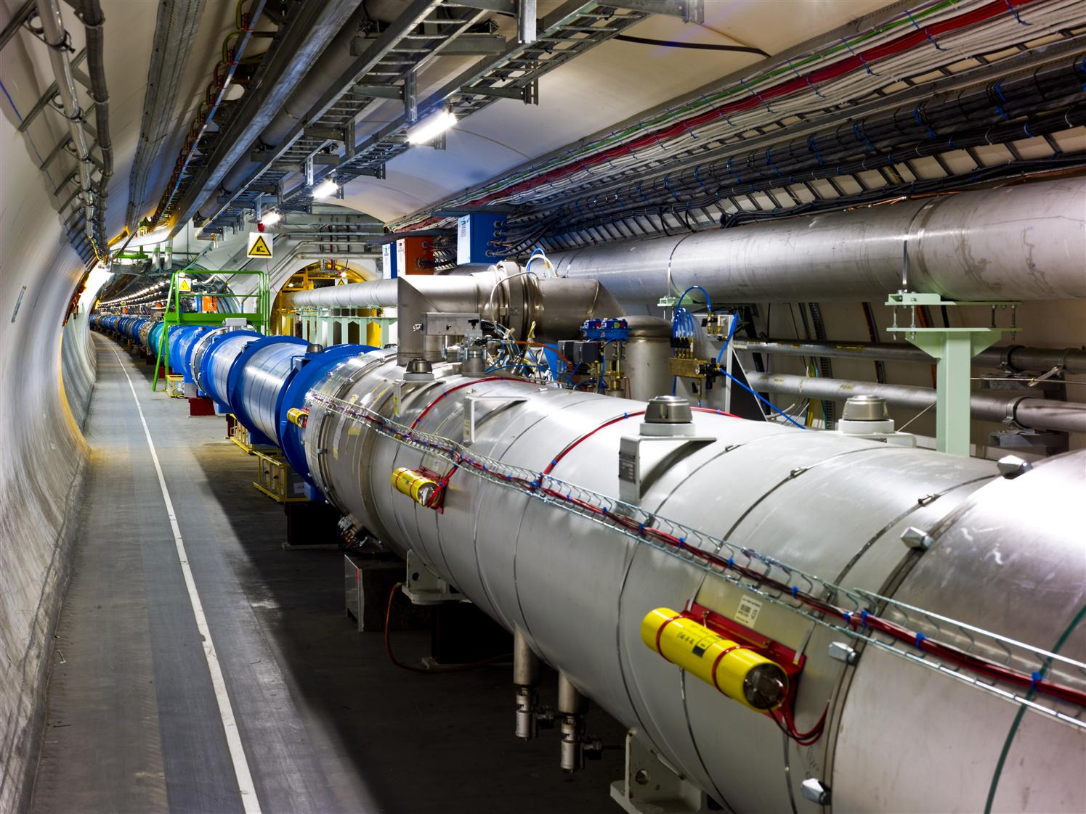
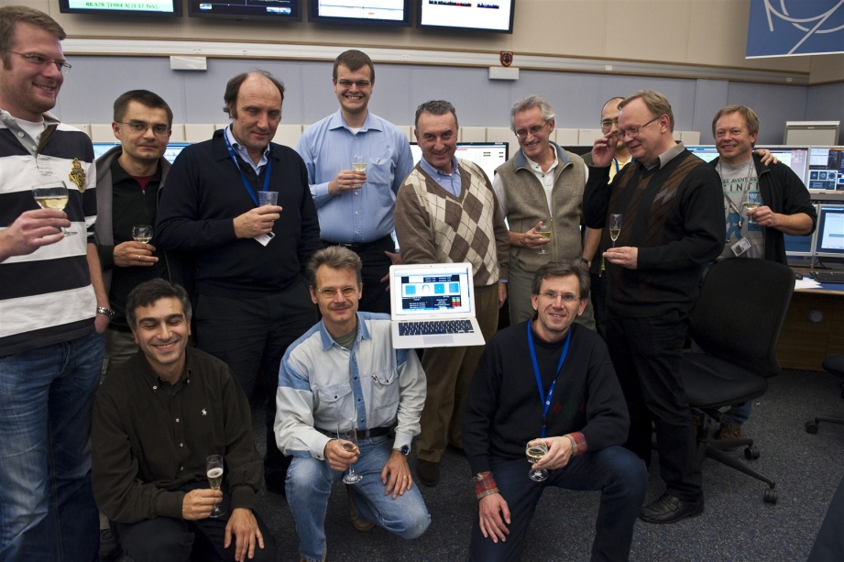
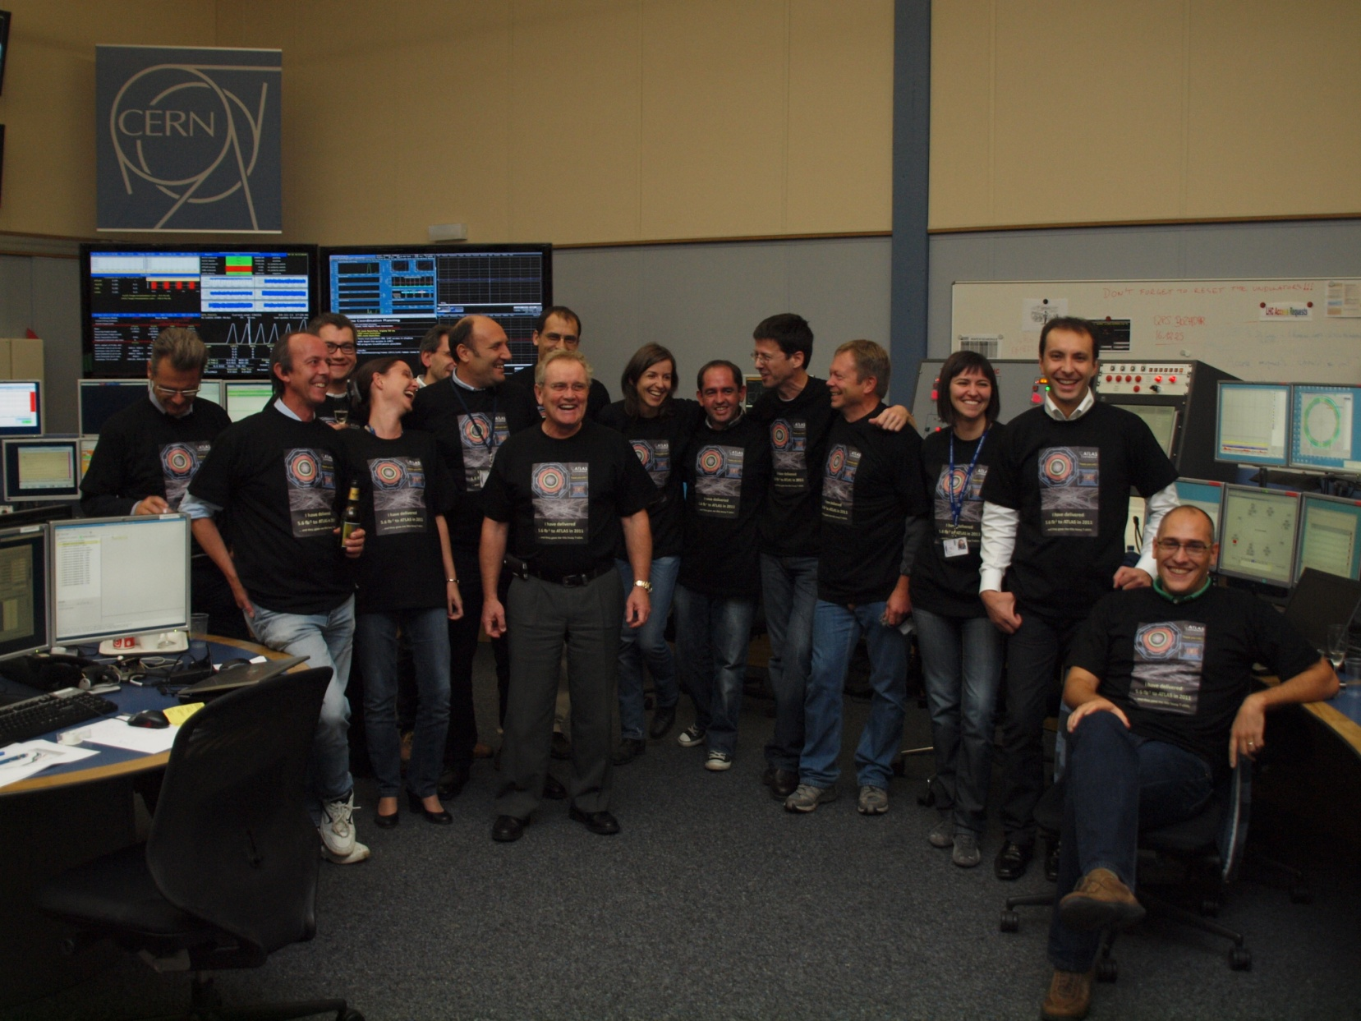
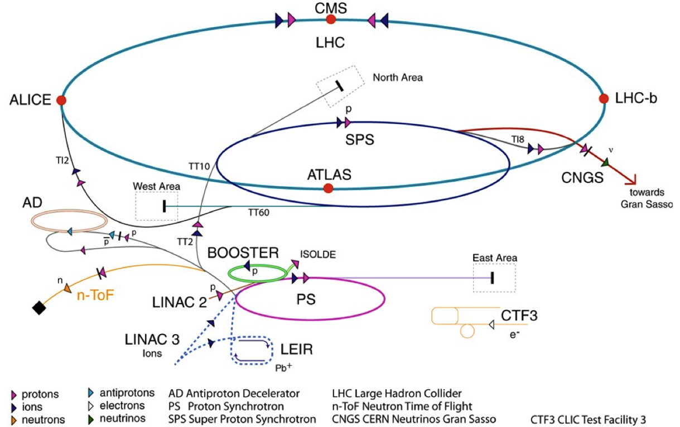
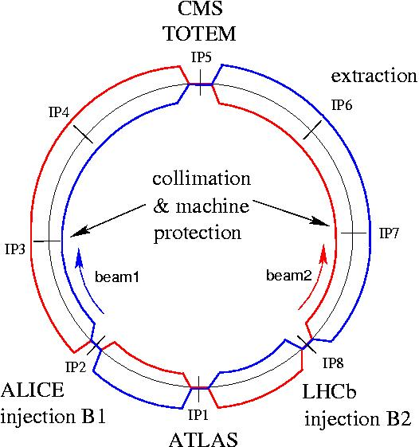
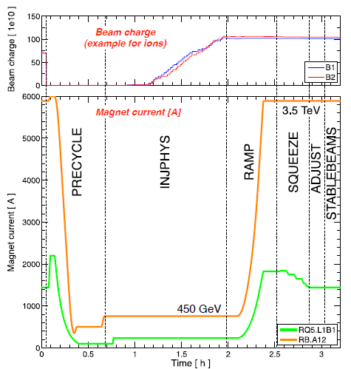
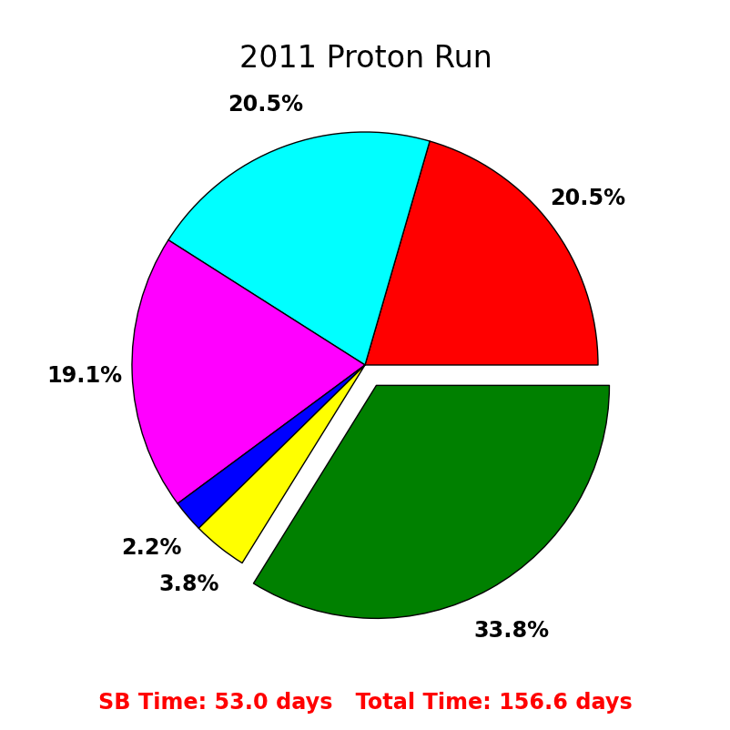
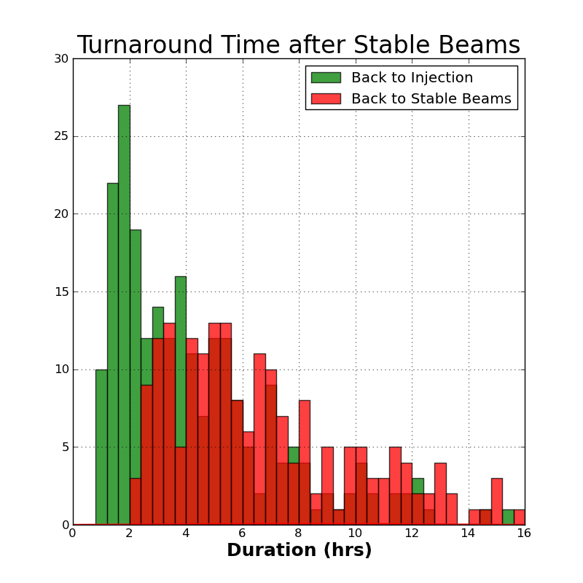
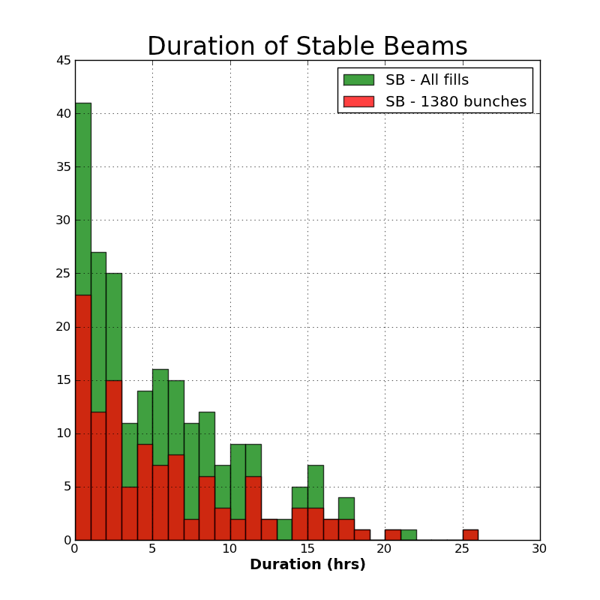
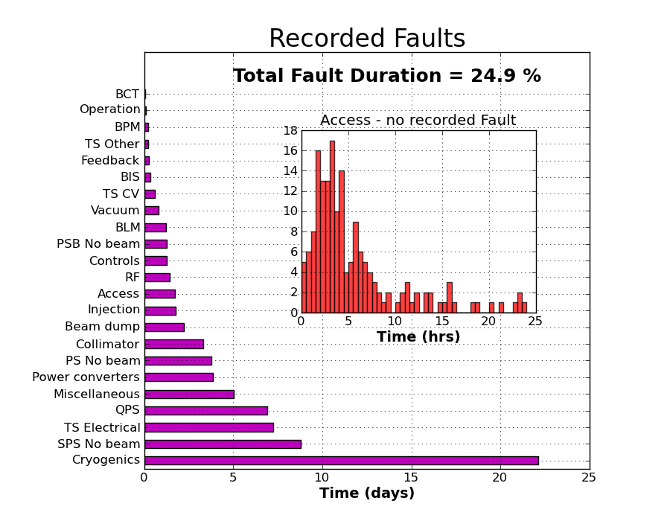
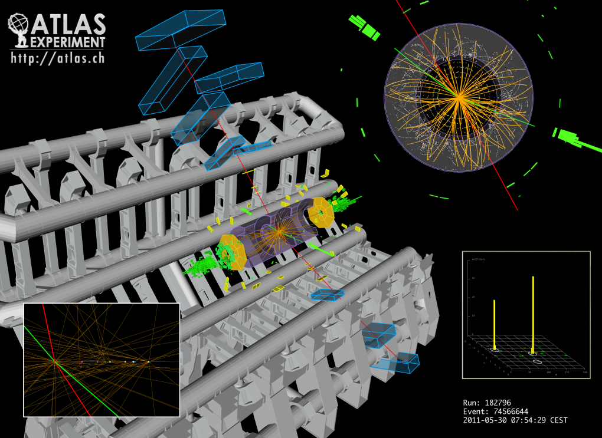
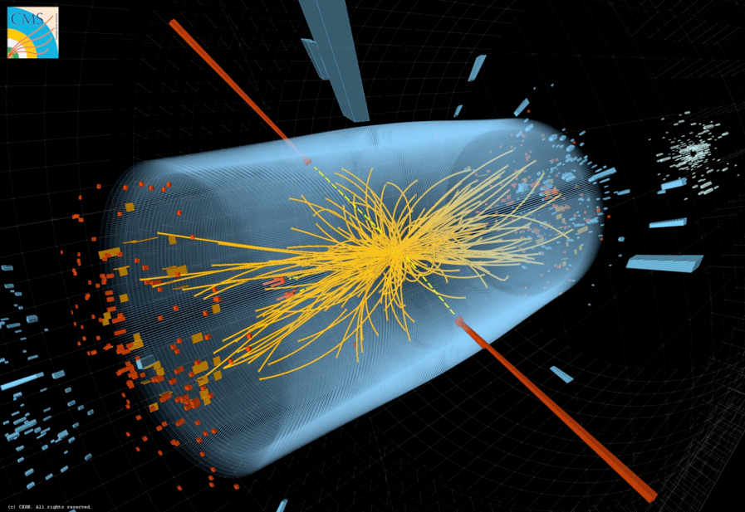
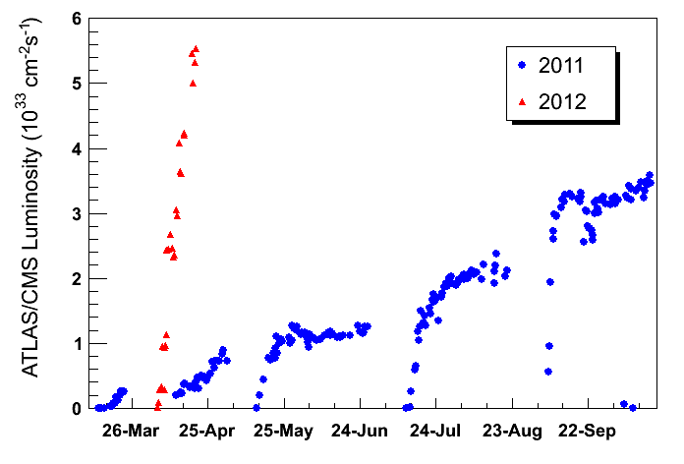
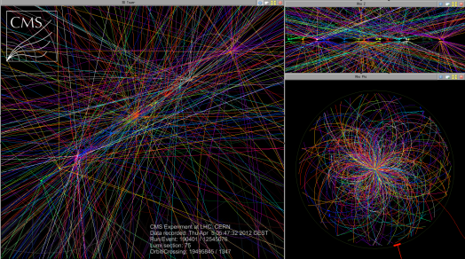
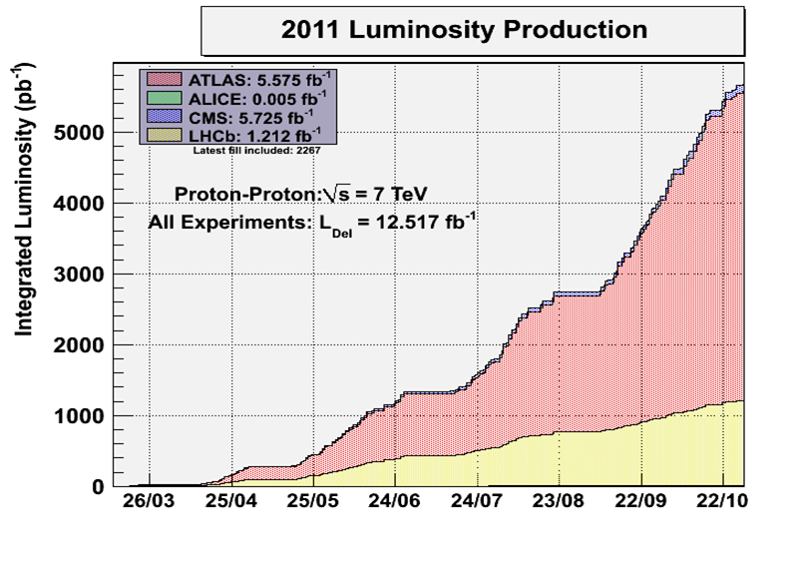
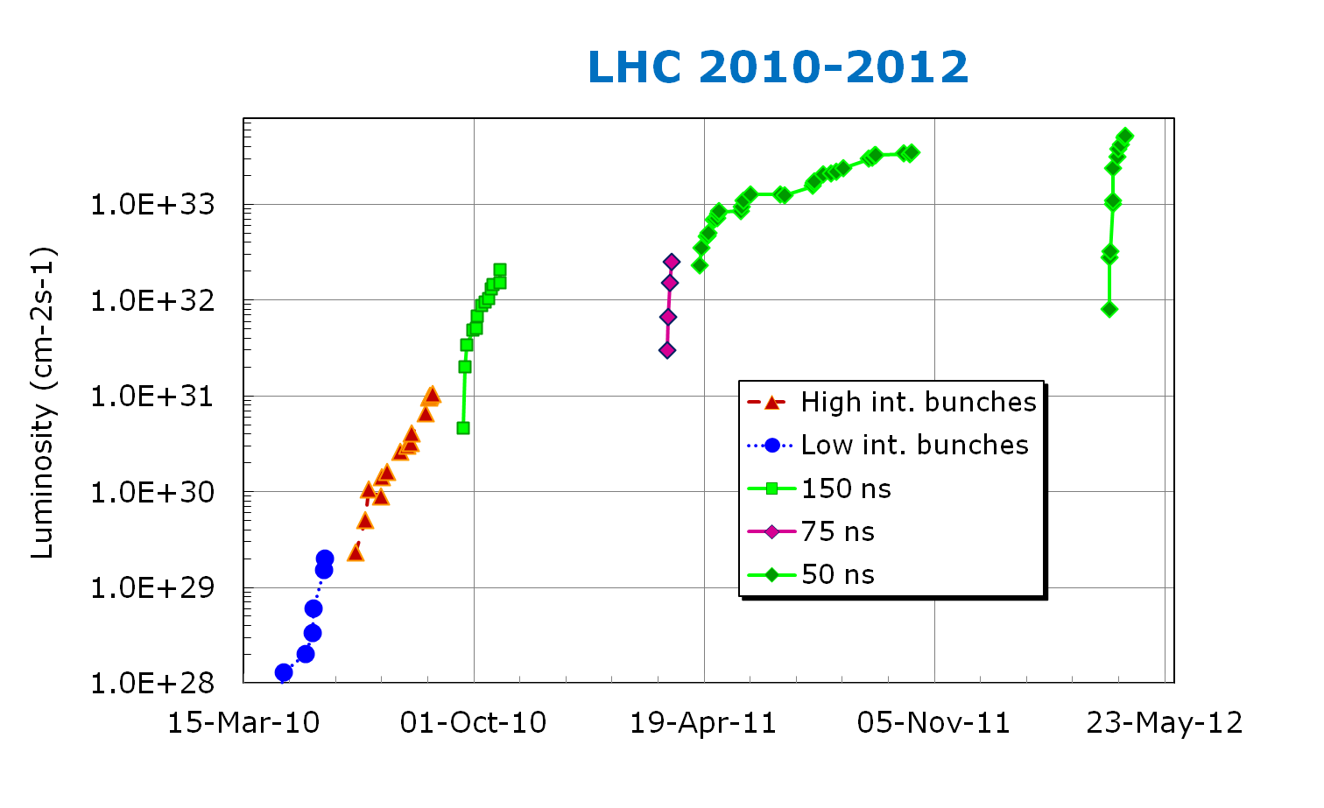
Operation of the LHC at High Luminosity and High Stored Energy
J. Wenninger, R. Alemany-Fernandez, G. Arduini, R. Assmann, B. Holzer, E.B. Holzer, V. Kain,
M. Lamont, A. Macpherson, G. Papotti, M. Pojer, L. Ponce, S. Redaelli, M. Solfaroli Camillocci,
J. Uythoven, W. Venturini Delsolaro, CERN, Geneva
The LHC
LHC injector chain
Two rings with 2 beams colliding in up to 4 interaction regions.
Two high luminosity experiments ATLAS and CMS.
A medium luminosity exp. LHCb, operating with lower β* and collision offsets (leveled luminosity).
A low luminosity / ion exp. ALICE. In 2012 ALICE is operated with collisions of main and satellite (parasitic) bunches.
Introduction
In 2011 the operation of the Large Hadron Collider LHC entered its first year of high luminosity production at a beam energy of 3.5 TeV. The performance improvements steps that were accumulated in 2011 eventually brought the peak luminosity to 3.6x10³³ cm⁻²s⁻¹. The integrated luminosity delivered to each of the high luminosity experiments amounted to 5.6 fb-1, a factor of 5 above the initial target defined in 2010.
 | E / GeV | Circumference / m
Linac | 0.05 | 30
PSB | 1.4 | 157
PS | 26 | 628 = 4 x PSB
SPS | 450 | 6’911 = 11 x PS
LHC | 4000 | 26’657 = 27/7 x SPS
Cycle & Efficiency
High intensity issues
As the intensity was increased, issues due to high intensity and high luminosity were encountered:
Before starting operation with 50 ns bunch spacing the vacuum chamber had to be conditioned to reduce e-cloud effects. This was done at injection with high intensity beams.
Heating of RF contacts due to installation issues and of protection devices.
Gas trapped on the magnet cold bores was released in bursts during operation.
Radiation effects on electronics led to frequent beam dumps (~1 dump / 0.1 fb⁻¹). Relocation and firmware improvements were used as mitigation. A large fraction of dumps are luminosity driven.
Despite over 100 MJ of stored energy no magnet was quenched during regulation operation at 3.5/4 TeV thanks to excellent machine protection and collimation systems.
Unexpected beam losses were observed on the millisecond time scale all along the circumference, leading a dozen of beam dumps. Nicknamed “UFOs” such events are believed to be due to falling dust particles.
Beam
setup
Min 2:10 minutes
Average length ~6 h
Lumi lifetime ~ 20 h
Injection
No beam
Ramp
Stable beams
Squeeze
The LHC cycle:
INJECTION,
RAMP to 3.5 TeV (2011), 4 TeV (2012),
Betatron SQUEEZE to β* 1m (2011) or 0.6 m (2012),
Bringing beam into collision (ADJUST),
STABLE BEAMS – experiments data-taking,
Ramp-down or magnet PRECYCLE.
THPPP006
histogram = data
Performance in 2011
THPPP086
The 2011 LHC run phases:
Low intensity commissioning – 3 weeks.
Scrubbing run for e-cloud mitigation – 1 week.
Increase of the number of bunches to 1380 – 3-4 months.
Ramp up of the bunch intensity – 1-2 month.
Reduction of β* from 1.5m to 1m in IR1/5. This reduction became possible after detailed aperture measurements.
Each step in intensity and every change in
machine conditions was analysed in the
light of machine protection.
In collision the high intensity bunches / beams must be stabilized with Landau octupoles and a Transverse FB system. The beams are unstable (TCBI) without those measures.
The high luminosity with 2x fewer bunches than nominal implied event pile-ups of up to ~18 events / bunch crossing in 2011, a value that was pushed to ~30 in 2012.
Parameter | Design | 2011 | 2012
Beam energy [TeV] | 7 | 3.5 | 4
Peak luminosity [10³³ cm⁻²s⁻¹] | 10 | 3.6 | 5.4
Stored Energy [MJ] | 362 | 112 | 115
Bunch intensity [10¹⁰ p] | 11.5 | 14.5 | 13.5
Bunch spacing [ns] | 25 | 50 | 50
Bunch number | 2808 | 1380 | 1380
Norm. emittance H/V [μm] | 3.5 | ~2.4 | ~2.4
β* IR1/IR5 [m] | 0.55 | 1.0 | 0.6
Performance evolution
Between 2010 and 2012 the LHC performance has been progressively increased by:
Reduction of β* at the collision points: from 3.5 to 1 m in 2011, to 0.6 m in 2012. The last reduction was obtained with tighter collimator settings (from 5.7 to 4.3σ) and reduced margins between collimators and aperture.
Reduction of the bunch spacing and a parallel increase of the number of bunches: from single bunches to 1380 bunches spaced by 50 ns. The 50 ns beam has become the workhorse as it provides higher performance as compared to the design 25 ns beam.
Increase of the bunch intensity and a reduction of the transverse emittances beyond design values.
For the LHC experiments this resulted in a pile-up of up to ~30 events / bunch crossing in 2012.
Extrapolated to 7 TeV, the current LHC performance would result in luminosities 2x above LHC design.
THPPR040
Higgs event candidates, mass ~125 GeV
Candidate H→eeμμ
Candidate H→γγ
β* 1.5 m → 1 m
Increasing
bunch pop.
E-cloud
Scrubbing
Increasing
bunch number

